Slide 1
Leadership and Career Advancement in Academic Medicine
Victoria J. Fraser, MD
Adolphus Busch Professor and Chairman
Washington University School of Medicine

Slide 2
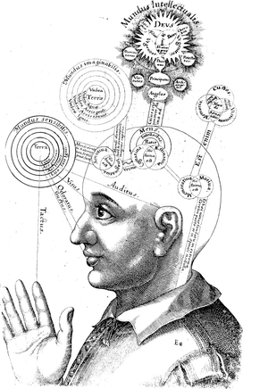
Disclosures
Research Funding:
CDC Epicenters Program
NIH CTSA Research & Education Director
The Foundation for BJH, Doris Duke Foundation
Not entirely sure how I succeeded in academics
Husband VP @ Express Scripts, 3 kids, Messy house
Guilty of most of things we should teach faculty to avoid/overcome
I have had many different career changes
Clinician, Occupational Health Med Director, Hospital Epidemiologist, Clinic Director, Researcher, Director of BJC Health System Infection Prevention, Mentor, Training Grant PI, Division Head, Department Chair,
Several research interests
HCW Safety, HIV, HAI, ARO, Safety/Quality, Training Grants

Slide 3
Women in Academic Medicine: Sticky Floor, Glass Ceiling & Leaky Pipeline

Slide 4
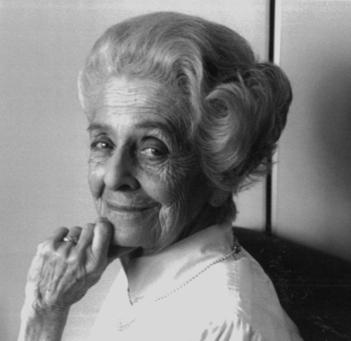
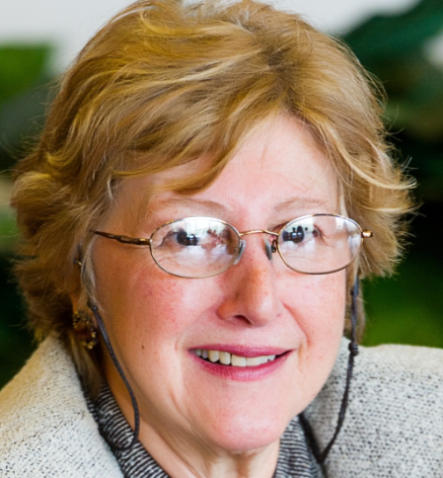
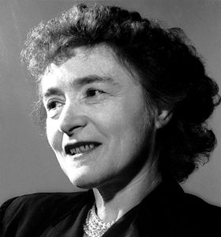
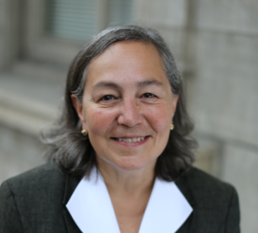
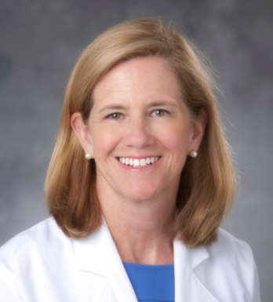
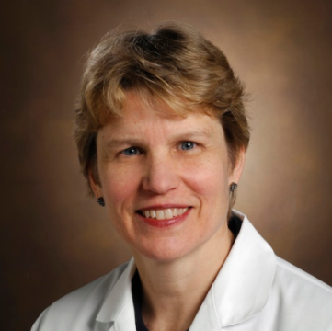
Dr. Rita Levi-Montalcini
Nobel Prize in Physiology or Medicine in 1986, Professor Washington University
Dr. Gerty Cori
Nobel Prize in Physiology or Medicine in 1947, Professor Washington University
Patricia A. Gabow, MD
Robert Wood Johnson Foundation Board of Directors, former CEO of Denver Health and Hospital Authority
Wendy Levinson, MD
Chair of Medicine, University of Toronto
Mary E. Klotman, MD
Dean, Duke University School of Medicine
Nancy J. Brown, MD
Chair of the Department of Medicine, Vanderbilt University
Katrina Armstrong, MD, MSCE
Head and Physician-in-Chief, Department of Medicine, Massachusetts General Hospital

Slide 5
Understanding Gender Differences in the Workplace
MASCULINE TRAITS
FEMININE TRAITS
Aggressive
Ambitious
Competitive
Forceful
Strong
Independent
Individualistic
Decisive
Self-sufficient
Risk taking
Cheerful
Compassionate
Affectionate
Gentle
Gullible
Shy
Soft-spoken
Sympathetic
Tender
Understanding
♀
♂

Slide 6
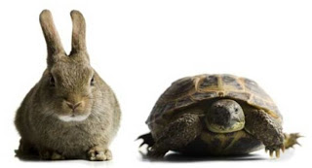
Unconscious Bias: Thinking Fast & Thinking Slow
Cognitive shortcuts commonly translate into undervaluing women
Men expected to be agentic (assertive & decisive)
Women → communal (nurturing & egalitarian)
Agentic → confident, analytic, detail-oriented, open, passionate in ♂
Communal → women judged more harshly if they are not
Boost women’s self efficacy (mentees)
Recommend approaches that combine
agentic & communal behaviors, role play
techniques
Coach mentees to develop versatile
communication skills

Slide 7
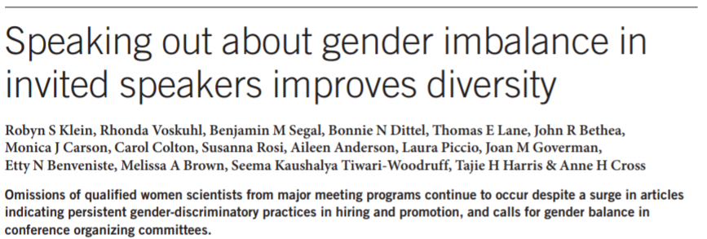
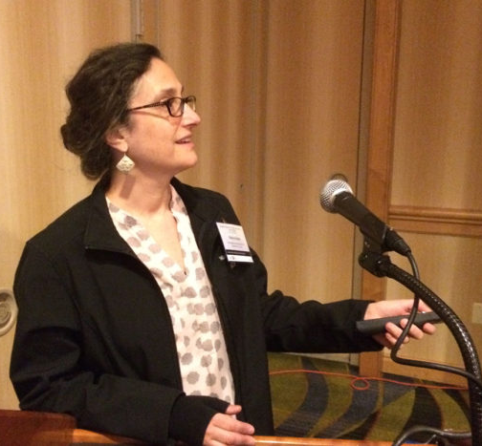
Gender Disparities in STEM
Frequency with which ♂ invite women to speak (Isbell 2012)
Perception of ♀ trainees’ competency and employability (Grunspan 2014; Moss-Racusin 2012)
Degree of self citations ♂ > ♀ (Symonds 2006)
♀ more intensive teaching roles; less research intensive institutions
National Academies of Sciences, Engineering, and Medicine. 2018.
Sexual Harassment of Women: Climate, Culture, and Consequences in Academic Sciences,
Engineering, and Medicine. Washington, DC: The National Academies Press. doi: https://doi.org/10.17226/24994.

Slide 8
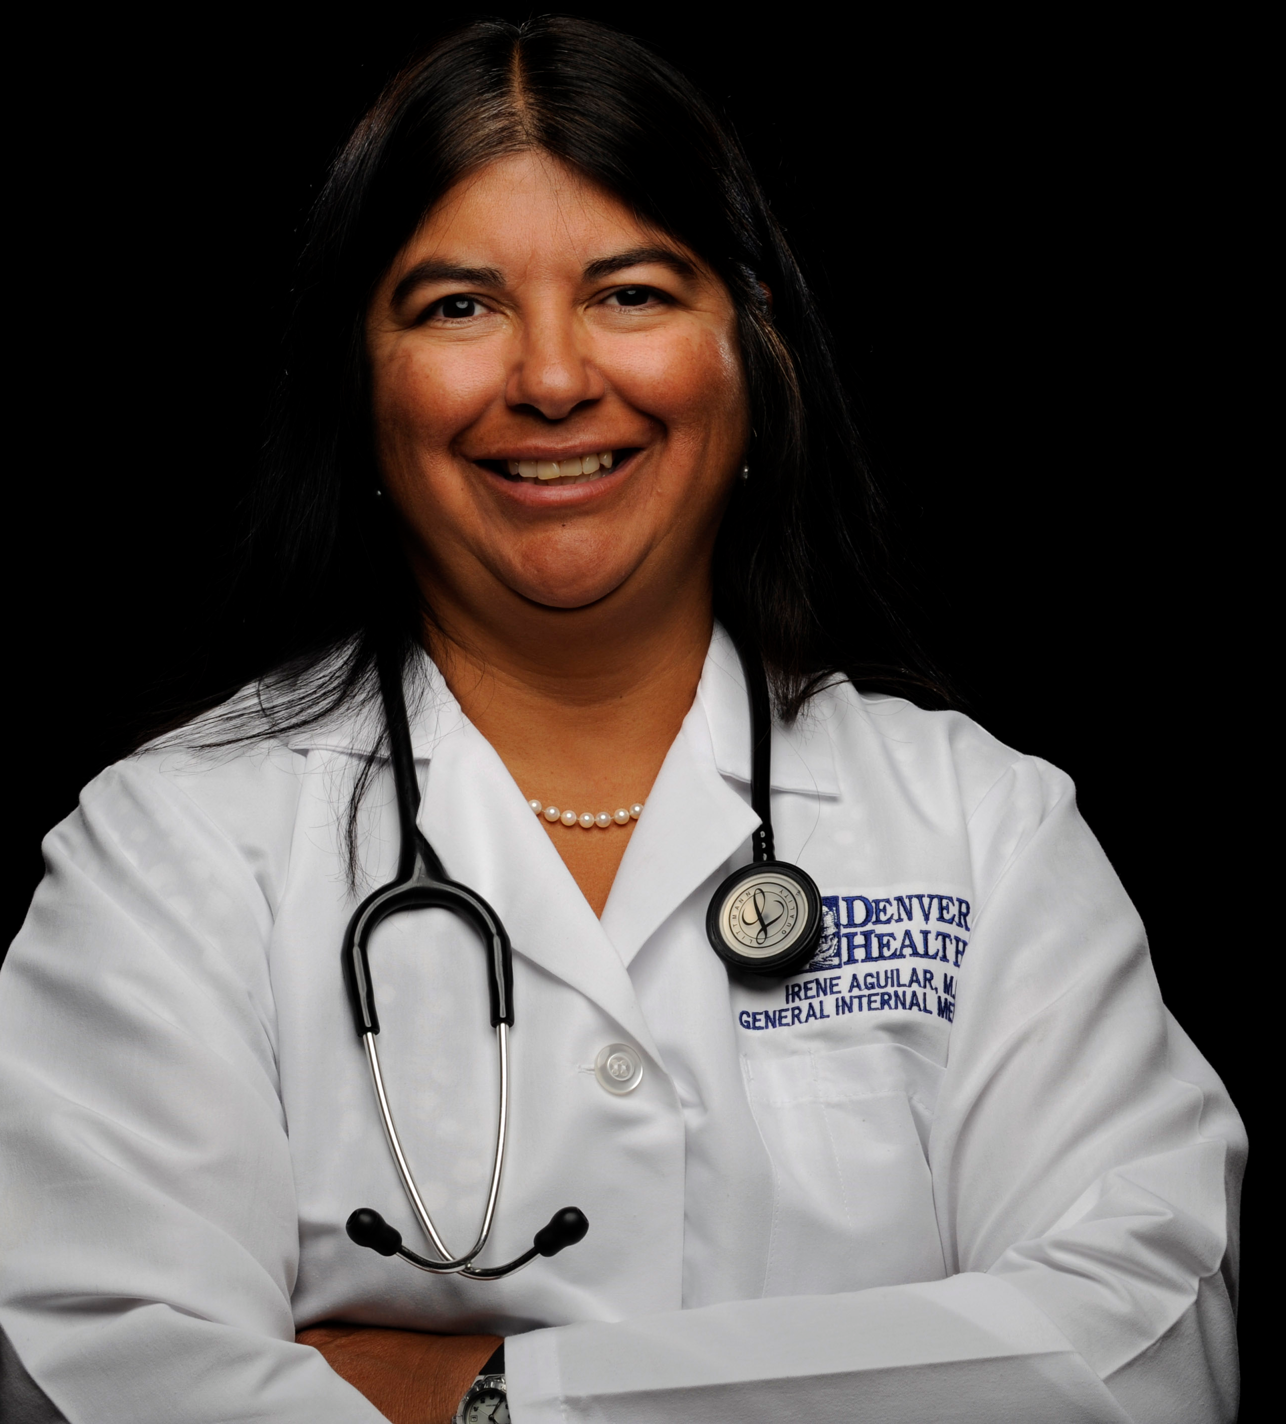
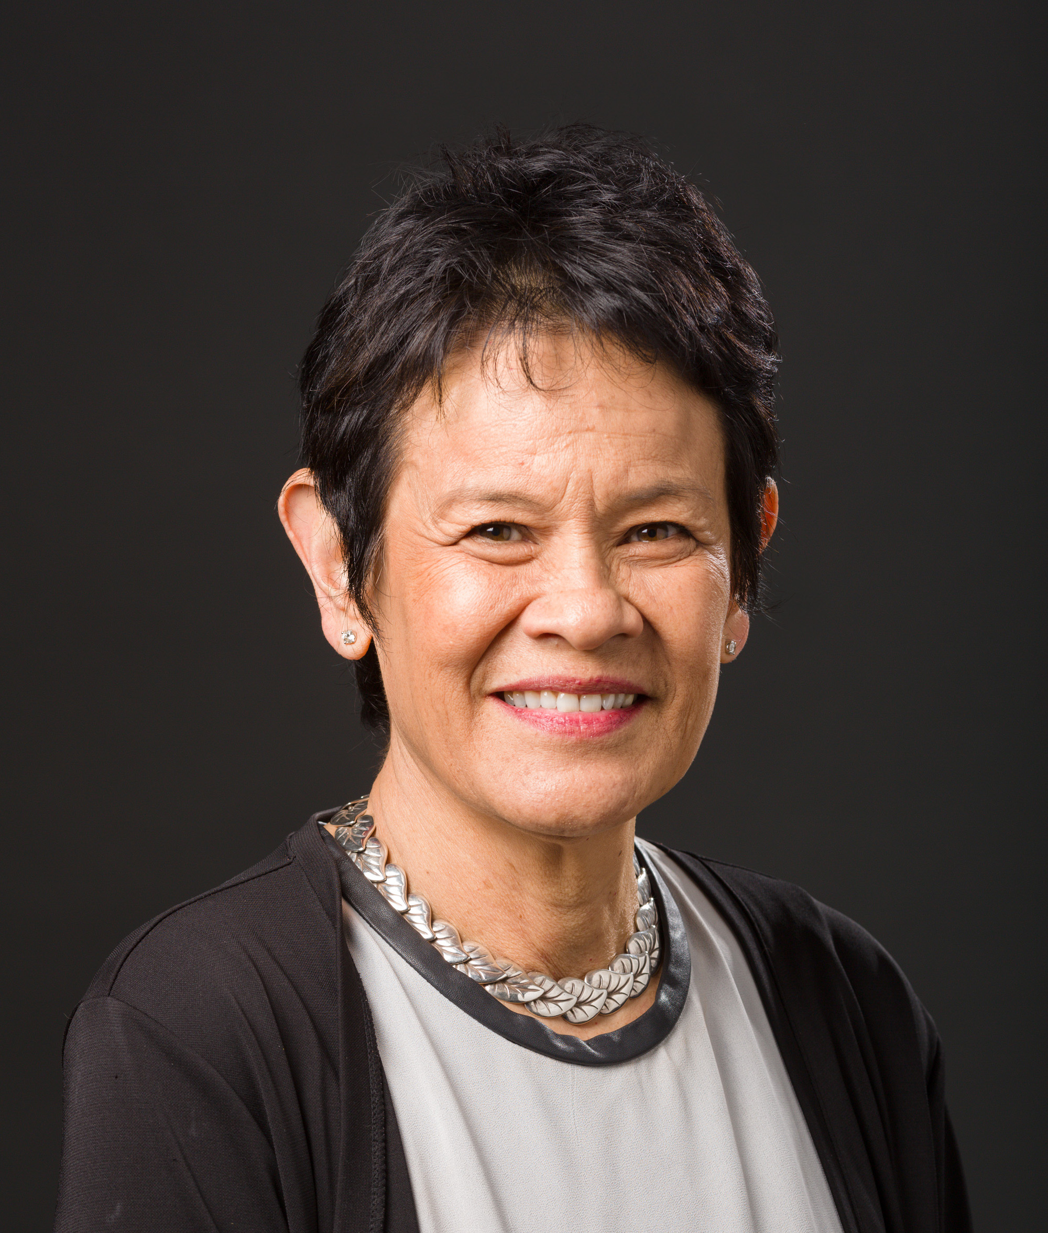
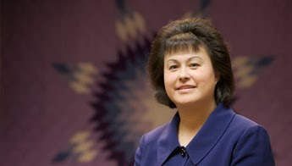
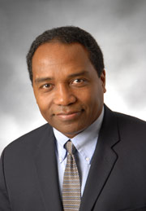
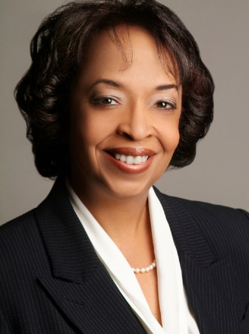
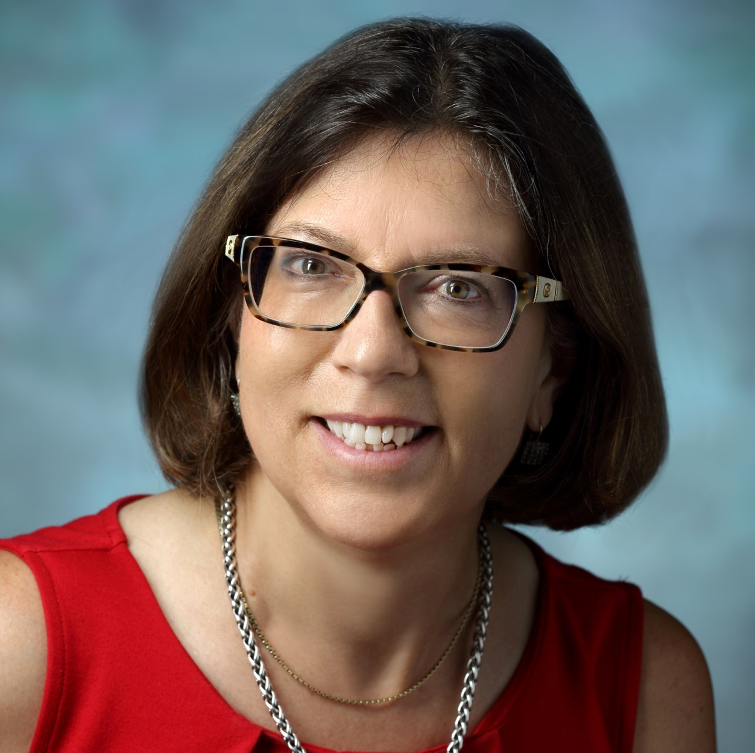
INCLUSION AT THE PODIUM
Senator Irene Aguilar, MD
Colorado Senate District 32
Gaudalupe Garcia-Tsao, MD
Professor of Medicine
Chief, Digestive Diseases,
VA-CT Healthcare System
Director, Clinical and Translational Core,
Yale Liver Center
Yvette Roubideaux, MD, MPH
Director of Policy Research Center
National Congress of American Indians
Griffin Rodgers, MD, MACP
Director, NIDDK
Eve J. Higginbotham, SM, MD
Vice Dean for Diversity and Inclusion
Professor, Ophthalmology
Perelman School of Medicine
Cynthia Sears, MD
Professor of Medicine and Oncology
Johns Hopkins University School of Medicine
Professor of Molecular Microbiology and Immunology
Bloomberg School of Public Health

Slide 9
Challenges for Female Medical Students, Housestaff and Junior Faculty
Fewer females see themselves as leaders
Women house officers can default to stereotypically female behaviors (apologizing, doing support work), less able to navigate uncomfortable situations with attendings
Less likely to participate in male dominated networks in male-driven advising

Slide 10
Coming to See Oneself and Be Seen by Others as a Leader
Fundamental identity shift
Context must support ↑ women’s motivation to lead & ↑ likelihood that others will recognize & encourage her efforts
Internalizing a leadership identity & developing a sense of purpose (iterative)

Slide 11
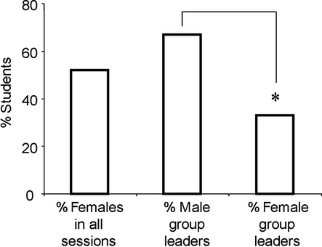
Gender Differences in Leadership Among First Year Medical Students in Small-Group Setting
Figure 1 Percentages of men and women who became group leaders under control conditions during Study 1 (2008). Asterisk indicates that significantly fewer group leaders were women compared with men (P < .025).
Wayne. Acad Med 2010;85(8):1276-1281.

Slide 12
Gender Differences in Leadership Among First Year Medical Students in Small-Group Setting
Gender of small-group leaders monitored
Control: basic instructions
Intervention: brief “pep talk” on importance of experiencing a leadership role in a safe environment
Interviews of students re: their perceptions
Gender bias in group leaders eliminated by “pep talk”
Wayne et al . Acad Med 2010;85(8):1276-1281.

Slide 13
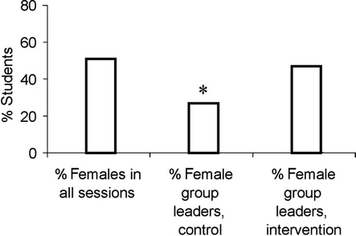
Gender Differences in Leadership Among First Year Medical Students in Small-Group Setting
Figure 2 Percentages of men and women who became group leaders under control and intervention conditions during Study 2 (2009). Asterisk indicates that significantly fewer group leaders were women compared with men in the control condition (P < .025). There was no significant difference between the number of men and women who became group leaders in the intervention condition.
Wayne. Acad Med 2010;85(8):1276-1281.

Slide 14
Leadership Building Blocks
Getting and using mentors/advisors
Choosing niche: research, clinical, teaching
Formal coursework/training
Hands-on mentored experiences
Environment & infrastructure
Communication: direct vs indirect in meetings, presentations, emails,
Writing: direct vs indirect in abstracts, manuscripts, grants
Individual Career Development Plan: Competencies, career goals & plan (work & life)

Slide 15
Lean In
Leadership ambition gap
Sit at the table
It’s a jungle gym, not a ladder
Are you my mentor?
Seek & speak your truth
Don’t leave before you leave
The myth of “doing it all”
Let’s start talking about it
Working together toward equality

Slide 16
Implicit bias
Prove-It-Again
Tightrope bias
Maternal wall
Tug of war

Slide 17
Strategies to Overcome “Prove it Again”
Organize & track your accomplishments; trump stereotype
Keep written records, compliments, awards, honors
Verbal → facilitate transfer to written (email, note)
Special file for achievements, productivity
“Get over yourself”
Speak up, positively disseminate successes
Don’t internalize failures, STOP questioning yourself, DON’T wait to be perfect
Foster courage, confidence; practice & role play

Slide 18
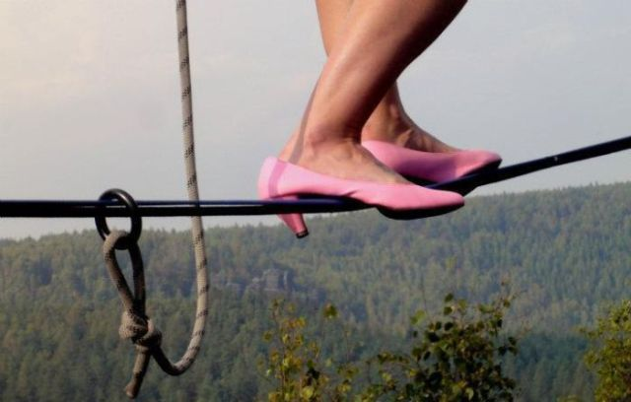
“Tight Rope” Strategies
Find your voice
Prepare for meetings
Use direct communication
STOP APOLOGIZING
Deal with lumpy tasks (get rid of something else, get credit, negotiate for higher status team members to help, report to higher up, secure a budget, sunset & succession plan)

Slide 19
12 Behaviors That May Hold Women Back
Reluctance to claim achievements
Expecting others to spontaneously notice and reward your contributions
Overvaluing expertise
Just building rather than building and leveraging relationships
Failing to enlist allies from Day 1
Putting your job before your career
The perfection trap
The disease to please
Minimizing
Too much
Ruminating
Letting your radar distract you

Slide 20
Four Kinds of Power
Expertise
Connections
(Whom You Know)
Personal Authority or Charisma
Position (Where You Stand in the Organization
Helgesen S and Goldsmith M. How Women Rise. Penguin Random House, 2018.

Slide 21
Essential Components to Build Confidence
Confidence – Mastery, action, decisiveness, doing, achievement
Self-esteem – Valuable, like oneself
Optimism – 1/2 full, 1/2 empty, “Pessimist sees difficulty in every opportunity, optimist sees opportunity in every difficulty” Churchill
Self-compassion
Self-efficacy – belief in ability to succeed

Slide 22
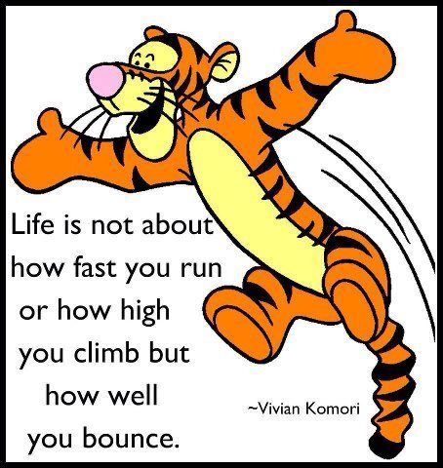
Strategies to Promote Resilience
Reframe rejection, make it more positive
Deemphasize emotion, be dispassionate
Provide moral support & encouragement
Positive thinking & adaptive mindsets
Foster passion & “fire in the belly”
Personal financial /fitness training
DeCastro. Acad Med 2014;88:497-504.

Slide 23
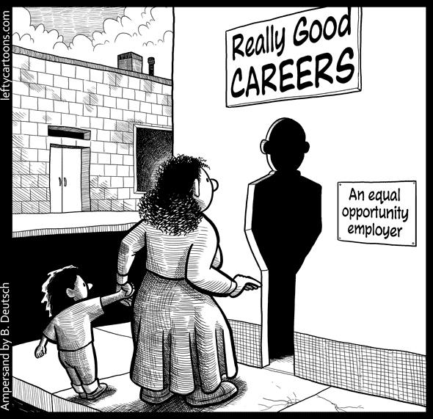
Actions to Support Women’s Leadership Development
Educate men & women about 2nd generation gender bias
Create safe “identity workspaces” to support transitions to bigger roles
Anchor women’s development
efforts in sense of leadership purpose
– not how women are perceived
These actions help give women insights
into themselves & their organization,
enabling charting a course to
leadership

Slide 24
Mid-Career Faculty Development
“There is no path that goes all the way.”
Han-shan
Essential for success of academic health centers
Re-examination of commitments at mid-career = important to adult development and resilience
Begin with fresh look at “Values” and “Priorities”
Shift from constraints to situations you can modify → opens new possibilities, ↑ ability
Annual reviews → assess satisfaction with effort distribution, setting term limits on leadership roles to increase opportunities, facilitate fresh ways of thinking about success
Bickel J. Acad Med. 2016:91(12);1601-1605.

Slide 25
Critical Self Inventory
Set aside time – deliberate introspective “pause” (personal or leadership development), “Reflection”
Reflective reading and writing → life long learning
Collect feedback (which behavioral tendencies obstruct their progress ?)
Overdoing strengths
Interpersonal behaviors to ↓ (perfectionism, over speaking)
Feedback helps close gap between good intentions and actual impact of behaviors
How can I do better?
Listen for themes

Slide 26
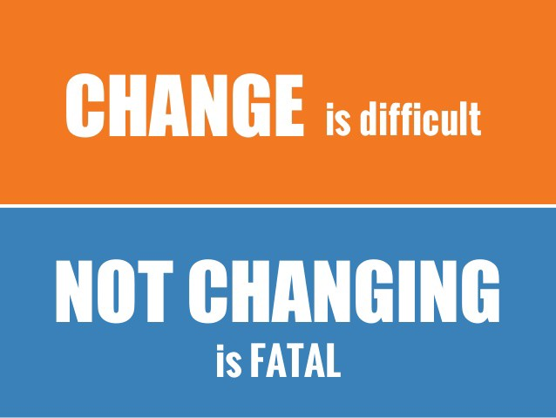
Translate Reflection to PLAN
In five years I want to be ________________.
However, I currently feel ________________.
In order to close the gap between where I am today to where I want to be, I need to focus on ___________ and let go of ___________________.
To move in that direction I need to sharpen my skills in ___________________.
The community, support and accountability I need to move in a new direction is ________________.

Slide 27
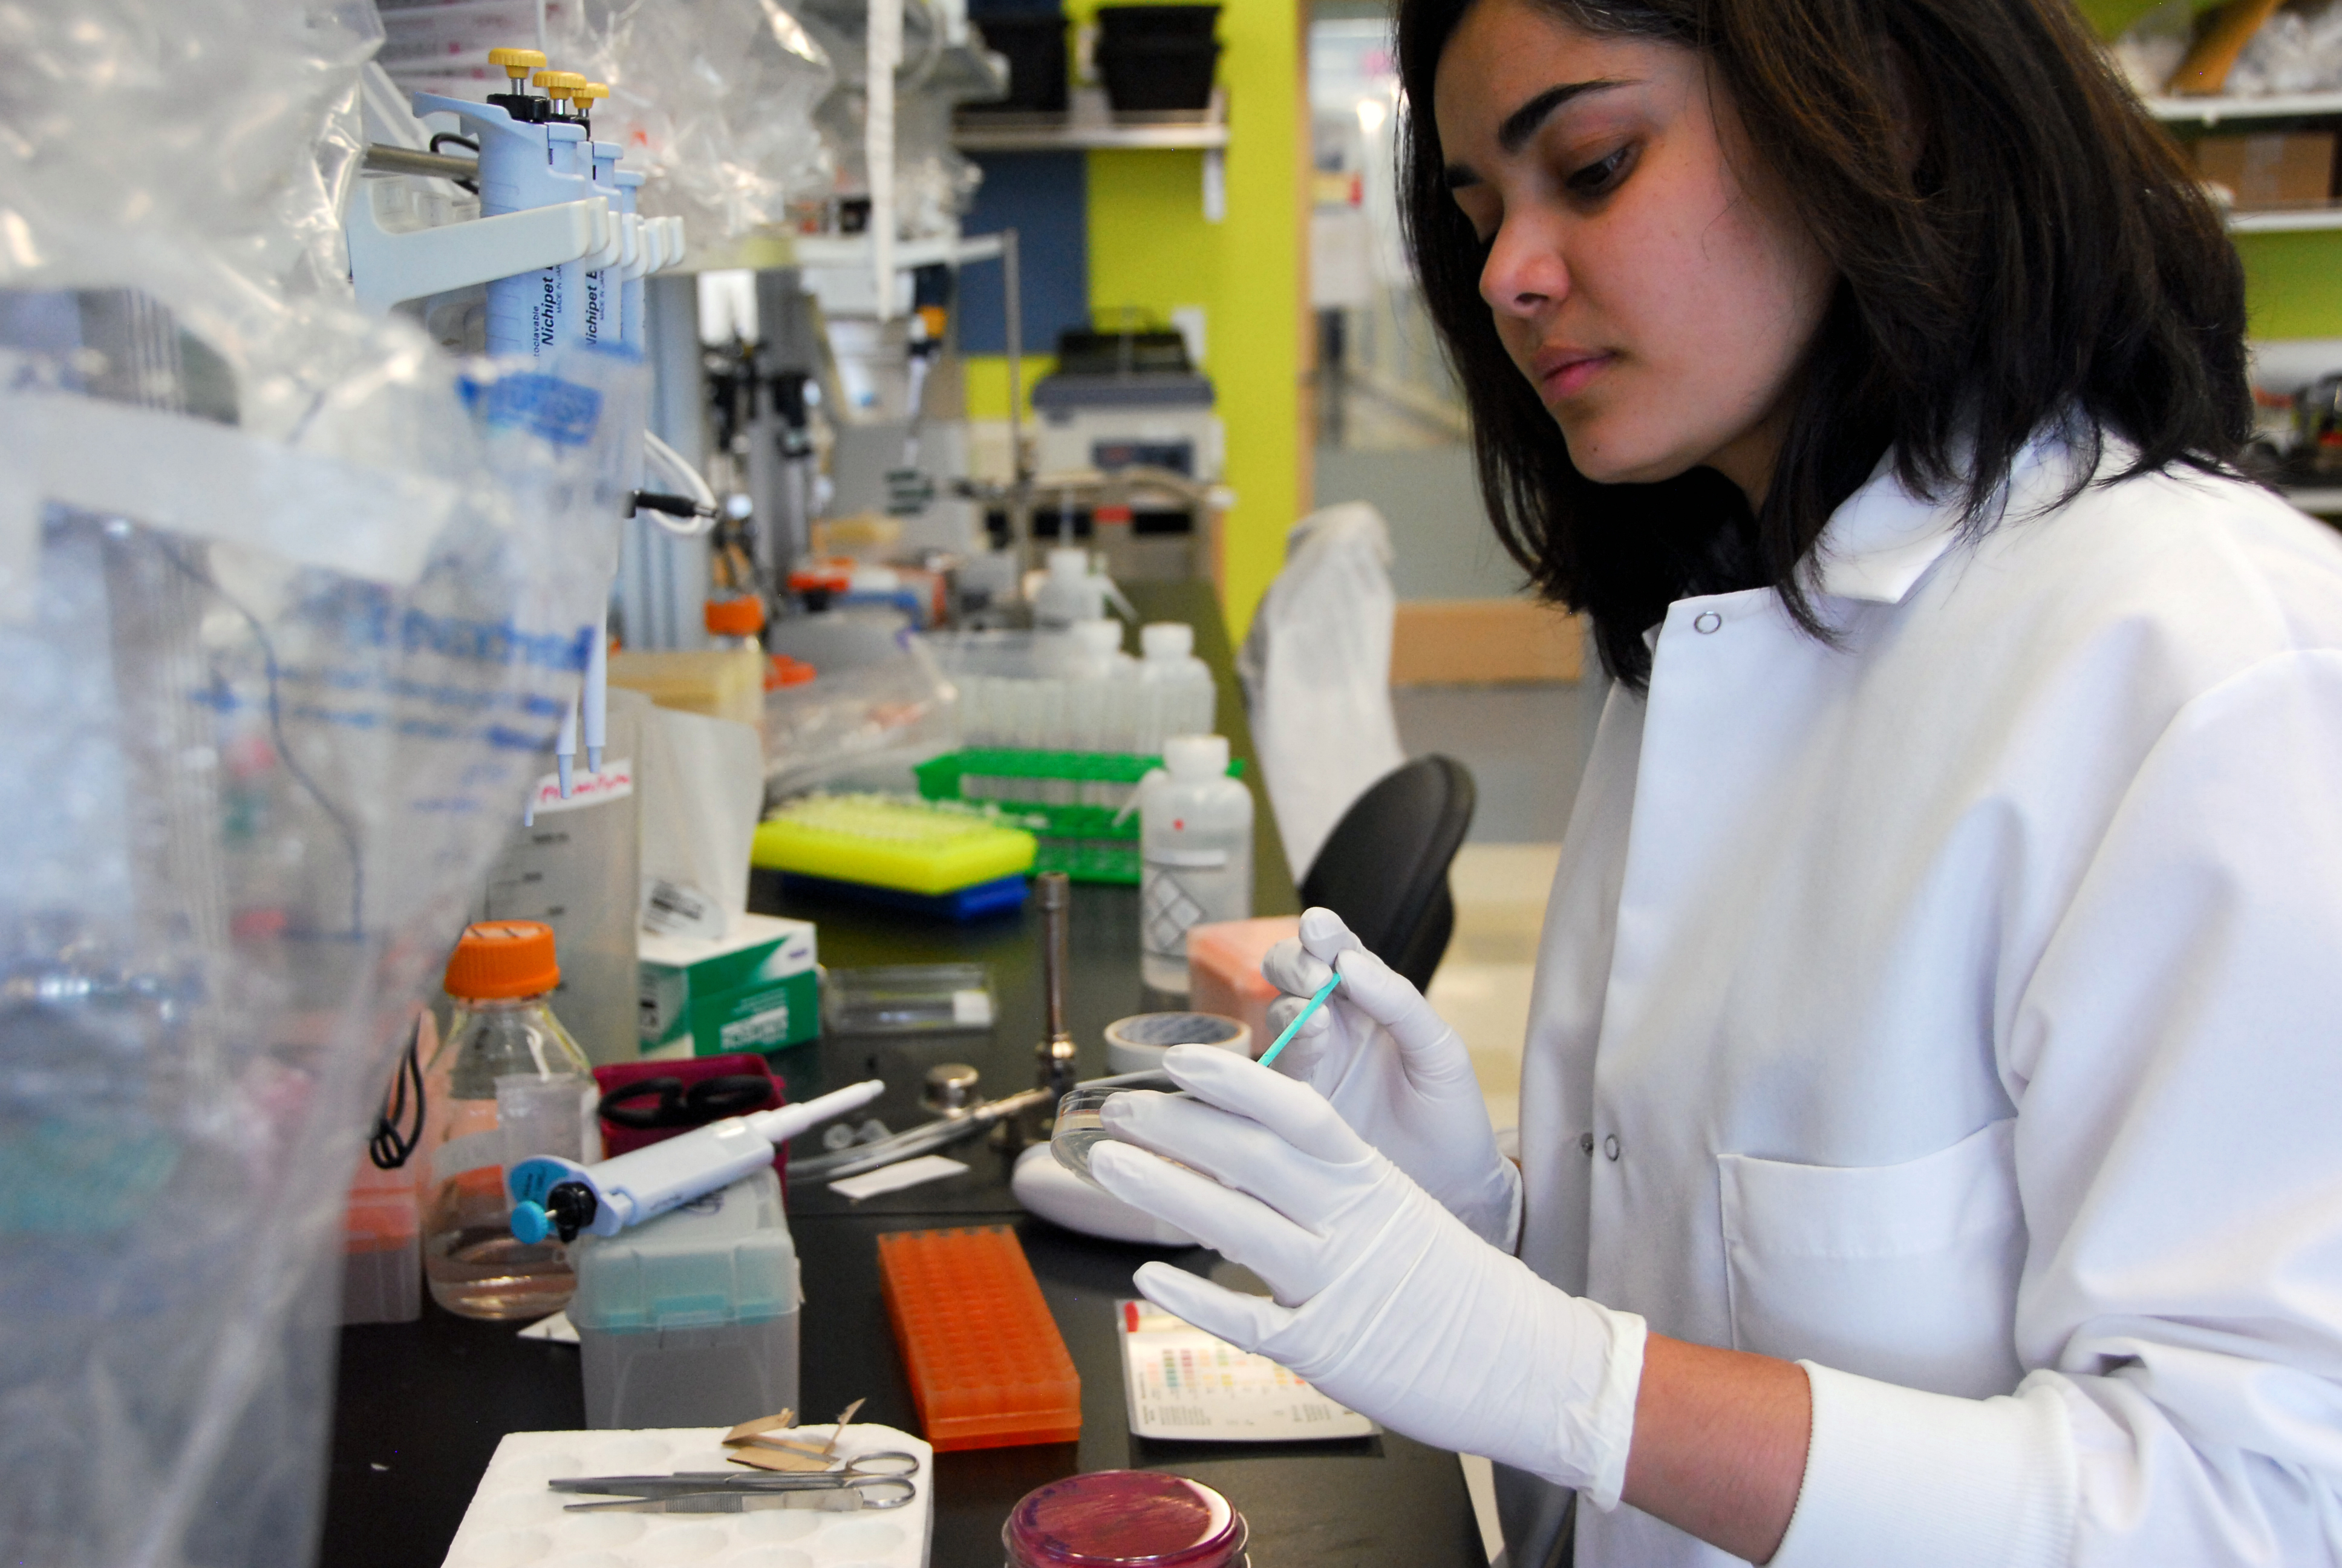
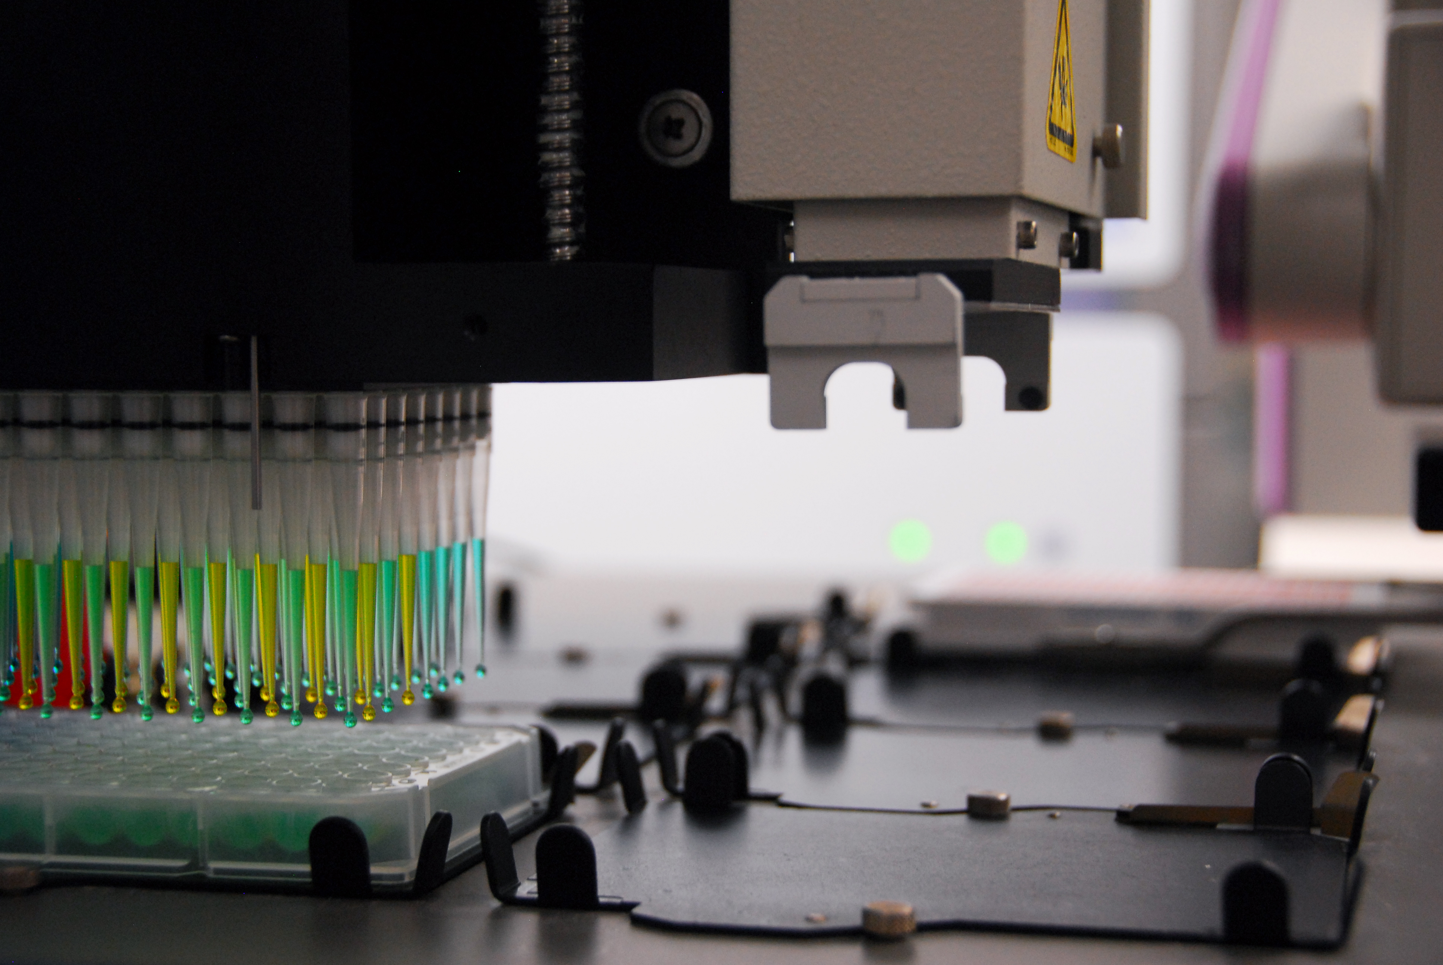
Mid Career Opportunities: Research
Late Assistant to Associate Professor
Promotion criteria
Center, Institute, Division Director
Study section, Council membership, Society leadership
National/International committees, roles, networks
Multicenter grants and research
Leadership skills, additional training
New skills, technology, collaborators, sabbatical

Slide 28
New Challenges and Paradigms for Mid-Career Research Faculty
Maintaining and diversifying support
Foundations, pharmaceutical industries
DoD, CMS, CDC, AHRQ, CDRMP
Other industries
CTSA, Cores, Centers, Institutes
Philanthropy

Slide 29
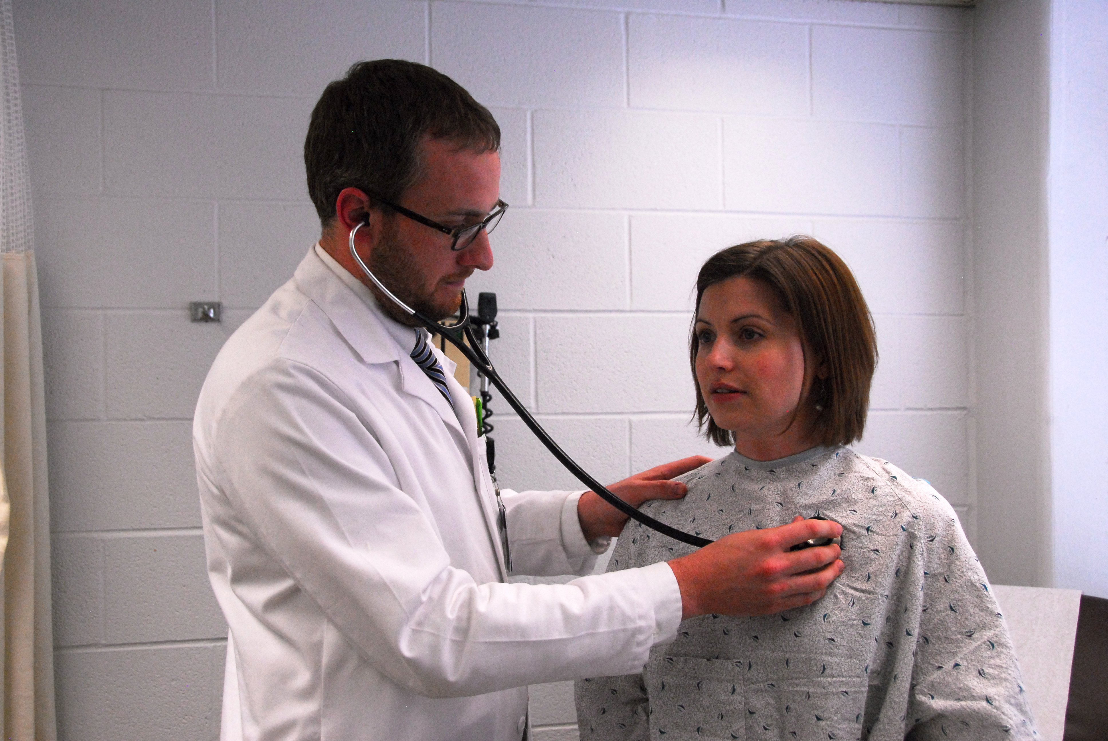
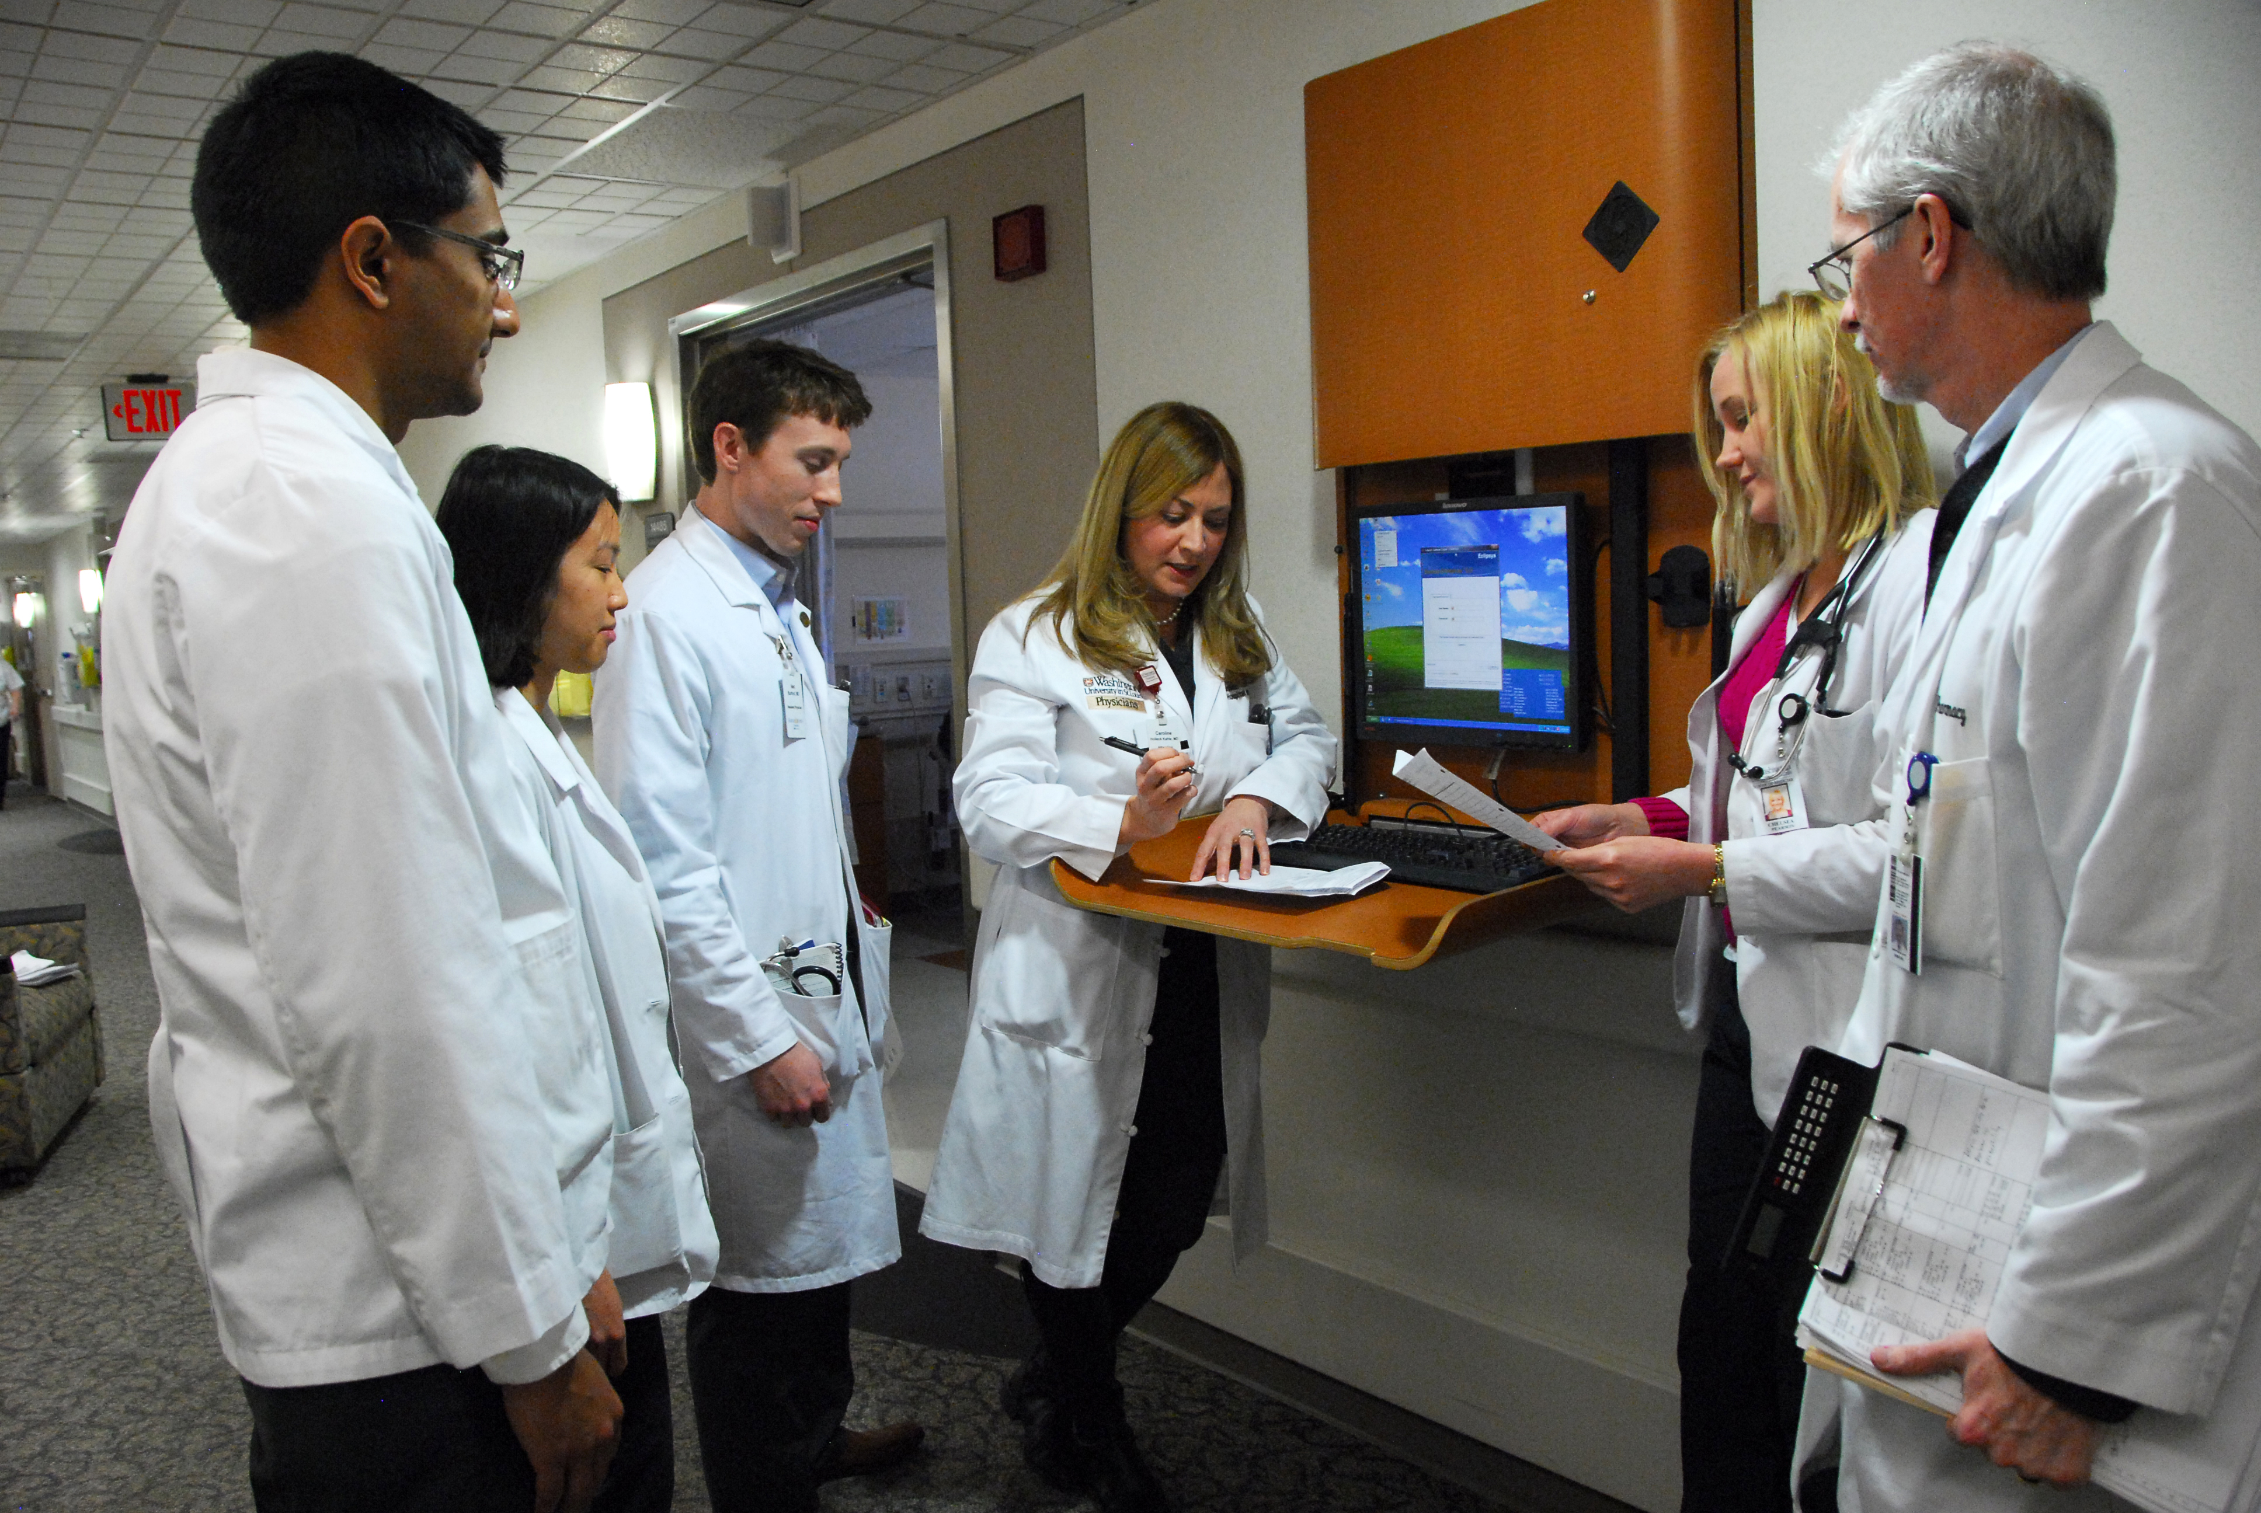
Mid Career Opportunities: Clinician
Master Clinician, change practice (private to academic, visa versa, inpatient/outpatient, ID hospitalist)
Safety, Quality, Medical Director, CMO, CMIO
Antimicrobial Stewardship Director
Infection Prevention, Hospital Epidemiologist
Telemedicine, Home IV antibiotics, Infusion Center
Travel Medicine
ID Consulting, policies, prevention,
Concierge, Military, Government, Public Health, FQHCs
Additional training (MPH, MPHS, MBA, certificate),
experiences, volunteer

Slide 30
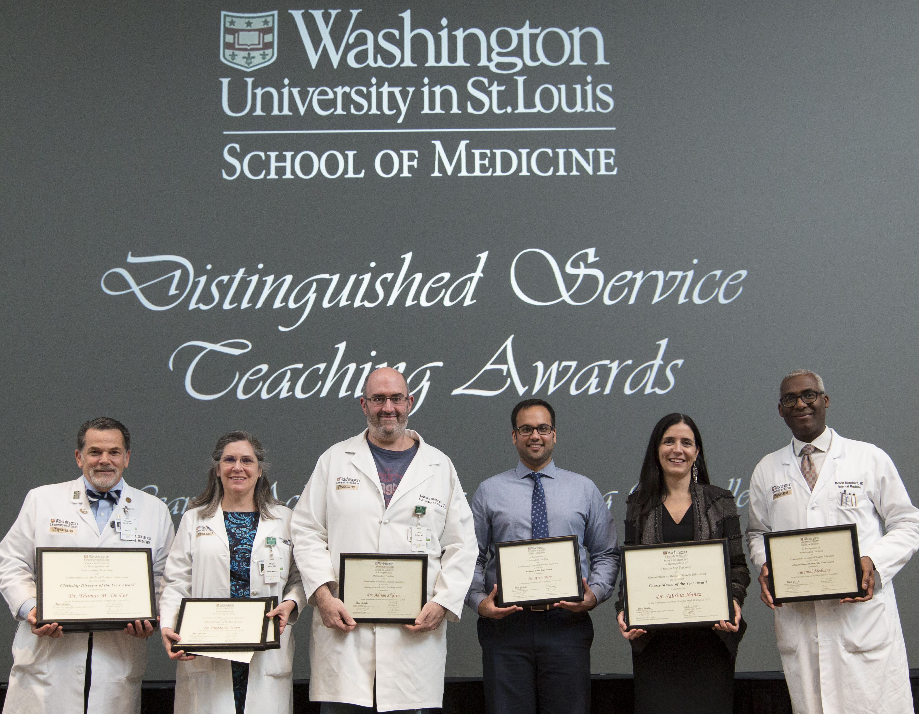
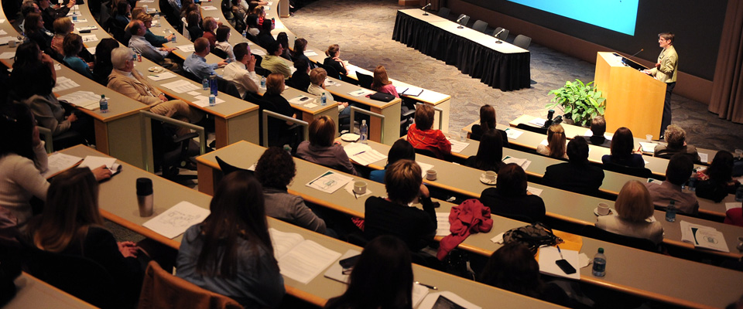
Mid-Career Opportunities: Education
Additional training, bedside teaching, curriculum, evaluation, competencies: Master Clinician Educator
Develop new curriculum, courses, electives, online training
Educational awards, recognition
Educational research, scholarship, grants, Macy Foundation
Publications, books, reviews, online materials, videos
Masters in Medical Education, Med Ed fellowship
Coursemaster, Housestaff or Fellowship Program Director
Assistant/Associate Dean of Education (curriculum, evaluation, UME, GME, CME )

Slide 31
Alternate Career Paths
Industry
Government agencies
Safety, quality, performance improvement
NIH, FDA, CDC
Antimicrobial Stewardship, Healthcare epi
Medical directors, STD/TB clinics, Health Dept, HIV, Federally Qualified Health Centers, Insurance Companies
Admin leadership, institutional/organizational (MBA)
Health services research (MPH, MSCI, MSCE)
Zweidler-McKay PA, et al. Pediatr Blood Cancer. 2016:63;1723-1730.

Slide 32
Core Competencies for Mid-Career Faculty
↑ Insight, self awareness, strengths and growth opportunities
↑ Collaboration
↑ Organizational knowledge & networking
Change management and leadership
↑ Safety, quality & efficiency
HR, administrative skills, team building, people management
Advancing inclusion and diversity
Communicating effectively
Achieve work / life integration
Maintain & promote resiliency
Enhance mentorship
↑ Financial skills
Scholarship and advancement

Slide 33
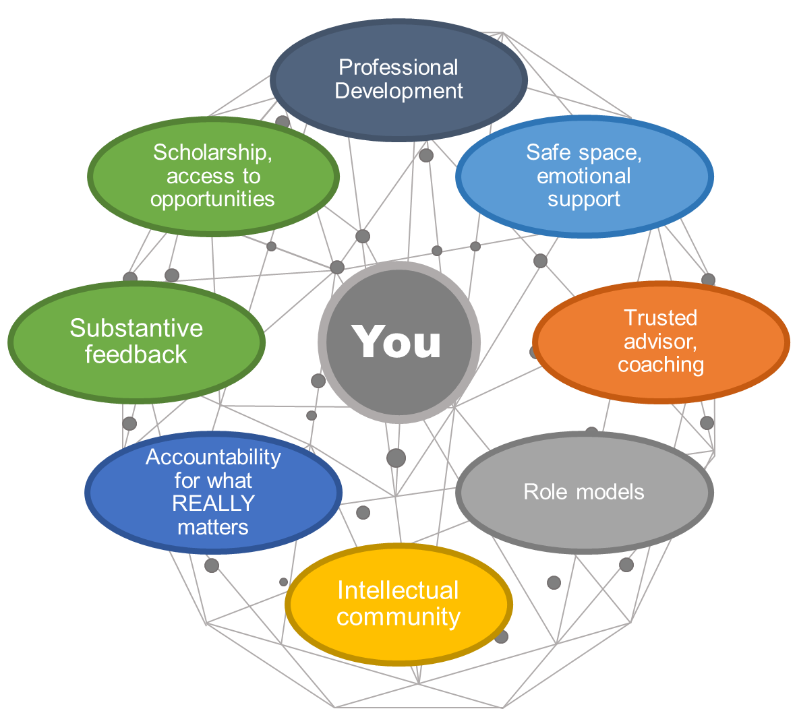
Mentorship Map

Slide 34
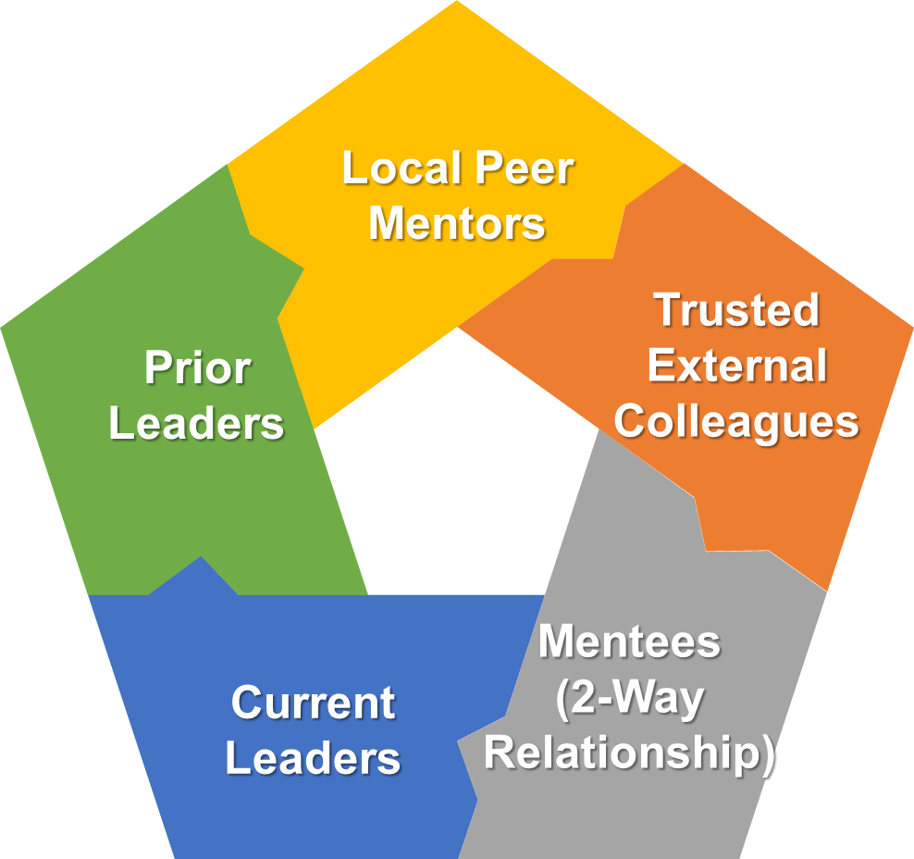
Who is Your Mentor Team

Slide 35
What Might Mentorship Look Like Now?
From Technical Skills
To Relational Skills

Slide 36
Mid-Career Faculty Development Programs
Harvard Medical School
Leadership development for MDs and scientists
2.5 days
Late assistant and associate professor
Panels with AMC leaders, group sessions
High degree networking
Brigham Leadership Program “Mini-MBA”
1 year
Four 2.5 day modules, overnight stay each module
Project group meetings all year
Team projects
Stanford
Vanderbilt
UCSF
Toronto
Indiana
Drexel ELAM
Harvard SPH
AAMC
AAIM
Most business schools
and AHCs

Slide 37
Sponsorship
Public support by powerful & influential person for advancement & promotion of an individual with untapped or unappreciated leadership talent or potential
Influence advancement to hi-profile
critical positions
Women often “over mentored” but
“under-sponsored”

Slide 38
How to Prioritize Work
and Evaluate Priorities
Urgent | Not Urgent
Box 1 Activities: Crises Pressing Problems Dead-line driven projects | Box 2 Activities: Prevention Recognizing new opportunities Planning Relationship building
Box 3 Activities: Interruptions, some calls Some mail, emails, texts, reports Some meetings Popular activities | Box 4 Activities: Trivia, busy work Some mail, email, texts Some phone calls Time wasters Pleasant activities
Important
Not Important
Franklin Covey, Inc.

Slide 39
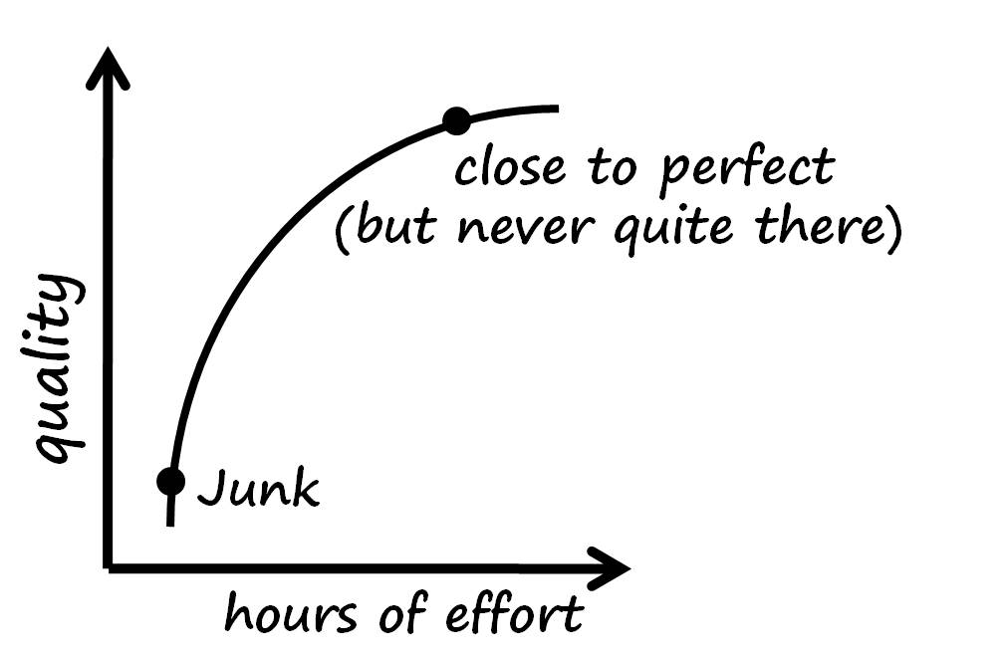
After You Evaluate Your Time & Activities: FIX IT
Urgent | Not Urgent
Box 1 Focus On and DO | Box 2 Focus On and Plan, Delegate, Defer
Box 3 Challenge and Delegate | Box 4 Eliminate
Important
Not Important
Franklin Covey, Inc.

Slide 40
Leadership Styles and Qualities
Q1
Direct
Q4
Tell & Do
Challenge & Motivate
Style
My way
Top down
Need to win
Personal Dimensions
Aggressive
Demanding
Close-mined
Style
Involvement
Best way
Challenges & risks
Personal Dimensions
Forceful
Open
Inquiring
Performance
Decisions made alone
Edicts
New ideas discouraged
Performance
Decision with input
Clear control
New ideas evaluated/accepted/credit
Insensitive
Sensitive
Q2
Don’t Rock the Boat
Q3
Let’s Be Pals
Style
Status quo
By the book
Personal Dimensions
Aloof
Unresponsive
Cautious
Style
Popular
Seek acceptance
Personal Dimensions
Over-agreeable
Compromises quickly
Performance
Postpone decisions
Loose control
New ideas rejected
Performance
Popular decision
Unclear delegation
New ideas accepted/do nothing
Indirect
Psychological Associates

Slide 41
Distribution of Leadership Styles
Leadership Styles
Q4
Q1
Q3
Q2
Psychological Associates

Slide 42
Opportunities for Learning to Lead
Trial and Error
Job Experience
Hardships
Job Assignments
Relationships
Formal Training
Role Models (Exemplars)
Education
Observation
Formal Education
Bad Examples

Slide 43
Ten Commitments of Leadership
PRACTICES | COMMITMENTS
Challenging the Process | 1. Search out challenging opportunities to change, grow, innovate, and improve.
 | 2. Experiment, take risks, and learn from the accompanying mistakes.
Inspiring a Shared Vision | 3. Envision an uplifting and ennobling future.
 | 4. Enlist others in a common vision by appealing to their values, interests, hopes, and dreams.
Enabling Others to Act | 5. Foster collaboration by promoting cooperative goals and building trust.
 | 6. Strengthen people by giving power away, providing choice, developing competence, assigning critical tasks, and offering visible support.
Modeling the Way | 7. Set the example by behaving in ways that are consistent with shared values.
 | 8. Achieve small wins that promote consistent progress and build commitment.
Encouraging the Heart | 9. Recognize individual contributions to the success of every project.
 | 10. Celebrate team accomplishments regularly.

Slide 44
Commitment Number 1 Search Out Challenging Opportunities to Change, Grow, Innovate, and Improve
Treat every job as an adventure.
Treat every new assignment as a start-over, even if it isn’t.
Question the status quo.
Send people shopping for ideas.
Put idea gathering on your own agenda.
Go out and find something that needs fixing.
Assign people to the opportunities.
Renew your teams.
Add adventure and fun to everyone’s work.
Take a class; learn a new skill.

Slide 45
Commitment Number 2 Experiment, Take Risks, Learn from the Resulting Mistakes
Set up little experiments.
Make it safe for others to experiment.
Eliminate fire-hosing.
Work even with ideas that sound strange initially.
Honor your risk takers.
Debrief every failure as well as every success.
Model risk taking.
Encourage possibility thinking.
Maximize opportunities for choice.
Make formal clothing and titles optional.

Slide 46
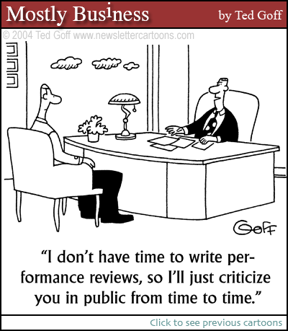
Effective Feedback
Capture the situation
Describe the behavior
Deliver the Impact

Slide 47
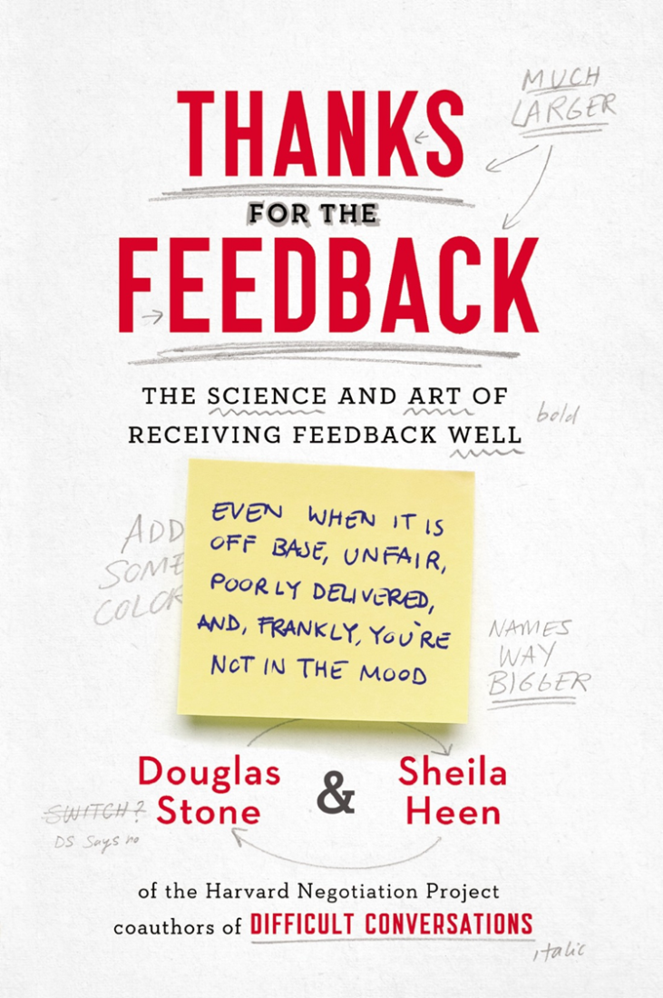
Common Mistakes in Giving Feedback
Feedback judges individuals not actions
Feedback is too vague
Feedback speaks for others
Negative feedback sandwiched between positive messages
Feedback exaggerated with generalities
Feedback psychoanalyzes motives behind behavior
Feedback goes on too long
Feedback contains implies threat
Feedback uses inappropriate humor
Feedback is a question not a statement

Slide 48
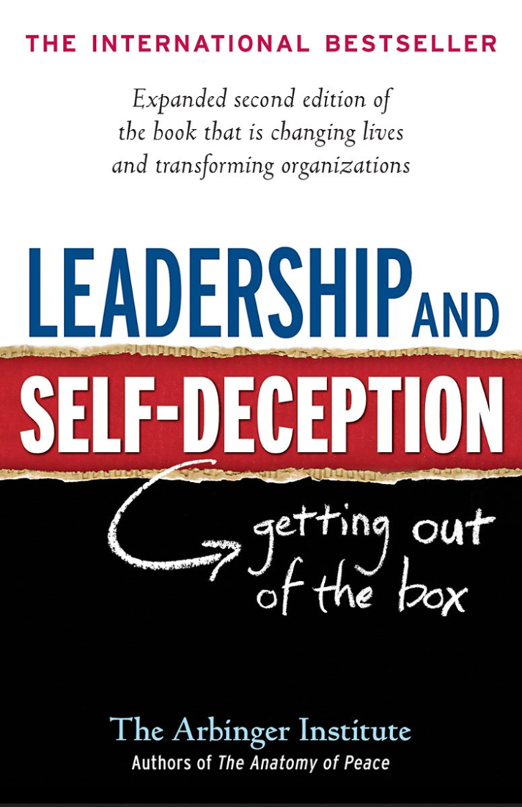
STATE MY PATH
Share your facts
Tell your story
Ask for other’s path
Talk tentatively
Encourage testing

Slide 49
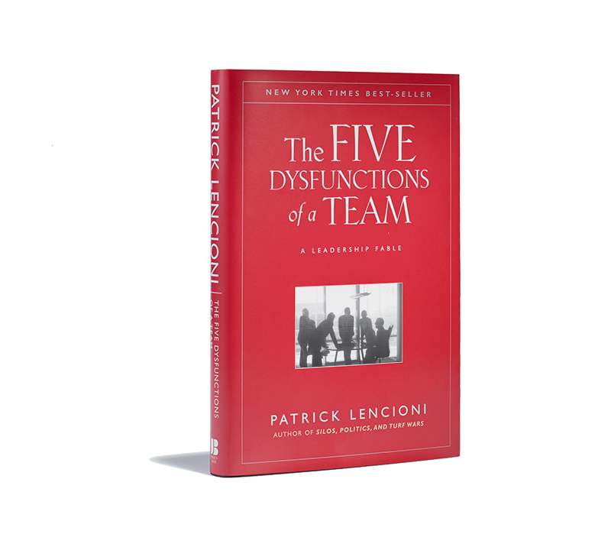

Slide 50
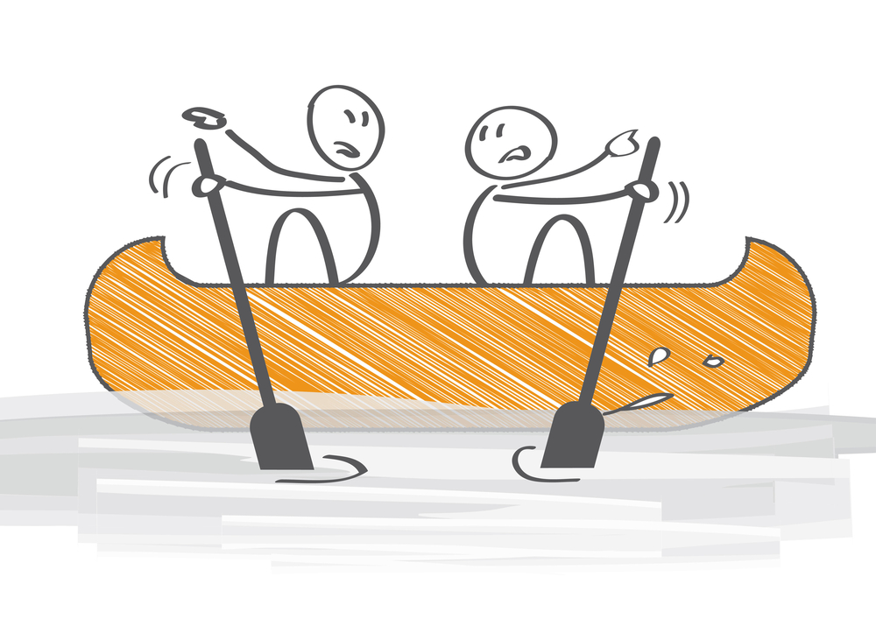
The Five Dysfunctions of a Team
Inattention to
RESULTS
Status and Ego
Avoidance of
ACCOUNTABILITY
Low Standards
Lack of
COMMITMENT
Ambiguity
Fear of
CONFLICT
Artificial Harmony
Absence of
TRUST
Invulnerability

Slide 51
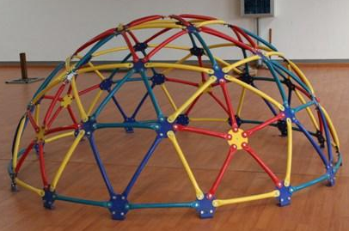
Career Advancement and Leadership Experiences

Slide 52
Going the Distance….
Your career is a marathon- NOT a sprint. Learn to “lean in” every day.
It is as much about the journey as the destination.

Slide 53
Thank You
Questions?
vfraser@wustl.edu
314-362-8061

Slide 54
Homework Books I Give Out
The Dance of Change: Challenges to Sustaining Momentum in Learning Organizations: Peter Senge.
Beyond Bias & Barriers: Fulfilling the Potential of Women in Academic Science & Engineering: NAS; IOM 2007.
The Vision of a Champion: Anson Dorrance, Gloria Averbuch.
Leading Change: John Kotter.
What Got You Here Won’t Get You There: Marshall Goldsmith.
The Upside of Irrationality: Dan Ariely.
Effective Motivation through Performance Appraisal: Robert Lefton.
Leading Quietly: Joseph Badaracco, Jr.
The Tipping Point: Malcolm Gladwell.
Don’t Fire Them, Fire Them Up: Frank Pacetta.
Becoming Leaders: A Practical Handbook for Women in Science, Engineering & Technology: F. Mary Williams & Carolyn Emerson.
Influencer: The Power to Change Anything: Kerry Patterson.
Indispensable by Monday: Larry Myler.

