Slide 1
Issues Impacting Gender Equity: Discrimination, Harassment and Unprofessional Behavior
Linda Chaudron, MD, MS
Associate Vice President and Senior Associate Dean

Slide 2
Objectives
Understand definitions and differences between discrimination, harassment and unprofessional behavior
Be able to identify resources in your institution and nationally to address discrimination and harassment

Slide 3
Disclosures
No financial disclosures or conflicts of interest

Slide 4

          Me Too Movement

Slide 5
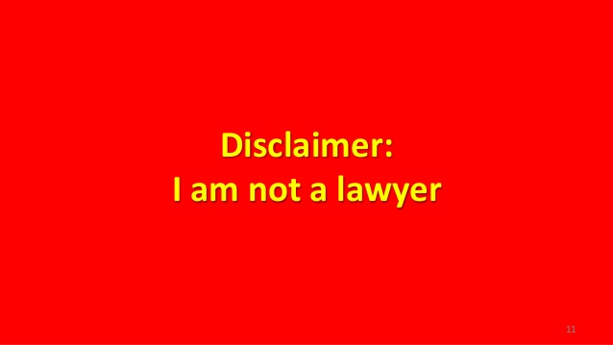

Slide 6
What is the Definition of Harassment?
  Informal:
  Harassment: The act or an instance of harassing, or disturbing, pestering or troubling repeatedly; persecution Dictionary.com
  Harass: to create an unpleasant or hostile situation for especially by uninvited and unwelcome verbal or physical conduct. Merriam-Webster Dictionary
  Formal:
  Harassment is a form of unlawful discrimination (if due to protected characteristic).
  Types of harassment in employment:
      Hostile Environment (racial, sexual, etc)
      General
  Harassment can be sexual in nature or based on other legally protected characteristic (i.e., race, disability)
  Harassment which is not unlawful may otherwise violate employer policy.

Slide 7
Harassment Further Defined
Hostile work environment harassment is a form of discrimination that involves:
  unwelcome verbal, physical, or electronic conduct intended to cause or which could reasonably be expected to cause an individual or group of individuals to feel intimidated, demeaned, abused, or fearful, or to have concern for their personal safety on the basis of a protected class where ….
  the harassment is so severe and pervasive that the work or academic conditions are materially altered and an abusive working environment exists and
  a reasonable person would believe that the conduct unreasonably interfered with work or academic performance or otherwise created an intimidating, hostile or offensive work or academic environment.

Slide 8
What is the Definition of Sexual Harassment?
Unwelcome
  Sexual advances
  Requests for sexual favors
  Or other visual, verbal or physical conduct of a sexual nature
WHERE:
  Submission to such conduct is an explicit or implicit conduction of employment or academic success (quid pro quo); or
  Submission to or rejection of such conduct is used as the basis for employment or academic decisions; or
  The conduct has the purpose or effect of a) unreasonably interfering with an individual’s work or academic performance or b) creating an intimidating, hostile or offensive work or academic environment

Slide 9
Harassment Defined
Types of actions which can give rise to hostile work environment claims:
  racial or ethnic jokes
  unwanted sexual touching of another person
  obscene language and/or gestures
  racial or gender related epithets or slurs
  degrading or derogatory remarks based on/related to the individual’s protected class
  making fun of a person’s disability
  derogatory or demeaning comments about an individual’s religious beliefs
  stereotyping of individual based on protected class
  graffiti left in employee’s work area
  intimidation of a verbal, written or visual nature (including pictures, computer)
  stalking
Notes:
Again though, to be unlawful it must meet the severe and pervasive req’mt and unreasonably interfere. Merely boorish or offensive not enough. Simple teasing, offhand comments or isolated incidents (unless extremely serious) generally not enough

Slide 10
What is the Definition of Discrimination?
Discrimination involves an adverse action or decision or harassing or differential treatment of a person or class of persons because of a legally protected status or because of perceived or actual affiliation or association with other individuals in a protected class.
Does not include actions or behavior not based on a protected class (e.g., nepotism, general bullying).

Slide 11
Illegal Bases for Discrimination
Age
Color
Criminal Conviction & Arrest Record **
Disability
Domestic Violence Victim (NYS)**
Ethnicity
Gender (includes pregnancy & sexual harassment)
****Some classes protected at the state but not federal level
Gender Identity and Expression
Marital Status
Military/Veteran Status
National Origin & Ancestry
Pregnancy
Race
Religion/Creed
Sexual Orientation
Notes:
Some classes protected state but not federal - ex. crim conviction (state not federal, but federal recognizes can result in discrimination on race, other), marital status, gender identity, S.O. (but Obama did add as a hate crime)

Slide 12
What are the relevant laws?
Title VII prohibits employers from discriminating in employment decisions based upon race, color, national origin, sex, or religion. Discrimination can be intentional or based upon a disparate impact.
Title IX prohibits discrimination on the basis of sex in any federally funded education program or activity.
      Title IX Coordinators are designated at universities
*Some different processes and expectations between Title IX and Title VII around mandated reporting, investigation and public reporting

Slide 13
Other Applicable Laws
Age Discrimination in Employment Act (“ADEA”) & Older Workers Benefits Protection Act (“OWBPA”)
Americans with Disabilities Act Amendment Act (“ADAAA”) (formerly ADA)
Equal Pay Act of 1963 (“EPA”); Lilly Ledbetter Fair Pay Act
Executive Order 11246 (as amended by Exec Order 11375)
Genetic Information Nondiscrimination Act (“GINA”)
Pregnancy Discrimination Act (“PDA”)
Rehabilitation Act of 1973
Section 1981 of the Civil Rights Act of 1866
Section 1983 of the Civil Rights Act of 1871
Title VI of the Civil Rights Act of 1964
Title VII and VIII of the Public Health Service Act
Uniform Services Employment & Re-employment Rights Act (“USERRA”) and Vietnam Era Veterans Readjustment Act of 1974 (“VEVRA”)
State and Local laws

Slide 14
Retaliation
All employees are prohibited from taking adverse action against an individual because he/she has engaged in “protected activity”.
Notes:
(whether relating to unlawful discrimination or other statutes providing employment rights)

Slide 15

What is Unprofessional Behavior?
Microagressions
Incivility
Implicit bias
Explicit bias

Slide 16
Legitimate, Non-discriminatory Reasons For A Decision
Failure to meet legitimate performance expectations or required standards
Financial / lack of funding
Insubordination
Misconduct
Lack of required qualifications
Applicant demonstrably not best qualified
Scientific misconduct
Violation of employer policy
Violation of law

Slide 17
What is Sexual Harassment?
It is about POWER…
NIH Director Francis Collins says “The goal of the perpetrator, most commonly but not exclusively a man, is to objectify, exclude, demoralize, diminish, and coerce the victim, most commonly a woman, to exert power over her. It’s morally indefensible, its unacceptable and it presents a major obstacle that is keeping women from achieving their rightful place in science…” Sept 17, 2018

Slide 18
Is Sexual Harassment an Issue in Academic Medicine and Science……Apparently
National Academy of Sciences, Engineering and Medicine
  June 12, 2018 - 300 page Report published
  November 9, 2018 Convening Leaders in Academia to Prevent Sexual Harassment – watch the webinar
National Institutes of Health
  September 17, 2018: Changing the culture of science to end sexual harassment by Francis Collins, MD, PHD, Director NIH
  NIH Anti-Sexual Harassment Webpage launched
National Science Foundation
  September 19, 2018 Announcement: next steps
  publishing a term and condition that requires awardee organizations to report findings and determinations of sexual harassment
  establishing a secure online portal for submitting harassment notifications.

Slide 19
NASEM Categories of Sexual Harassment
Gender Harassment
  verbal and nonverbal behaviors that convey hostility, objectification, exclusion or second-class status about members of one gender
Unwanted sexual attention
Sexual coercion
Unwelcome
  Sexual advances
  Requests for sexual favors
  Or other visual, verbal or physical conduct of a sexual nature
WHERE:
  Submission to such conduct is an explicit or implicit conduction of employment or academic success (quid pro quo); or
  Submission to or rejection of such conduct is used as the basis for employment or academic decisions; or
  The conduct has the purpose or effect of a) unreasonably interfering with an individual’s work or academic performance or b) creating an intimidating, hostile or offensive work or academic environment

Slide 20
NASEM Report
Documented extents and persistence of sexual harassment
Negative consequences for careers and health
Solutions to increase identifying and reporting
15 evidence-based recommendations

Slide 21
Examples of sexual harassment in science and medicine
NIH K award recipients (2006-2009) N = 493 women and 573 men “In your professional career, have you encountered unwanted sexual comments, attention, or advances by a superior or colleague (yes or no)
30% of women vs. 4% of men said YES
    Among the 150 women who responded yes:
      92% sexist remarks or behavior
      41% unwanted sexual advances
      9% coercive advances
      6% subtle bribery to engage in sexual behavior
      1% threats to engage in sexual behavior
  47% reported it negatively affected their career
  Jagsi, et al. JAMA, May 2016
  COMPARED TO:
Academic medical faculty surveyed (1995) N= 953 women and 1010 men
  52% of women vs. 5% of men

Slide 22
Examples of sexual harassment in science and medicine
NASEM Report (p 65): Encounter or experience sexually harassing conduct in academia
> 50% of women faculty and staff
20-50% of women students
AAMC 2017 Medical School Graduation Questionnaire:
  14.8% of medical students reported they had been subjected to offensive sexist remarks at least once
  4.3% reported unwanted sexual advances
  0.3% asked to exchange sexual favors for grades or other awards

Slide 23
What Contributes To Sexual Harassment in Medicine and Science?
Male dominated field
Male dominated leadership
Hierarchical power structure
Silos of power especially dependence on mentors for career advancement
Superstars
Informal communications network of rumors and accusations
Lack of clarity of policies and repercussions
              DISPARITY of POWER

Slide 24
Behaviors that are Illegal
Behaviors that violate institutional policies
Behaviors that are unacceptable but not covered in policies and laws

Slide 25
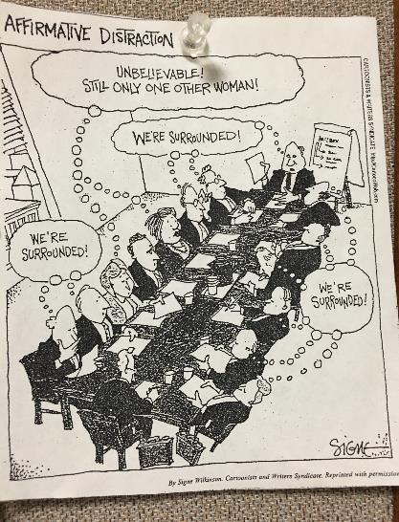
Why Are We Still Here?

Slide 26
Women in Medicine Change in Laws
1847 Elizabeth Blackwell, first female physician to graduate from US school (Geneva Medical College)
1880 = 2,000 female physicians
1880’s = 6 women’s medical colleges
1880’s - early 1900’s = women accepted to male medical schools
1910 = 6% of medical students were women
1915 = AMA accepted women
1969 = 9% of medical students were women
1980 = 29% of medical students were women
2017 = 51% of medical students are women
Pololi, LH. Changing the Culture of Academic Medicine: Perspectives of Women Faculty
1920 = Women got right to vote
1964 = Civil Rights Act Title VII
1972 = Title IX
1991 = Title VII Amended

Slide 27
Percentage of Women Faculty in Academic Medicine

Slide 28
SLOOOOOOW Progress
The proportion of full professors who are women has increased 7 percentage points since 2004 (14% - 22%)……..
At this rate it will take 48 years to get to 50%
The percentage of new tenured posisions given to wome has remained the same (30%)

Slide 29
Why Are We Not Moving the Needle Faster?
Hierarchical Organizational Structures
▪ Because there are few women in leadership positions throughout academic medicine, women who report instances of gender discrimination are often faced with the challenge of reporting to the very men they view as perpetrating the discrimination (Carr, 2003).
▪ The production and reification of male dominated hierarchies in academic medical organizations only fuels a lack of institutional trust and re-instills harmful, traditionally held notions that women can’t succeed in academic medicine (Barbaria, 2009; Carr, 2003; Levine, 2013).

Slide 30
Why Are We Not Moving the Needle Faster?
Lack of Women Serving on Search Committees
Lack of Women Serving on Powerful Committees:
  Finance, chair’s cabinet, etc.
Conflation with Familial Issues
  Women’s issues in academic medicine have been conflated with familial issues. There has been a focus on improving family resources for women as a means to ending gender discrimination in the work place (Carr, 2003; Rich, 1994).

Slide 31
We Still Have Issues of Equality, Equity and Parity
Equality:
  Treating everyone the same
  Aims to promote fairness but only works if everyone starts at the same place
Equity:
  Giving everyone what they need to be successful
  Appears unfair but gets us to a more level playing field
Parity:
  The state of being equal or equivalent (Merriam-Webster’s Learner’s Dictionary)
  Concept of equal pay for equal work in a career

Slide 32
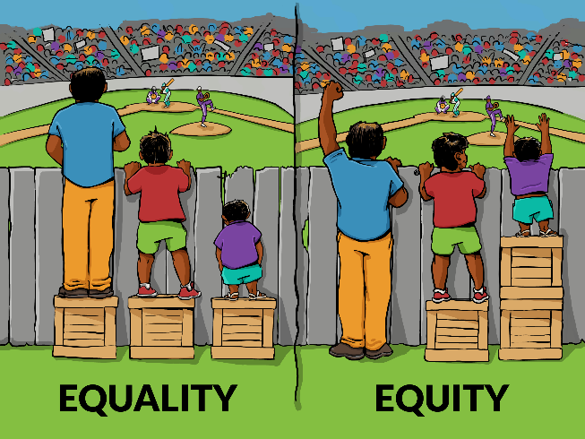

Slide 33
Remember Many Aspects to Diversity
Gender identity
Veteran status
Age
Socioeconomic
Rural, urban, suburban
Ethnicity THINK INTERSECTIONALITY!
Race
Able bodied
gender
religion
race

Slide 34
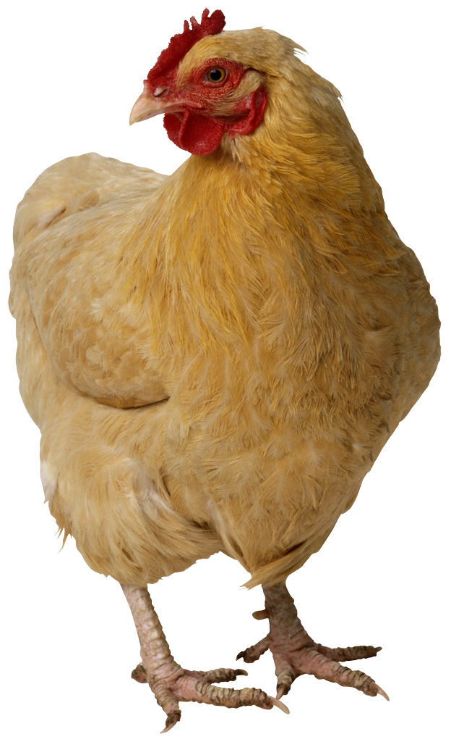

How do they impact one another?
Harassment
Gender Equity

Slide 35
How Does Gender Inequity Interface with Gender Harassment
Decline in job satisfaction
Withdrawal from organization
Decline in productivity
Do not get into leadership
Culture and Climate lead to more harassment

Slide 36
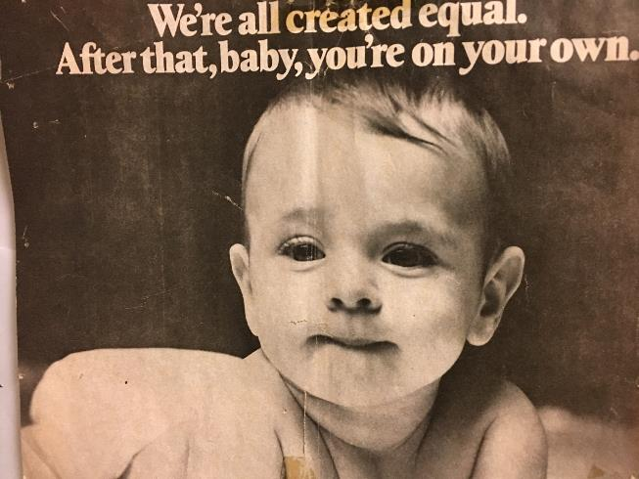
We Don’t Want This To Be The Outcome….

Slide 37
What Can Be Done?
  Develop mechanisms that encourage disclosure without fear of retaliation
  Mandatory training
  Do not tolerate sexual harassment – must have monitoring and sanctions
  Must not engage in dismissal of “locker room talk”
  Professional societies must break the silence and address at leadership councils and annual meetings
  Additional research
  Bates, et al. It is Time for Zero Tolerance for Sexual Harassment in Academic Medicine. Academic Medicine, 2018

Slide 38
What Can Be Done? Recommendations of the NASEM on Addressing Sexual Harassment and Gender Discrimination, 2018
  Create diverse, inclusive and respectful environment
  Address gender harassment
  Move beyond legal compliance
  Improve transparency and accountability
  Diffuse hierarchical and depend relationships between trainees and faculty
  Provide support for the target
  Strive for strong diverse leadership
  Measure progress
  Incentivize change
  Encourage involvement of professional societies
  Initiate legislative action
  Address failures to meaningfully enforce Itile VII
  Increase federal agency action and collaboration
  Conduct research
  Make the entire academic community responsible for reducing and preventing sexual harassment

Slide 39
What URMC Is Doing?
Focusing on a Culture and Climate of Respect
  ICARE Values
  TAUBMAN IN TWO Video
  Faculty Professionalism Council
  Unconscious Bias Training
  Anti-Harassment and Anti-Discrimination Training
  Ombuds program review and expansion
  University is reviewing its policies and procedures
  Salary Equity Study

Slide 40
Some of Your Local Resources and Policies
Harassment including Sexual Harassment
https://www.sdbor.edu/policy/documents/1-17.pdf
Prevention of, Dating Violence, Domestic Violence Sexual Assault and Stalking
https://www.sdbor.edu/policy/documents/1-17-1.pdf
Human Rights Complaint Procedure
https://www.sdbor.edu/policy/documents/1-18.pdf

Slide 41
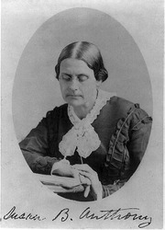
We Are Getting There!!
Join the union, girls, and together say Equal Pay for Equal Work.
SUSAN B. ANTHONY, The Revolution, Mar. 18, 1869
Failure is impossible.
SUSAN B. ANTHONY,
Remarks at her 86th birthday celebration,
Feb. 15, 1906

Slide 42

Questions, Comments, Ideas

