Slide 1
Feedback:
From Sandwiches to Conversations
(with a side of teaching ideas)
Jason Kemnitz, EdD
Associate Dean
Academic Development and Faculty Affairs
Notes:
Positive environment
Students / Resident can feel intimidated
Interpersonal skills

Slide 2

It’s All about Communication

Slide 3

What is Interpersonal Communication?
Notes:
Unit of Measurement- Intra _ Inter - Public
Grading Competency

Slide 4

SSOM Expected Student Interpersonal Competencies
Communicate effectively with patients and families, as appropriate, across a broad range of socioeconomic and cultural backgrounds.
Establish rapport and demonstrate empathy with patients and their families.
Communicate effectively with physicians, other health professionals, and health related agencies.
React appropriately to difficult situations including ethical dilemmas, conflicts, and noncompliance.
Work effectively as a member of a health care team.
• Formulate timely, legible, medical records that are routinely used in medical practice.

Slide 5

Set the Teaching Climate
Notes:
Positive climate
Students can feel intimidated
Be aware of interpersonal skills – including nonverba

Slide 6

Control the Teaching Session
Notes:
The more rigid you teach the less likely people will learn – without justification
Adult learners like experiential learning

Slide 7

Communicate Goals
Notes:
Done before you start
Ask what the learner is looking for - their strength ans weakness
Goals should include: Time Frame Action and Assessment
Allow for 2 way communcaiton

Slide 8

Test Your Clear Communication Skills
Notes:
Ask the speaker to describe the geometrical image in detail. The drawer will
attempt to recreate the image on their blank piece of paper, based upon the
instructions. Neither member can see the others’ paper, and the listener may
not communicate with the speaker. Allow 5 – 10 minutes for this portion of
the exercise.
What steps did you take to make sure your instructions would be clear? How can these
steps be translated to real-life conversations?
What was it like not having feedback from the listener during the exercise?
What we mean to say, and how it’s interpreted, are often not the same. What can you do
while speaking to reduce the risk of miscommunication in real-life conversations?

Slide 9

Promote Understating and Retention
Notes:
Analysis and synthesis vs recall
Meaninfhful explanation: answer the why
Encourafge useful habits – reinforced reading etc..

Slide 10

Offer Effective Evaluation
Notes:
Knowledge and skills only
Based on previous set goal

Slide 11

Give Abundant Feedback
Notes:
At the time of learning
Only on actions observed
Avoid feed back by silenc

Slide 12

What to do
And what not to do

Slide 13

Feedback Sandwich
Common – No Preferred
Something Positive to set them up
Feedback You want to give
Something Positive to soften the blow

Slide 14
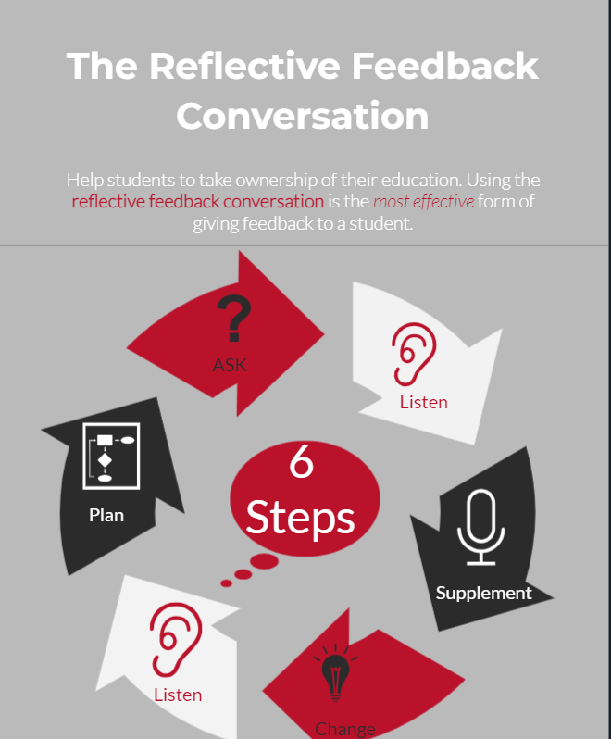
Reflective Feedback Conversation

Slide 15

Receiving Feedback
Notes:
Listen to the feedback given. This means not interrupting. Hear the person out, and listen to what they are really saying, not what you assume they will say. You can absorb more information if you are concentrating on listening and understanding rather than being defensive and focusing on your response.
Be aware of your responses. Your body language and tone of voice often speak louder than words. Try to avoid putting up barriers. If you look distracted and bored, that sends a negative message as well. Attentiveness, on the other hand, indicates that you value what someone has to say and puts both of you at ease.
Be open. This means being receptive to new ideas and different opinions. Often, there is more than one way of doing something and others may have a completely different viewpoint on a given topic. You may learn something worthwhile.
Understand the message. Make sure you understand what is being said to you, especially before responding to the feedback. Ask questions for clarification if necessary. Listen actively by repeating key points so that you know you have interpreted the feedback correctly. In a group environment, ask for others’ feedback before responding. As well, when possible, be explicit as to what kind of feedback you are seeking beforehand so you are not taken by surprise.
Reflect and decide what to do. Assess the value of the feedback, the consequences of using it or ignoring it, and then decide what to do because of it. Your response is your choice. If you disagree with the feedback, consider asking for a second opinion from someone else.
Follow up. There are many ways to follow up on feedback. Sometimes, your follow-up will simply involve implementing the suggestions given to you. In other situations, you might want to set up another meeting to discuss the feedback or to re-submit the revised work.

Slide 16
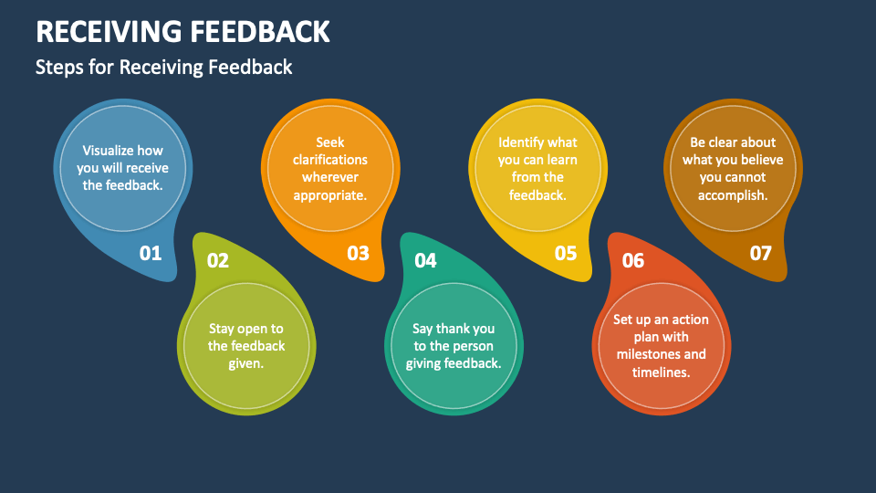
Notes:
Listen to the feedback given. This means not interrupting. Hear the person out, and listen to what they are really saying, not what you assume they will say. You can absorb more information if you are concentrating on listening and understanding rather than being defensive and focusing on your response.
Be aware of your responses. Your body language and tone of voice often speak louder than words. Try to avoid putting up barriers. If you look distracted and bored, that sends a negative message as well. Attentiveness, on the other hand, indicates that you value what someone has to say and puts both of you at ease.
Be open. This means being receptive to new ideas and different opinions. Often, there is more than one way of doing something and others may have a completely different viewpoint on a given topic. You may learn something worthwhile.
Understand the message. Make sure you understand what is being said to you, especially before responding to the feedback. Ask questions for clarification if necessary. Listen actively by repeating key points so that you know you have interpreted the feedback correctly. In a group environment, ask for others’ feedback before responding. As well, when possible, be explicit as to what kind of feedback you are seeking beforehand so you are not taken by surprise.
Reflect and decide what to do. Assess the value of the feedback, the consequences of using it or ignoring it, and then decide what to do because of it. Your response is your choice. If you disagree with the feedback, consider asking for a second opinion from someone else.
Follow up. There are many ways to follow up on feedback. Sometimes, your follow-up will simply involve implementing the suggestions given to you. In other situations, you might want to set up another meeting to discuss the feedback or to re-submit the revised work.

Slide 17

Give it a try

Slide 18

Encourage Self Directed Learning
Notes:
Help Find Useful Purposeful resources
Explain why it is important

