Slide 1
Neurology Board review- Part 1
Valentina Joseph MD
Assistant Professor of Neurology
Neurology Clerkship director-USD School of medicine

Slide 2
Stroke

Slide 3
Stroke
Sudden onset of a neurological deficit from the death of a brain tissue.
Third most common cause of death in US
Risk factors: HTN, DM, HPL, Smoking
Etiology:
Ischemic- 85%→ Thrombus or embolus from
Heart→ Afib, Valvular heart disease, DVT causing paradoxical embolism
Carotid stenosis
Bleeding-15%

Slide 4
Thrombotic stroke | Embolic stroke
Atherosclerotic risk factors (uncontrolled HTN, diabetes)+/- h/o TIA Local obstruction of artery (Carotid, cerebral or vertebral) Stuttering progression (symptoms may alternate with periods of improvement) | H/o cardiac disease (Afib, endocarditis) or carotid atherosclerosis Different vascular territories-multiple infarcts Usually abrupt onset with and is maximal at the start.
Infective endocarditis: IV antibiotics reduce the risk of septic cardio embolism within weeks of initiation of therapy
Valve surgery: If infection is persistent, difficult to treat medically, recurrent septic embolic or of heart failure

Slide 5

TIA(Transient ischemic attack)
Symptoms last <24 hours.
Initial treatment is modifying risk factors, starting aspirin/ statin and improving BP control.
Amaurosis fugax: Painless, rapid, transient, monocular vision loss (curtain descending over the visual field) → suspect retinal ischemia due to atherosclerotic emboli from ipsilateral carotid artery → Carotid duplex is indicated

Slide 6
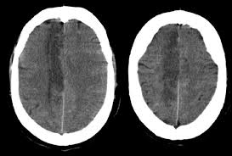
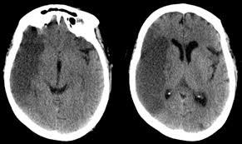
Presentation
ACA stroke | 1. Personality/cognitive defects 2. Urinary incontinence 3. C/L somatosensory and motor deficit( Legs> Arm weakness) 4. Abulia (lack of initiative)
MCA stroke | C/l weakness, sensory loss C/L Homonymous hemianopsia-’eyes look towards the side of the lesion’ Aphasia if dominant side Hemineglect if non-dominant side
Vertebrobasilar system stroke | Alternate symptoms (Ipsilateral cranial nerve and contralateral limb weakness/ numbness) Limb ataxia

Slide 7
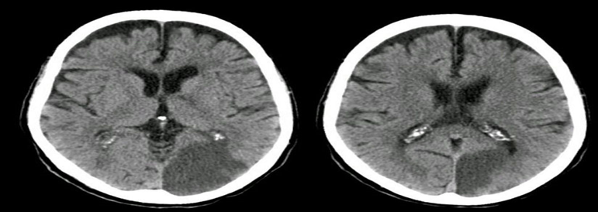
Cont..
PCA stroke | Homonymous hemianopia, alexia without agraphia (dominant hemisphere), visual hallucinations (calcarine cortex), sensory symptoms (thalamus), third nerve palsy, c/l motor deficits (cerebral peduncle, midbrain)
ICA occlusion | Both ACA and MCA involvement (C/L dense hemiplegia with C/L visual, sensory, language or spatial impairments

Slide 8
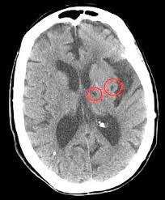
Lacunar infarcts
- Small vessel infarcts affecting the deep cortical structures (<1.5 cm)
Occlusion of single deep penetrating vessel of a large cerebral artery
Some common presentations:
Face, arm and leg are equally involved without any cortical symptoms.
Affected areas: Basal ganglia, subcortical white matter, Pons.
Risk factors: Hypertension, DM, smoking, advanced age, increased LDL
Pathology: Small vessel lipohyalinosis
Pure motor
Pure sensory
Sensorimotor
Dysarthria clumsy hand
Ataxic hemiparesis

Slide 9
Diagnosis and Treatment
Best initial test → CT brain w/o contrast
Most accurate test → MRI brain
Why CT brain is done first?
Treatment:
General strategies:
1. < 3 hours → thrombolytics (IV TPA). Or even up to 4.5 hours. Thrombectomy up to 6 to 8 hours (or even 24 hours)
2. Stroke with no prior antiplatelet therapy→ Aspirin.
3. If the patient is already on ASA→ then add Dipyridamole or switch to Clopidogrel
4. If Afib- Long term anticoagulation (Warfarin, Dabigatran, Rivaroxaban)
5. Large intracranial atherosclerosis→ ASA + Plavix for 90 days, then only ASA
Statins:
Every patient should be started regardless of LDL. Goal < 70.

Slide 10
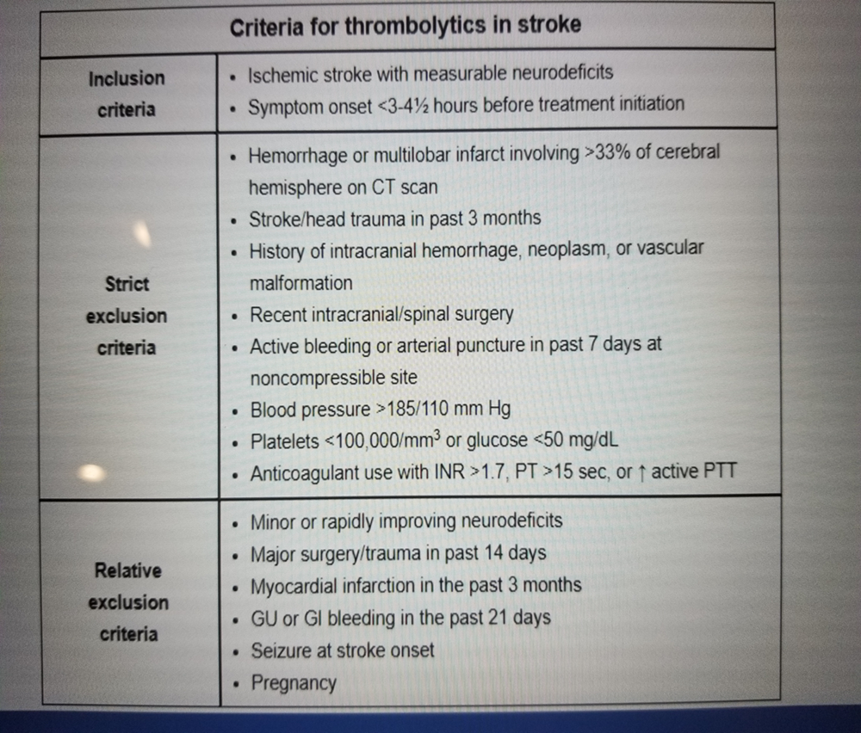
Remember!
No Aspirin 24 hours following IV TPA
BP should be kept </=185/110 prior to TPA to avoid risk of hemorrhage(Use Labetalol if the BP is high)

Slide 11
Evaluation of causes of stroke and their treatment
Echocardiogram:
- Damaged valves-repair
- Thrombi: Heparin followed by Warfarin (INR 2-3) or Rivaraoxaban/Dabigatran
- PFO
- EKG: Atrial fibrillation/flutter
- Holter: If initial EKG is normal

Slide 12
Contd..
Carotid Duplex ultrasound:
If symptomatic cerebrovascular disease +> 70% stenosis → surgical correction
<50% stenosis (mild disease)- no surgery
Moderate stenosis (moderate disease)-unclear if surgery is beneficial
100% stenosis- no intervention
- Endarterectomy is superior to carotid angioplasty

Slide 13
Control of risk factors for stroke
Diabetes to a HbA1C below 7%
Hypertension
Reduce LDL <70
Stop smoking

Slide 14
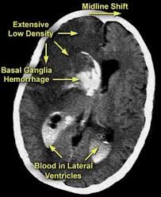
Complications post stroke
Hemorrhagic transformation:
Especially when stroke affects a large area or due to embolic stroke or treated with thrombolytics.
Typically <48 hours after the initial stroke
Manifests as deteriorating mental status.
Emergency CT brain w/o contrast is needed → may need urgent decompression

Slide 15
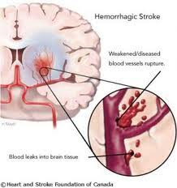
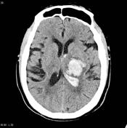
Hemorrhagic stroke
H/o uncontrolled HTN, coagulopathy, illicit drug use (cocaine, amphetamines)
Hypertensive vasculopathy involving small penetrating branches of major cerebral arteries → causes spontaneous deep intracerebral hemorrhage
Chronic hypertension leads to Charcot-Bouchard aneurysms→ that ruptures and causes the bleed
Quick progression (minutes to hours)
Focal neurological complaints appear early followed by symptoms of increased ICP
Most common locations: Basal ganglia(Putamen), cerebellar nuclei, thalamus, Pons
Brain CT confirms intracranial hemorrhage (highly sensitive)
Although MRI brain can detect hemorrhage, CT is preferred (because of ready availability, cost and quick results)

Slide 16
Contd..
Warfarin associated ICH:
- Supratherapeutic INR
Can be provoked by OTC cold medications (acetaminophen increases anticoagulation effect of warfarin and phenylephrine can increase BP)
Symptoms of elevated intracranial pressure (headache, altered mental status, nausea/vomiting) as the hemorrhage expands
Treatment: Immediately reverse the anticoagulation effect
IV Vitamin K- takes 12-24 hours to be effective (promotes Vitamin K dependent clotting factors)
Prothrombin complex concentrate- contains Vitamin K dep clotting factors→ rapid and short term reversal of Warfarin
FFP can be given if PCC is not available but it takes longer time to prepare and is a larger volume infusion

Slide 17
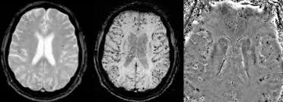
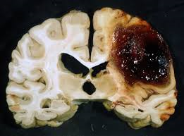
Other facts
Brain AVM is the most common cause of intraparenchymal hemorrhage in children
Cerebral amyloid angiopathy- most common cause of spontaneous lobar/ cortical (Occipital/ parietal) hemorrhage in elderly >60 yrs (as a consequence of beta amyloid deposits in the walls of small to medium sized cerebral arteries→ vessel wall weakening → rupture.
Similar kind of amyloid protein also seen in Alzheimer’s dementia

Slide 18
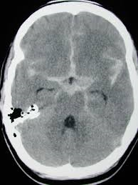
Subarachnoid hemorrhage
- More frequent in patients with
Bleeding from berry aneurysm or AVM
Severe headache at the onset
Neck stiffness due to meningeal irritation
Focal deficits -30%
Fever → secondary to blood irritating the meninges.
a) Polycystic kidney disease
b) Tobacco smoking
c) Hypertension
d) Hyperlipidemia
e) High alcohol consumption

Slide 19
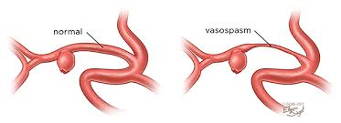
Complications of subarachnoid hemorrhage
Rebleeding (first 24 hours)
Vasospasm (after 3 days up to 10 days)→ due to arterial narrowing at the base of the brain→ can cause infarction → can cause delayed morbidity and death
Hydrocephalus/ Increased intracranial pressure
Seizures
Hyponatremia (usually from SIADH)

Slide 20
Diagnostic tests
Best initial test → CT without contrast
Most accurate test: Lumbar puncture showing blood Xanthrochromia (Yellow discoloration of CSF from the breakdown of RBCs)
LP is necessary only for 5% that have a falsely negative CT scan.
Ratio of WBCs to RBCs will be normal in CSF (1 WBC for every 500 to 1000 RBCs)
Angiography- to determine the site of aneurysm
CTA, MRA or standard angiography

Slide 21
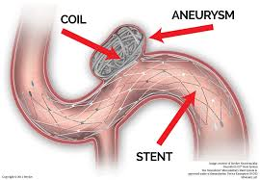
Treatment
Nimodipine (Calcium channel blocker) prevents subsequent ischemic stroke.
Hyperdynamic therapy to reduce vasospasm(hypertension, hypervolemia, and hemodilution to optimize cerebral perfusion)
Embolization (Coiling/stenting) → to clog up the site of bleeding to prevent repeated hemorrhage
Embolization is superior to clipping in terms of survival and complications.
VP shunt: Only if hydrocephalus develops.
Seizure prophylaxis: Phenytoin for seizure prophylaxis (still controversial)
50-70% of those who rebleed will die.
EKG: Large or inverted T waves suggestive of MI (cerebral T waves) from excessive sympathetic activity.

Slide 22
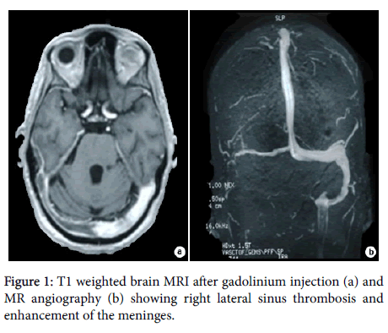
Cerebral venous thrombosis
Malignancy, Birth control pills, hypercoagulability
C/f: Headache, seizures, altered mental status and focal neurologic deficits.
MRI/ MRV or CT venogram

Slide 23


Slide 24
Multiple Sclerosis

Slide 25
Multiple Sclerosis
Autoimmune inflammatory demyelinating disorder of CNS that presents with neurologic deficits disseminated in space and time.
Onset: 15 to 50 years
C/F: Optic neuritis, INO, RAPD, Lhermitte sign, Uhthoff phenomenon, sensory (numbness and paresthesia), motor (paraparesis, spasticity), bowel bladder symptoms.
INO→MLF lesion→ inability to adduct on the side of lesion as a result the c/l eye abducts with nystagmus
Transverse myelitis: Motor and sensory loss below the level of lesion with bowel bladder involvement. Initially have flaccid paralysis (spinal shock) followed by spastic paralysis with hyperreflexia
Disease patterns: Relapsing remitting, Primary progressive, secondary progressive, Progressive relapsing

Slide 26
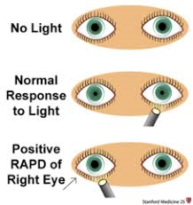
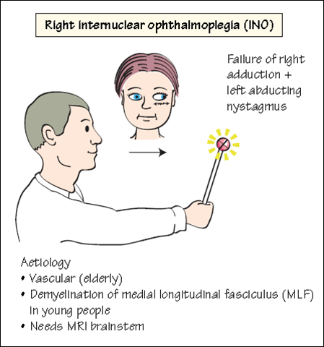
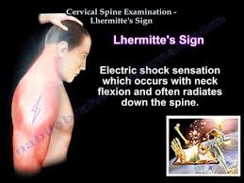

Slide 27
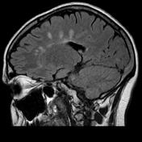
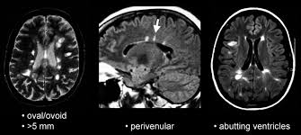
Diagnosis and Treatment
T2 MRI lesions disseminated in space and time (periventricular, juxtacortical, infratentorial, spinal cord)→ ovoid hyperintense white matter lesions.
CSF: Oligoclonal Ig G bands (85-95% of patients with MS) with normal cell count (lymphocyte predominance) and normal protein count (high IgG compared to other proteins)
Treatment:
Acute exacerbation: IV methylprednisone. If no response→ PLEX
Immunomodulators: Interferon beta, natalizumab, glatiramer

Slide 28

Optic neuritis
Epidemiology:
Young women
Immune mediated demyelination.
Associated with MS
C/F: Acute peak-2 weeks, monocular vision loss, eye pain with movement,
‘Washed-out’ color vision, RAPD, central scotoma
Fundus: usually normal as the inflammation occurs behind the optic nerve head
Diagnosis: MRI orbits and brain
Treatment: IV steroids.
35% recurrence

Slide 29
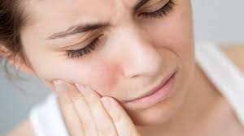
Trigeminal neuralgia in MS:
Bilateral
Demyelination of the CN V nucleus or its nerve root → improper nerve signal → paroxysms of severe pain

Slide 30
Headaches

Slide 31
Headache | Presentation | Treatment | Prophylaxis
Migraine | +/- aura, photophobia, phonophobia, nausea, vomiting (Pulsatile and throbbing) Often unilateral Female> male | Avoid triggers NSAIDs Triptans (5-HT1 agonists) | If > 3 attacks/ month Propranolol Verapamil TCAs, SSRIs, Topiramate, Botox
Tension headache | -Bilateral band-like pressure -Lasts 4-6 hours (30 minutes to 7 days) (Dull, tight, persistent) Female> male | NSAIDs Acetaminophen | Amitriptyline, Nortriptyline and CBT to learn stress reduction techniques
Cluster headache | -Episodic pain -Unilateral periorbital intense pain -Lacrimation, eye redness, nasal stuffiness, ptosis, miosis (Excruciating, sharp and steady) Male > female | 100% Oxygen Sumatriptan Octreotide Prednisone | Verapamil, Lithium Prednisone Sodium valproate

Slide 32
Other facts
Basilar migraine:
Cerebral vasospasm involving the brainstem
C/F: Basilar aura (vertigo, dysarthria, tinnitus and diplopia) followed by migraine headache
Hemiplegic migraine: Familial, can cause unilateral motor deficits
Cluster attacks: Typically last for about 90 minutes, occurs up to 8 times daily for 6-8 weeks followed by remission lasting up to a year

Slide 33
Trigeminal neuralgia
Recurrent, sudden onset severe pain involving V1, V2 and V3 branches of trigeminal nerve.
Rare to involve V1 and can cause i/l tearing, rhinorrhea
Lasts for few seconds to minutes
Triggered by minor stimuli (touch, wind, chewing)
Usually unilateral
MS→ can be bilateral
Herpes zoster: Viral reactivation → nerve inflammation → dermatomal vesicular rash.
Herpes zoster ophthalmicus → involves V1 nerve and can cause blindness.

Slide 34
Treatment
Carbamazepine, Oxcarbazepine
If unsuccessful nerve decompression/ radiosurgery
Side effects of carbamazepine: Nausea, vomiting, leukopenia, hyponatremia

Slide 35
Pseudotumor cerebri
Associated with obesity, venous sinus thrombosis, oral contraceptives, Tetracyclines, growth hormone and Vitamin A toxicity.
Features of increased ICP in an alert patient (Headache, transient vision loss , pulsatile tinnitus, diplopia)
Momentary vision loss that varies according to the change in head position
Exam: Papilledema with diplopia from sixth nerve palsy, peripheral visual field cut, enlargement of blind spot
Diagnosis:
CT or MRI to exclude intracranial mass lesion +/- MRV
LP to show increased pressure.(>250 mm water with normal analysis)

Slide 36
Treatment
Serial LPs or short term steroids (while awaiting surgery)
VP shunt, LP shunt
Optic nerve fenestration
Medications: Acetazolamide (carbonic anhydrase inhibitor that reduces CSF production), Lasix can be added
Weight loss
- Fundoscopy and routine eye exams required to prevent vision loss

Slide 37
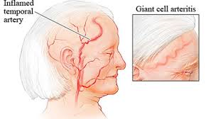
Giant cell arteritis
>50 years with new onset headaches localized to temples
Frequently associated with fever, weight loss, vision changes and jaw claudication (fatigue and pain when chewing)
Associated with polymyalgia rheumatica.

Slide 38
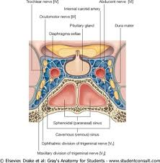
Cavernous sinus thrombosis
Infection of medial face, sinuses, teeth → spreads through valveless facial venous system → cavernous sinus thrombosis
C/F: headache, fever, periorbital edema, proptosis, vomiting, CN 3,4,6, 5(V1,V2) deficits. Fundoscopy may reveal papilledema.
Diagnosis: MRI/ MRV brain
Treatment: Broad spectrum IV antibiotics and prevention/ reversal of cerebral herniation

Slide 39

Warning signs in a patient with headache
Seizures, change in consciousness, specific deficits
Change in frequency, intensity or character of headache
New at age>40, sudden onset, trauma, early morning headaches
If so, consider early imaging

Slide 40


Slide 41
Neurology board review-2
Valentina Joseph MD,
Neurology Clerkship Director,
USD Sanford School of medicine.

Slide 42
Dementia

Slide 43
Delirium
Acute confusional state with reduced or fluctuating level of consciousness and inability to sustain attention. Reversible
Sleep wake disturbance ( sundowning)
MC in elderly with medical illness or conditions like PD, dementia, prior stroke
Often associated with anxiety, agitation, hallucinations
Precipitating factors:
Drugs: Narcotics, sedatives, antihistamines , relaxers , polypharmacy
Infections: Pneumonia, UTI, meningitis
Electrolyte disturbance (hyponatremia, hypercalcemia)
Metabolic derangements (volume depletion, Vitamin B12 deficiency, hyperglycemia)
Systemic illness (CHF, hepatic failure, malignancy)
CNS conditions (stroke, seizure, SDH, head injury)

Slide 44

Contd..
Treatment of choice for elderly is low dose Haloperidol
Atypical antipsychotics can also be used (Quetiapine, Risperidone)
Prolonged use can increase mortality in elderly
Benzodiazepines are contraindicated in older patients due to adverse events (withdrawal, dependence, motor impairment), may experience worsening agitation (paradoxical effect) because they metabolize slowly and hence can cause long lasting effects

Slide 45
Alzheimer’s disease
Progressive dementia
Risk factors: Old age, female sex, family history, head trauma , Down syndrome
Early stage:
Memory loss for recent events (anterograde amnesia-immediate recall affected and distant memory is preserved), language difficulties
Visuosaptial and executive problems (e.g getting lost in a familiar surroundings)
Late stage:
Neuropsychiatric (hallucinations, wandering, delusions, paranoia), apraxia, lack of insight, personality changes, impaired judgement

Slide 46
Contd..
Imaging: Early AD –MRI could be normal. Generalized cortical atrophy, reduced hippocampal volume, medial temporal lobe atrophy(temporal and parietal atrophy)
Other tests: VDRL/RPR, B12 and thyroid function test
Treatment:
Psychosocial intervention and pharmacological therapy
Cholinesterase inhibitors may improve quality of life and cognitive functions (e.g memory, thought, language, reasoning) but they do not alter the course of dementia
e.g: Donepezil, Rivastigmine, Galantamine for mild to moderate dementia
Memantine (NMDA receptor antagonist) for moderate to severe dementia
Selegiline- MAO inhibitor sometimes used in AD for antioxidant properties but evidence is weak.
Vitamin E → limited evidence for treatment of mild to moderate dementia.

Slide 47
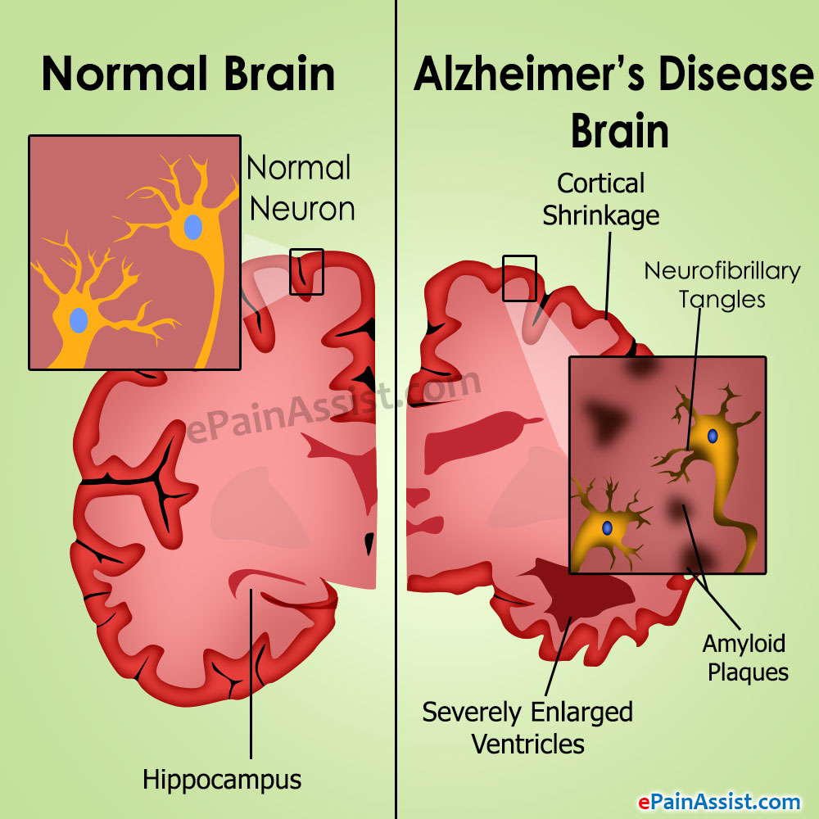
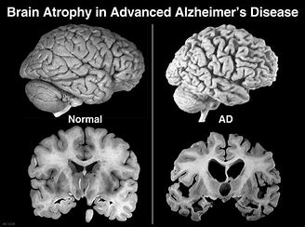

Slide 48
Lewy body dementia
Fluctuating cognitive impairment, bizarre visual hallucinations and Parkinsonism (if 2 positive-probable DLB, if 1 is positive- possible)
Symptoms worsened with neuroleptic drug (severe sensitivity to dopamine antagonists (first generation antipsychotics, Risperidone)
Deficits in attention , frontal-subcortical skills, visuospatial ability
Other supportive features:
Repeated falls
Syncope/ transient LOC
Autonomic dysfunction
Neuroleptic sensitivity
Systematized delusions
Sleep disturbance (RBD)

Slide 49
Huntington’s disease
AD neurodegenerative disorder
Typically present in 40s or 50s with chorea and/or behavioral disturbance
Chorea: Sudden jerky and irregular movements of the extremities.
Impaired judgement, executive function, awareness and attention (early stage)
Memory impairment (late finding)
Depression, irritability and social withdrawal
Atrophy of the caudate nucleus (enlargement of lateral ventricles)

Slide 50
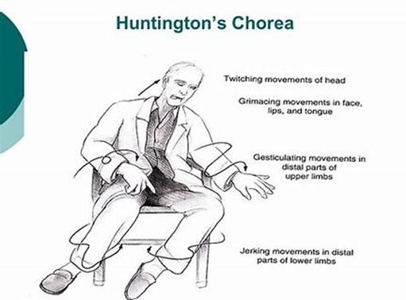

Slide 51
Contd..
Autopsy: Eosinophilic intracytoplasmic inclusions (alpha synuclein) in neurons of substantia nigra , locus coeruleus, dorsal raphe, substantia innominata
Treatment:
Parkinsonism: Carbidopa-levodopa
Dementia: acetylcholinesterase inhibitors
Psychotic features: low dose second generation antipsychotic (avoid first generation due to severe neuroleptic sensitivity)
Note: In patients with Parkinson’s disease with dementia, dementia appears much later in the course and also visual hallucinations are not that common unless they are on dopaminergic medications

Slide 52
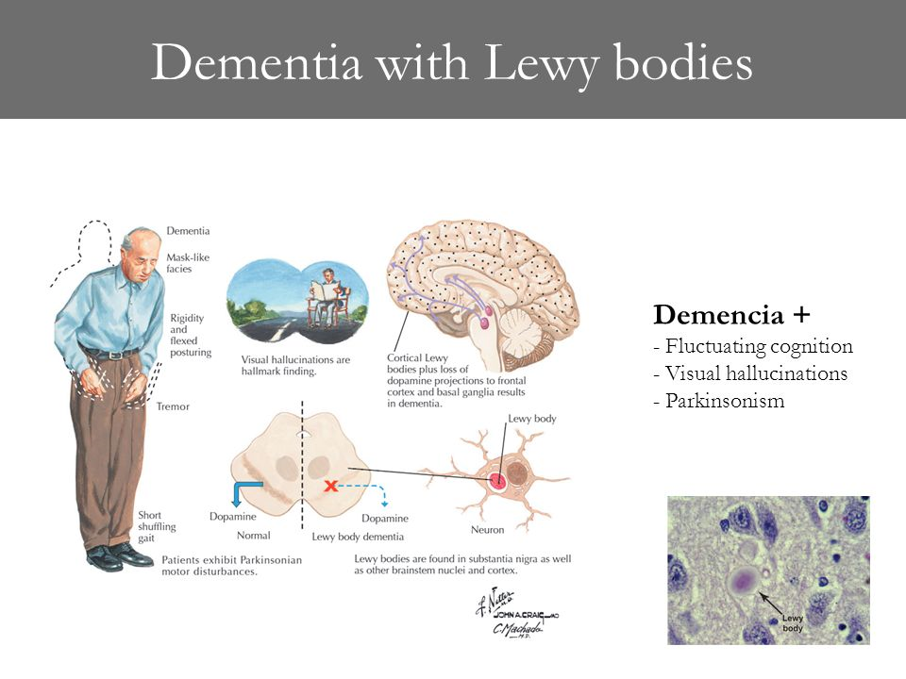
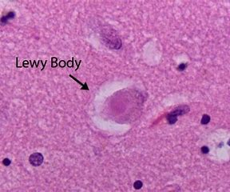

Slide 53
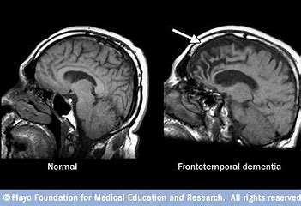
Frontotemporal dementia (Pick disease)
Earlier onset than AD (usually 50-60 years)
Early personality changes (e.g. disinhibition, apathy, euphoria)
Compulsive behaviors (e.g peculiar eating habits)
Hyperorality, frontotemporal atrophy (neuroimaging)
Behavioral changes precede memory impairment.
25% have family history
MRI: Atrophy of frontal and temporal lobes

Slide 54
Vascular dementia
15-20% of dementia cases
Cognitive decline with focal neurological symptoms (stepwise decline)
Deficits in executive function > memory impairment
Brain imaging: Multiple small cortical (large artery) and subcortical infarcts (small artery)
Risk factors: Older age, Male sex, Black race, smoking, HTN, diabetes, vasculitis.
Treatment is directed towards modifying the risk factors

Slide 55
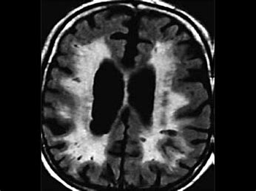

Slide 56
General paresis
Form of tertiary neurosyphilis
15-20% of late syphilis
C/F: Decreased concentration, memory loss, personality changes, dysarthria, tremors of fingers and lips, irritability, mild headaches
RPR may be non reactive but FTA-ABS will confirm the test.

Slide 57
Normal Pressure hydrocephalus
Triad of gait disturbance (magnetic gait/ gait apraxia, slow shuffling), dementia and urinary incontinence (but fecal incontinence can happen in advanced cases)
Symptoms arise due to distortion of brain matter adjacent to the ventricles.
CT or MRI shows dilated ventricles
CSF opening pressure is normal
If repeated spinal taps leads to improvement, then VP shunt can be considered

Slide 58
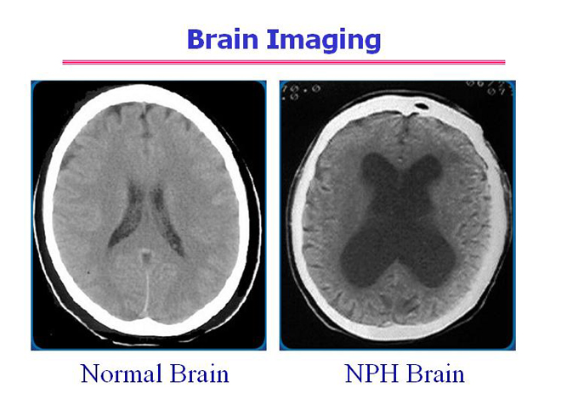

Slide 59
Prion disease
Behavioral changes
Rapid progression
Myoclonus and seizures
Probable diagnosis:
Rapidly progressive dementia
2 out of 4 clinical features (myoclonus, akinetic mutism, cerebellar or visual disturbance, pyramidal/ extrapyramidal dysfunction-hypokinesia)
Periodic sharp wave complexes on EEG and/or Positive 14-3-3 CSF assay
Definitive diagnosis : Above features + brain biopsy (gold standard) or demonstrated PRNP gene mutation

Slide 60
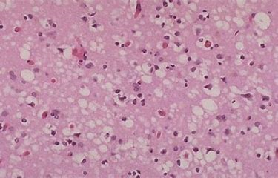
Contd..
Key features: Long incubation period, characteristic spongiform changes and lack of inflammatory response
Most cases are sporadic (85%) and remainder (hereditary or iatrogenic due to contaminated transplants or surgical instruments)
Most patients die within 1 year of onset of symptoms.

Slide 61
Depression related cognitive impairment
Features of major depression (anhedonia, poor appetite, fatigue, difficulty to focus, feeling of worthlessness) + memory impairment
Pseudodementia
On cognitive testing: Deficits in attention, concentration, memory and executive function
Poor effort/ difficulty completing the test
Patients are more concerned about their memory problems unlike other dementias where patients are brought by family members for clinical attention.
Treatment: Underlying depression management (e.g: SSRIs and psychotherapy)

Slide 62
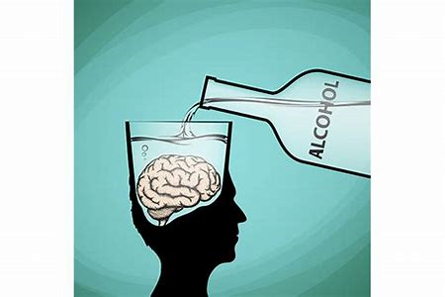
Korsakoff syndrome
Acute onset severe memory impairment seen in Thiamine deficiency
Common is alcoholics
Can occur concurrently with or following the Wernicke encephalopathy (ocular disturbances, alteration of consciousness and ataxia)

Slide 63
Spinal cord disorders and trauma

Slide 64
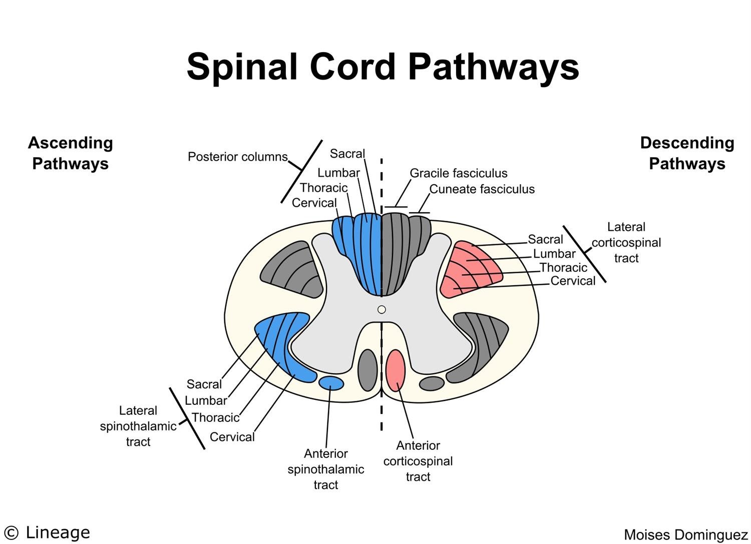
Spinal cord disorders

Slide 65
Anterior cord syndrome
Usually after injury to anterior spinal artery (e.g: disc retropulsion, fragments of bone from vertebral burst fracture) affecting anterior 2/3 rds of spinal cord.
C/F: 1) Bilateral hemiparesis (Lateral corticospinal tract, at the level of cord injury and below)
2) Diminished b/l pain and temperature sensation (lateral spinothalamic tract, 1-2 levels below the cord injury because LST decussates 1-2 levels before the corresponding level
3) Intact b/l proprioception and vibration, light touch (dorsal columns are supplied by posterior spinal arteries which are bilateral and reinforced by radicular segmental branches)

Slide 66
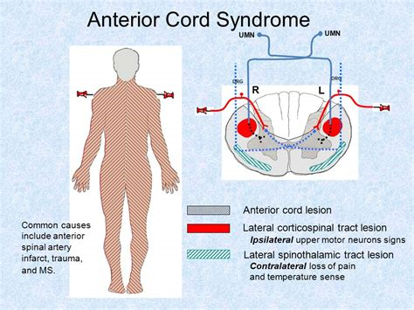

Slide 67
Central cord syndrome
Decreased sensation and motor functions in the arms with relative sparing of the legs after forced hyperextension (fall, whiplash)
Can be associated with bladder dysfunction
Seen in elderly with underlying cervical spondylotic myelopathy
Damages the central portion of corticospinal tract and decussating fibers of lateral spinothalamic tract
UE has more weakness than lower (arm fibers are closer to the center)
Dissociative anesthesia (selective loss of pain and temperature sensation in arms- cape like distribution)

Slide 68
Contd..
Syringomyelia: Fluid filled cavity in the cord that represents dilatation of central canal or a separaCervical or thoracic te cavity within the spinal parenchyma
but may involve brainstem (Syringobulbia)
Commonly associated with Arnold Chiari malformation type 1 but can also be due to inflammation, tumor, infection or trauma
As the cavity enlarges→ interruption of anterior gray matter →LMN signs of UE (areflexic weakness)

Slide 69
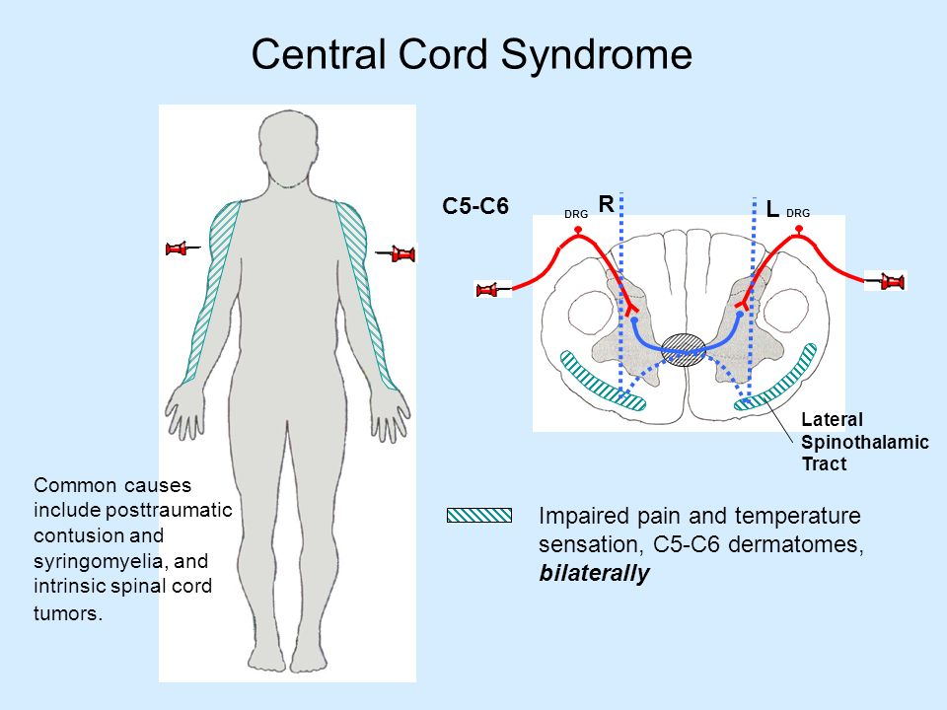

Slide 70
Posterior cord syndrome
B/L loss of position and vibration often with weakness, parasthesias , urinary incontinence or retention
MC causes are MS and vascular disruption (e.g Vertebral artery dissection)

Slide 71
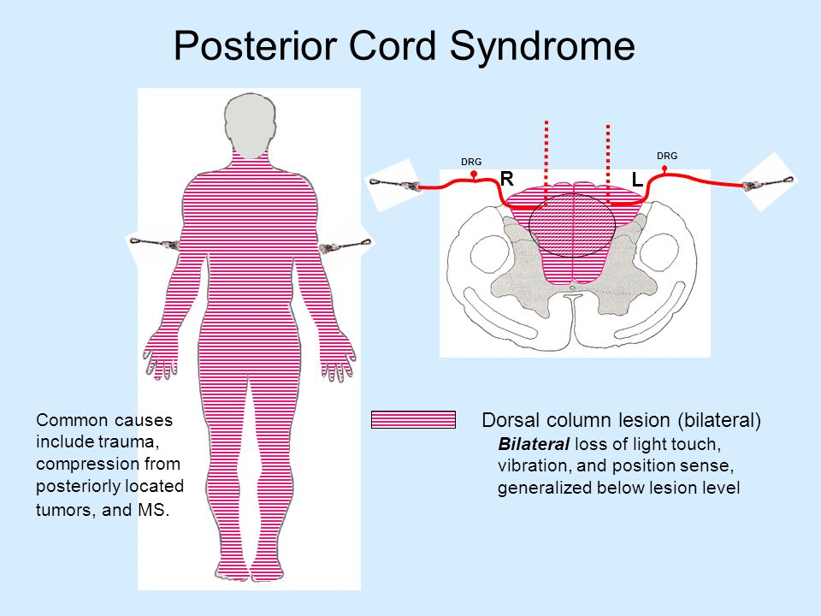

Slide 72
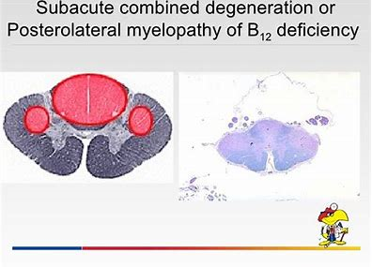
Subacute combined degeneration
Subacute combined degeneration can occur in Vitamin B12 deficiency (Impaired position and vibration + spastic muscle weakness)→ sensory ataxia

Slide 73
Cord hemisection
Mostly due to penetrating injury
Leads to Brown-Sequard syndrome
Ipsilateral: Weakness, spasticity, loss of position and vibration
Contralateral: Loss of pain and temperature

Slide 74
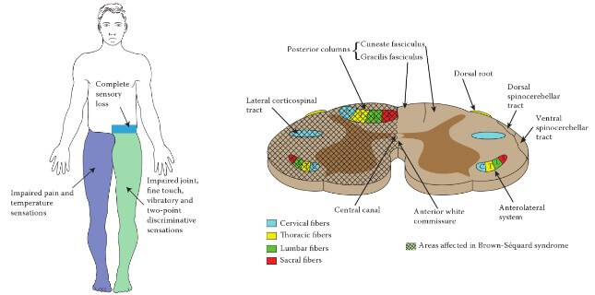

Slide 75
Lumbar spinal stenosis
Can cause low back and leg pain.
Narrowing spinal canal → compression of spinal nerve roots (neuropathic claudication)
MC cause is degenerative joint disease (disc herniation and facet osteophytes impinge upon the spinal cord)
Flexion of spine causes widening of spinal canal (improvement of symptoms like sitting and uphill walking)
Extension causes narrowing of spinal canal (therefore exacerbation of symptoms, standing and downhill walking)
Weakness, sensory loss, numbness/tingling and leg discomfort
Neuro exam can be normal and only 10% will have positive straight leg test
MRI is the study of choice.

Slide 76
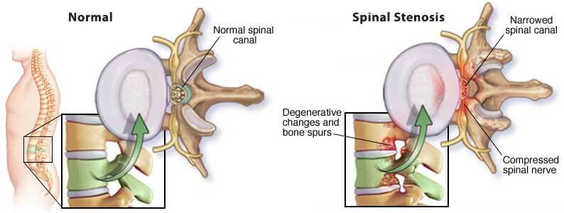

Slide 77
Spinal cord compression
Causes: Spinal injury (MVA), malignancy (lung, breast, prostate cancers, myeloma), infection (epidural abscess-IV drug abuser)
C/F:
Management: Emergency MRI, IV glucocorticoids, radiation oncology/neurosurgery consultation
Gradual worsening, severe local back pain
Pain worse in the recumbent position/ at night
Early signs: Symmetric LE weakness (Corticospinal tract), hypoactive/ absent DTRs
Late signs: B/L Babinski reflex, decreased rectal sphincter tone, urinary retention, flaccid bladder, bladder shock (autonomics in reticulospinal tract) paraparesis/paraplegia with increased DTRs, sensory loss (spinothalamic tract-sensory level is 2 spinal segments below the level of lesion)

Slide 78
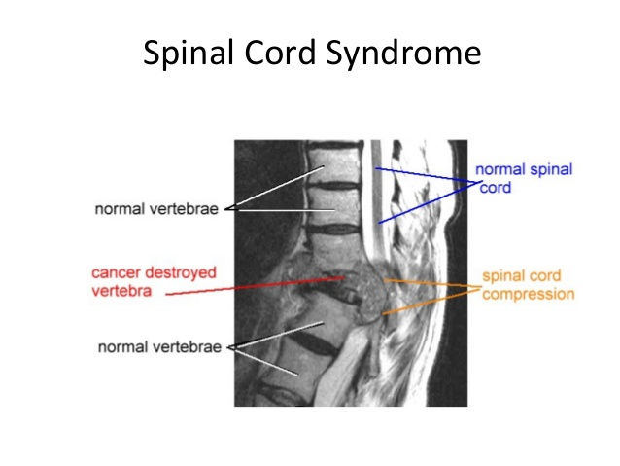

Slide 79
Cauda equina syndrome | Conus medullaris
Usually bilateral, severe radicular pain | Sudden onset severe back pain
Saddle hypo/anesthesia | Perianal hypo/anesthesia
Asymmetric motor weakness | Symmetric motor weakness
Hypo/areflexia | Hyperreflexia
Late onset bowel bladder dysfunction | Early onset bowel bladder dysfunction

Slide 80
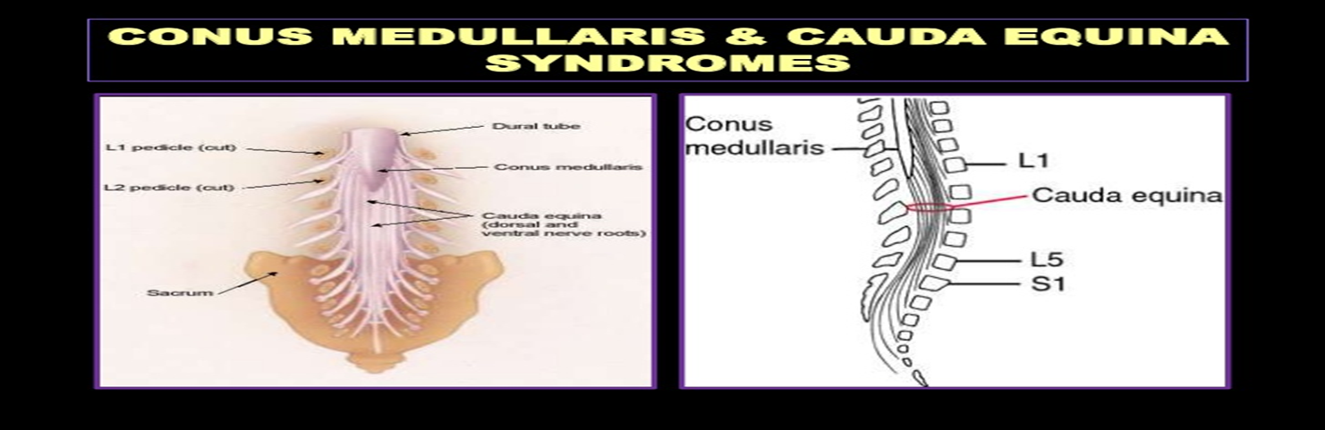

Slide 81
Subdural hematoma
Tearing of bridging veins → slow bleed into subdural space
Patients with cerebral atrophy (elderly and alcoholics) are at high risk because the bridging veins must traverse long distance → more susceptible to tears
Anticoagulants increase the risk of bleeding
C/F: gradual onset of symptoms (1-2 days after the initial injury), impaired consciousness, confusion and symptoms of intracranial hypertension (headaches, nausea , vomiting)
CT brain: Crescent shaped hyperdensity that crosses suture lines
Treatment: Conservative if small and surgical evacuation if large

Slide 82
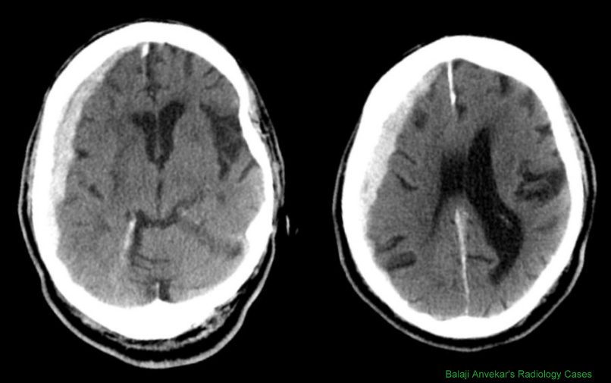

Slide 83
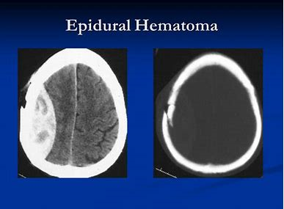
Epidural hematoma
Middle meningeal artery injury (from trauma to sphenoid bone)
CT brain: Biconvex hematoma

Slide 84
Diffuse axonal injury
Traumatic acceleration/ deceleration shearing forces that diffusely damages axons in the brain
C/F: Instantly lose consciousness (Coma) and then persistent vegetative state
CT brain: May show diffuse small bleeds at the grey-white matter junction but MRI is more sensitive

Slide 85
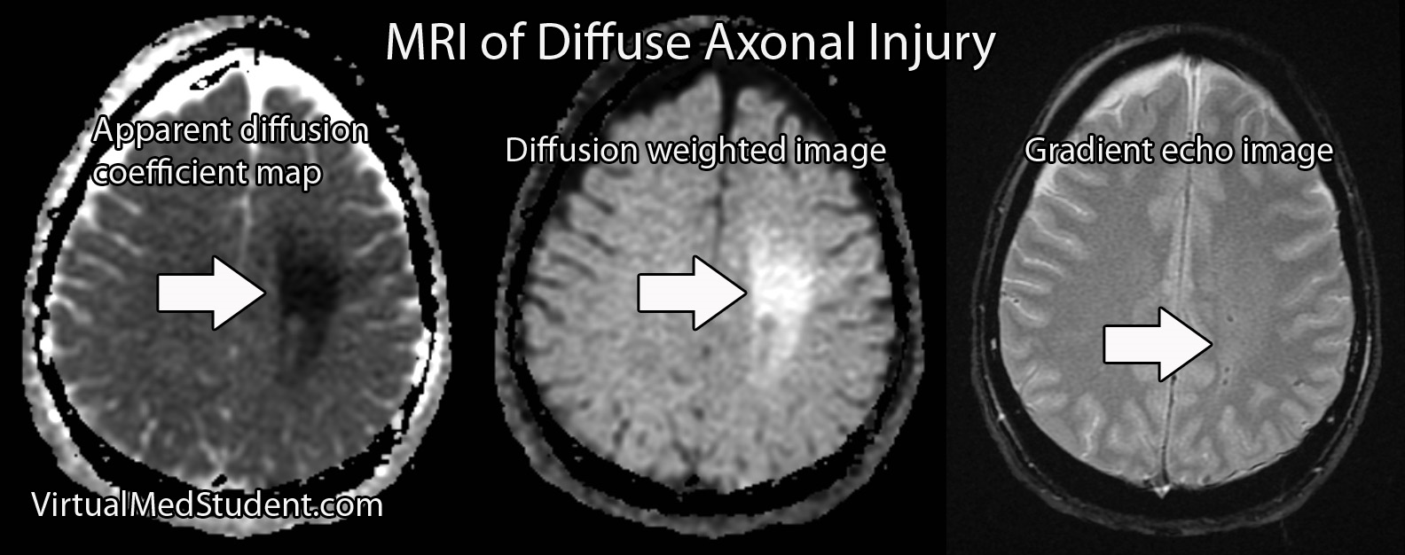

Slide 86
Post concussive syndrome
Headache, confusion, amnesia, difficulty concentrating or multitasking, vertigo, mood changes, sleep disturbance and anxiety
Usually follows a mild TBI
Symptoms resolve within few weeks to months following TBI
Some patients have persistent symptoms lasting > 6 months

Slide 87
Movement disorders

Slide 88
Parkinson’s disease
Resting tremor, bradykinesia, rigidity (lead pipe or cogwheel), postural instability (at least 2 signs –clinical diagnosis)
4-5 Hz rest tremor, asymmetric
Mask-like facies, decreased arm swing, stooped posture, micrographia, hypophonia
Degeneration of neurons of substantia nigra → decreased dopaminergic activity, increased cholinergic activity
Trihexyphenidyl : young patients with tremor predominance

Slide 89
Medications
Drug | Action | Side effects
Levodopa plus carbidopa | Dopamine precursor | Somnolence, confusion ,hallucinations , dyskinesia
Trihexyphenidyl or Benztropine | Anticholinergic | Dry mouth, blurry vision , constipation, urinary retention , nausea
Amantadine | Unclear mechanism | Ankle edema, livedo reticularis
Apomorphine, Bromocriptine, Pramipexole, Ropinirole | Dopamine agonist | Somnolence, hypotension, confusion Hallucinations (older pts)
Entacapone, Tolcapone | COMT inhibitor | Dyskinesia, hallucinations , confusion, nausea, orthostatic hypotension
Selegiline | MAO B inhibitor | Insomnia, confusion (elderly patients)

Slide 90
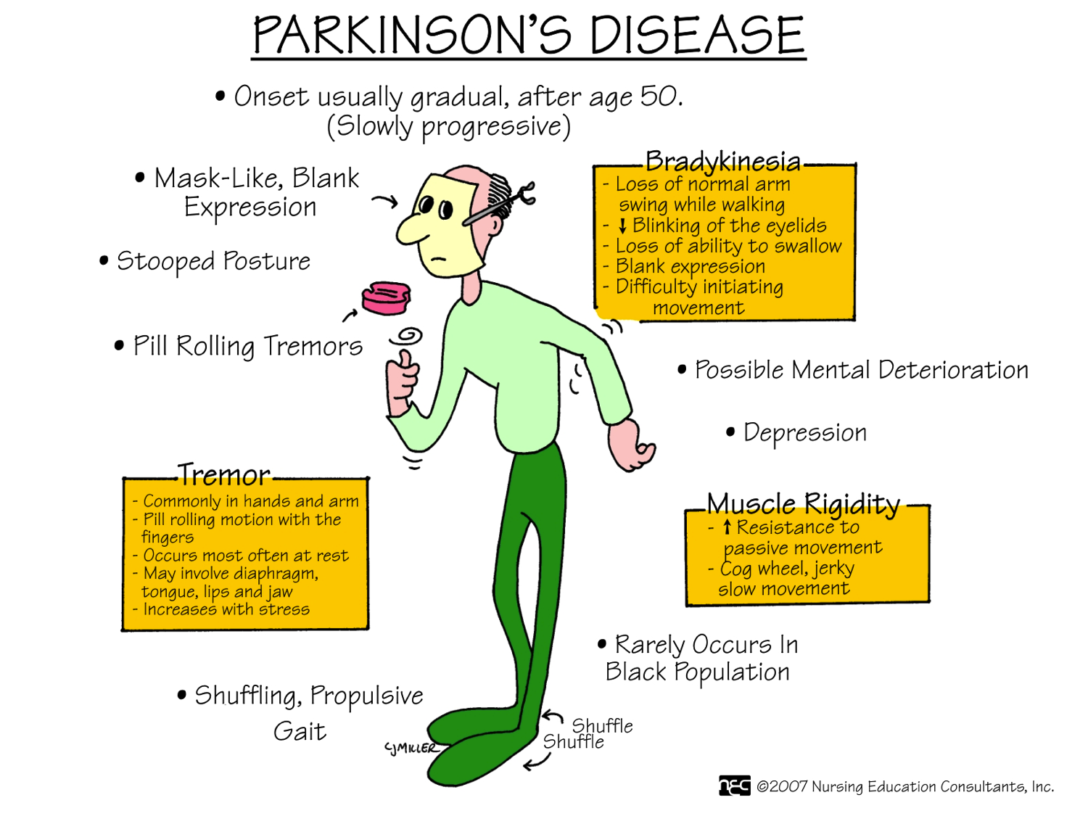

Slide 91
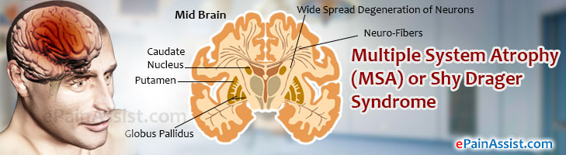
Multiple system atrophy
Shy Drager syndrome is a degenerative disease
C/F:
Parkinsonism
Autonomic dysfunction (postural hypotension, bladder bowel disturbance, impotence, abnormal salivation/lacrimation, gastroparesis)
Widespread neurological signs (cerebellar, pyramidal or lower motor neuron)
Bulbar symptoms and laryngeal stridor are fatal
Antiparkinsonian treatment are usually ineffective
Orthostatic hypotension: Intravascular volume expansion, Fludrocortisone, salt supplementation, alpha adrenergic agonists and constrictive garments to lower body

Slide 92
Tremor
Tremor | C/F
Essential tremor | Bilateral action tremor of hands without leg involvement Possible isolated head tremor without dystonia No other neurological signs Improves with alcohol
Parkinson’s disease | Rest tremor (4-6 Hz) that decreases with voluntary movement. Pill rolling quality. Usually involves legs and hands Facial involvement less common (jaw, face,tongue, lips) and not the whole head More pronounced with distractibility and re-emergence when movement is stopped
Cerebellar | Associated with ataxia, dysmetria or gait disorder Tremor increases steadily as the hand reaches its target
Physiologic | Low amplitude (10-12 Hz) not visible under normal conditions Acute onset with increased sympathetic activity (drugs , hyperthyroidism, anxiety, caffeine) Usually worse with movement and can involve face and extremities

Slide 93
Essential tremor
Intention tremor affecting the upper extremities, head, voice and other body parts
Resolves during sleep and improves with alcohol
Positive family history
5% of population
C/F:
Action and postural tremors
Bilateral
Hands> arms>head >>legs
Treatment: Propranolol, Primidone, Clonazepam

Slide 94
Chorea
Brief, irregular, unintentional muscular contractions.
Movements flow from one location to another but are not repetitive or rhythmic.
Huntington’s disease: Autosomal dominant, affects both sexes equally(30-50 yrs)
C/f: Mood disturbance(depression, apathy),dementia, choreiform movements (facial grimacing, ataxia, dystonia, tongue protrusion, writhing movements)
Progressive eventually disabling

Slide 95
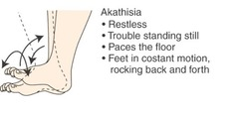
Akathisia
Sensation of restlessness that causes patients to move frequently

Slide 96
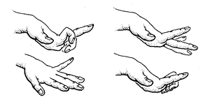
Athetosis
Slow, writhing movements that affect the hands and feet
Athetoid movements are a characteristic of Huntington disease
Chorea and athetosis can happen together

Slide 97
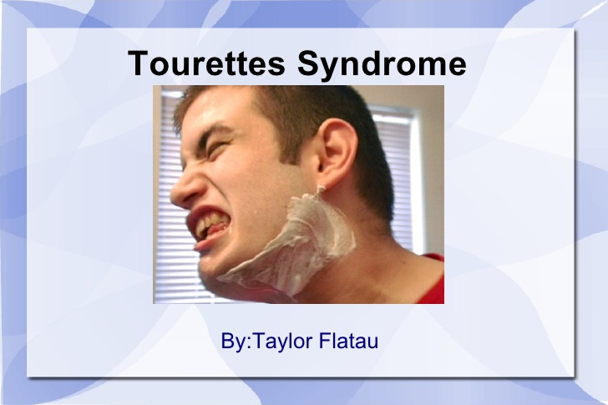
Tourette syndrome
Involuntary, stereotyped, repetitive movements and vocalizations called tics.
Common tics include shrugging, blinking, grimacing, coprolalia (swearing)

Slide 98
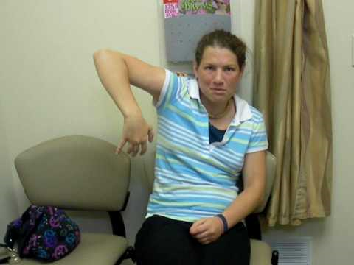
Hemiballismus
Unilateral, violent , arm flinging movements
Due to damage to contralateral subthalamic nucleus
Very disruptive but tends to be self limited

Slide 99

Myoclonus
Involuntary jerking of muscle or muscle group
Usually rhythmic or patterned (unlike chorea)
Usually initiated by contraction or relaxation

Slide 100

Wilson’s disease
Autosomal recessive
Abnormal copper deposition in tissues like liver, cornea, basal ganglia.
Children and young adults usually present with liver disease (asymptomatic aminotransferase elevation to fulminant hepatic failure)
Young adults →Neuropsychiatric disease (tremor, rigidity to depression, paranoia and catatonia)
Diagnosis: Low serum ceruloplasmin (<20 mg/dL) +increased copper excretion/ KF rings (Kayser-Fleischer → slit lamp exam)

Slide 101

Torticollis
Focal dystonia of sternocleidomastoid muscle.
Dystonia : Sustained muscle contraction resulting in twisting, repetitive movements or abnormal postures
Focal (affecting only one muscle) or diffuse.
Can be congenital, idiopathic, secondary to trauma, local inflammation, drug induced, medications (typical antipsychotics, metoclopramide and prochlorperazine)

Slide 102


