Slide 1
Your Future is Family Medicine
Information, facts, and answers to frequently asked questions about family medicine
Notes:
Before we get started there are four important points you should know about a career in family
medicine:
1. Family medicine is a satisfying career and an ideal specialty choice for students
who like getting to know their patients as much as they like getting to know their patients’
diagnoses.
2. It is intellectually stimulating and personally rewarding to care for families and individuals over
time – through various life stages and during routine and significant events. It forges a
patient/doctor relationship unlike any other specialty. And we know that this is exactly what
patients want.
3. Recent research confirms that family medicine has more impact on population and individual
health than other specialties and that family physicians are highly valued for their diagnostic and
patient advocacy skills.
4. Being able to follow patients throughout their entire lives helps to ensure that men, women
and children get the appropriate screening and preventive services well before they have
established disease.

Slide 2

Family Medicine: Do You Get It?

Slide 3
What are the primary care specialties?
Millions
Source: National Ambulatory Medical Care Survey 2010
http://www.cdc.gov/nchs/data/ahcd/namcs_summary/2010_namcs_web_tables.pdf
Notes:
To understand family medicine and the context in which family physicians view their patients, it
is instructive to understand the tenets and value of primary care to individual health and quality
of life.
The three primary care specialties recognized by the Institute of Medicine are family medicine,
general internal medicine and general pediatrics. Each requires three years of residency
training.
In 2010, 214 million office visits were made to family physicians, more than any
other specialty.
Family physicians provide more primary care than any other discipline in the United States; they
provide almost 40% of all primary care visits. Family physicians see and manage a wide
variety of problems, concerns and diagnoses and are often the first to hear and see the new
problem.
To keep up with patient demand for family physicians’ services and to ensure a good lifestyle,
family physicians are adopting new clinical and practice support strategies which will be
addressed in more detail later in this presentation.

Slide 4
What’s a typical week in primary care?
Source: National Ambulatory Medical Care Survey, 2009. Hyattsville, MD: National Center for Health Statistics. 2011.
Notes:
The family medicine office is where family physicians provide the majority of care to their
patients.
Their patients present with diverse medical problems that demand the broad medical and
psychosocial knowledge that family physicians possess.
Family physicians also deliver care in several other settings: hospitals, nursing homes,
community health centers, urgent care centers, emergency rooms, the homes of their patients,
managed care clinics, and university-based health centers to name a few.

Slide 5
Continuity of care
Source: National Ambulatory Medical Care Survey 2010 National Health Statistics Reports.
Notes:
Continuity of care is the process by which the patient and the physician are cooperatively involved in ongoing health care management toward the goal of high quality, cost-effective medical care.
Continuity of care is a hallmark and primary objective of family medicine and is consistent with quality patient care. The continuity of care inherent in family medicine helps family physicians gain their patients’ confidence and enables family physicians to be more effective patient advocates. It also facilitates the family physician's role as a cost-effective coordinator of the patient's health services by making early recognition of problems possible. Continuity of care is rooted in a long-term patient-physician partnership in which the physician knows the patient’s history from experience and can integrate new information and decisions from a whole-patient perspective efficiently without extensive investigation or record review.

Slide 6
Why is primary care important?
Better health outcomes, higher patient satisfaction, lower health care costs
  Fewer cases as deaths due to heart disease, lung disease, colon and cervical cancer, and more.
  Better detection of breast cancer
  Less ER and hospital use; better control of health care costs
  Better preventative care
  Continuity of care, whole-patient care
  Reduced health disparities
Notes:
Cancer prevention, behavior modification, and control of chronic diseases are some of the ways
in which primary care improves the health of individuals.
When we examine medical outcomes related to primary care we find:
U.S. adults and children who have a regular source of primary health care have better health
outcomes than those who don’t.
An increase in the proportion of physicians who practice primary care leads to earlier detection
of several types of cancer including cancer of the breasts, colon, cervix and skin.
Having a primary care physician reduces mortality due to cardiovascular and pulmonary
diseases.
States that have more primary care doctors have lower death rates.
Primary care decreases hospital admission rates and decreases emergency room utilization for
children and adults.
Countries that emphasize primary care have better population health [as measured by longevity,
infant mortality and patient satisfaction] at lower costs.
Researchers who have examined the potential impact of primary care on health care spending
in the United States estimate that the nation would save more than $67 billion dollars per year if every
American used primary care physicians as their usual source of care.
To put the cost/quality value of primary care into context:
U.S. health spending per person is twice the average of that in Britain, Canada, France,
Germany, and Italy -- countries that support and emphasize primary care and have better health
rankings.
In the United States, one-third of excessive costs is attributed to performance of unnecessary
and non-indicated procedures.

Slide 7
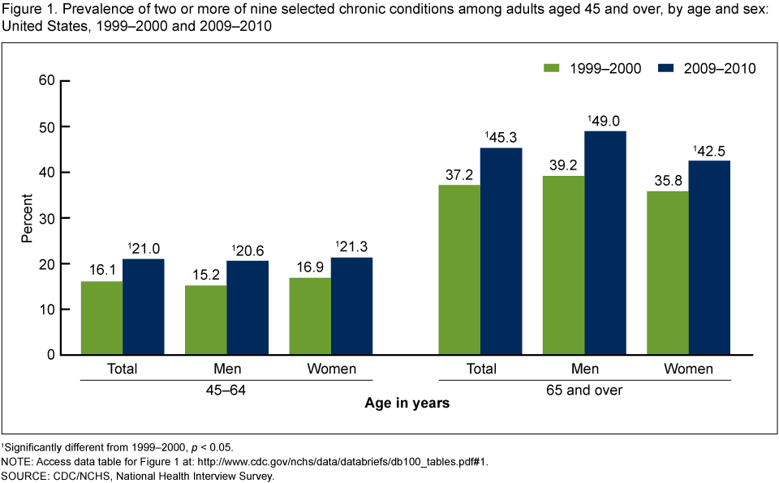
People rely on primary care physicians to care for complex diseases
Studies suggest that the presence of multiple chronic conditions adds a layer of complexity to disease management.
Notes:
Primary care physicians are the key source of health care for people with complex diseases and
provide ongoing care for most of the health care needs of these patients.
Recent research indicates that primary care physicians are better diagnosticians than their
subspecialty colleagues.
The ability to make an accurate diagnosis is a skill that makes family physicians, general
internists and general pediatricians the ideal first contact point for patients in a highly complex
health care system.

Slide 8
What do family physicians do?
Family physicians provide comprehensive and continuous primary health care to:
  Individuals and families
  Women and men regardless of age or disease
  Infants, children, and adolescents regardless of age or disease
Notes:
Family physicians care for people and families of all ages. Family physicians emphasize
wellness, disease prevention, and evidence-based medical interventions; they are always
aware of the psychological and social dimension of their patients’ lives.
Family physicians are important because they:
• Care for a wide variety of medical problems,
• Coordinate care with other health professionals,
• Prioritize from a broad agenda to meet their patients’ needs,
• Practice patient-centered medicine,
• Provide care to individuals within the context of family and community,
• Develop relationships over time and multiple patient visits,
• Perform a significant amount of patient education,
• Tailor messages about health habits to high-risk patients,
• Use illness visits as opportunities for prevention, and
• Use patient visits and opportunities to identify mental health problems.

Slide 9
Family physicians provide
Prevention and management of acute injuries and illnesses
Health promotion
Hospital care for acute medical illnesses
Chronic disease management
Maternity care
Well-child care and child development
Primary mental health care
Rehabilitation
Supportive and end-of-life care
Notes:
Family physicians recognize and manage complicated acute and chronic diagnoses including
diabetes, heart disease, hypertension, anxiety, depression, obesity and cancer. Helping patients
and their families prevent the onset of these complex diseases is an area in which family
physicians excel.
Sometimes, family physicians focus on the needs of very specific kinds of patients and have the
option of pursuing additional expertise and training through fellowships in areas such as
geriatrics, sports medicine, palliative care, preventive medicine, and international medicine, to
name a few.

Slide 10
Procedures performed by family physicians
Arterial lines
Audiometry
Casting
Central lines
Colonoscopy
Colposcopy/LEEP
EKG
Excisions of moles, nevi, cysts, warts, skin tags
Endoscopy
Intubation
Joint injections
Paracentesis
Pap smears
Pulmonary function testing
Punch biopsies
Skin biopsies
Spirometry
Suturing lacerations
Thoracentesis
Ultrasound imaging
Tympanometry
Vasectomy
Notes:
Family medicine is a great specialty for students who want to have long-term patient
relationships and still have the opportunity to perform a variety of hands-on procedures.
In addition to office-based procedural training, family physicians receive training in hospital-based
medicine, including critical care and obstetrical procedures, such as amniocentesis and
cesarean section. Family physicians have the flexibility to incorporate procedures into their
patient care as their skills and interests evolve and demand for those procedures change in the
community.

Slide 11
Performance of diagnostic procedures in family physicians’ offices
Diagnostic Procedures | % of family practices that perform
Dermatologic Procedures | 87.3%
Tympametry | 39.3%
Circumcision | 29.3%
Colposcopy | 29.2%
Holter Monitoring | 23.9%
Physical Therapy | 13.6%
Loop Electrosurgery (LEEP) | 10.6%
Nasopharynoscopy | 6.7%
Laryngoscopy | 6.6%
Botox | 4.6%
Source: American Academy of Family Physicians, Practice Profile II Survey, April 2011

Slide 12
What distinguishes family physicians from general internists?
Ages and gender of patients seen by family physicians and general internists
Source: National Center for Health Statistics. Health, United States, 2011.
Notes:
In a nutshell, family medicine is the most versatile of all physician specialties and the only
primary care specialty that provides comprehensive medical care to patients of both sexes and
all ages within the context of family and community.
Though there are several similarities between family medicine and other primary care
specialties, such as internal medicine, these graphics show that family physicians have an
unprecedented opportunity to have an impact on the health of an individual patient over that
person’s entire lifetime.
Being able to follow patients through key life stages helps the physician ensure that men,
women and children get the appropriate screening and preventive services long before they
have established disease.
Another key distinction between family physicians and internists is that the vast majority of
internal medicine residents don’t plan to work in a primary care setting.

Slide 13
Family medicine aims to:
Show the value and benefits of primary care
Ensure every person has a personal relationship with a family physician in the “medical home”
Reduce health care disparities
Lead evolution of the patient-centered medical home
Ensure a well-trained primary care workforce
Improve payment for primary care
Source: Family Medicine for America’s Health Organizational Update No. 8, September 2014

Slide 14
What attributes are valued in a family physician?
Deep understanding of the whole person
Act as a partner to patients over many years
Talent for humanizing health care
A command of complexity
Martin JC, Avant RF, Bowman MA, et al. The Future of Family Medicine: A collaborative project of the family medicine community. Ann Fam Med. 2004 Mar-Apri; 2 Suppl 1:53-32
Notes:
A national market research firm asked subspecialists what they valued most about
family physicians. Subspecialties said that family physicians are the best suited specialty to:
• act as a partner to patients
• know a patient’s long-term medical history
• provide preventive care
• care for patients with complex medical problems
People who become patients value their relationships with family physicians above all else.
The value of the patient-doctor relationships is especially emphasized in family medicine
training and it creates unique opportunities to make a difference in the lives of patients and their
families.
Include examples from your experience such as a time when a suspecialist depended on you to
track the patient’s clinical course, or a time when the patient relied on you to explain the
treatment and plan of the subspecialist.

Slide 15
Family physicians’ whole-person orientation and training ensures that family physicians…
Consider all of the influences on a person’s health
Know and understand peoples’ limitations, problems and personal beliefs when deciding on a treatment
Are appropriate and efficient in proposing therapies and interventions
Develop rewarding relationships with patients
Notes:
Family physicians are trained to go beyond the routine family medical history and to use tools
such as genograms to gain a better understanding of a patient’s situation. These tools and FPs'
orientation to the whole person help a family physician know how family patterns and
imbalances might affect illness management and reveal sources of support that may inhibit or
contribute to well being.
Family physicians integrate biomedical and psychosocial factors into every patient visit often
spending time with the patient discussing issues that may not have anything to do with their
current complaint.
Include examples from your experience such as a time when the patient’s chief complaint was
not the true reason for their visit and how you arrived at what was really on the patient’s mind,
how your ability to identify the true reason for the visit affected how much the patient trusted
you.

Slide 16
Family physicians have a unique influence on patients’ lives
Serving as partner with patients to maintain wellbeing over time
Empowering with information and guidance that are needed to maintain health over time
Providing care that includes long-term behavioral change interventions that lead to better health
Developing ongoing communication between patient and physician
Shepherding patients through the complex health care system
Notes:
Family physicians are oriented to their patients' long-term health goals as well as the short-term
interventions that their patients need.
Family physicians’ unique bond with their patients and their families help create opportunities to
monitor and tailor the care plans of their patients. For example, in a 15-minute illness visit that
you might observe between a family physician and a patient, you likely would see the family
physician casually visit with the patient at the beginning or end of the visit. Family physicians
are particularly adept at using information from these open-ended conversations, which may
appear to have limited medical value, to identify subtle signs of hidden disease, check the
health status of a family member, or evaluate the success of a long-term health intervention
suggested by the physician in a prior visit.
Include examples from your experience

Slide 17
Family physicians are relationship-oriented, which ensures…
Good relationships with other physicians and health care providers
Better patient understanding of complex medical issues and improved participation in the care process
Less expensive and better health care experience for patients
Notes:
A family physician’s ability to develop good relationships is key to ensuring the good health of
their patients. It may be one of the most effective tools that a family physician has. Family
physicians use technology to confirm what they have already learned from their relationship with
the patient.
Family medicine specific training is different from other primary care training models because it
emphasizes the value of continuity and physician-patient relationships. It does this by assigning
a panel of patients that the resident will follow through all three years of training.
Include examples from your experience. For example, identify a situation that showed how a
long standing relationship with a patient helped you to identify a hidden problem or how you
helped a patient navigate a frustrating experience in the health care system.

Slide 18
Family physicians have a natural command of complexity, and…
Thrive on managing complex medical problems
Integrate all of the medical and personal issues facing an individual
Break down medical terms and complex medical issues to make it easier for patients to understand
Notes:
Family physicians enjoy being the first point of contact for the undifferentiated patient.
They enjoy the challenge of making the right diagnosis from what seems like a series of
unrelated or vague symptoms.
Family physicians take pride in their ability to help patients understand the varied and subtle
ways in which an individual’s health affects the family and community.

Slide 19
How are family physicians trained?
3 years of residency; more than 450 U.S. family medicine residencies
Community-based
Medical school-based
Military
Inner-city
Urban
Suburban
Rural
Innovative Training Models
Notes:
Each of the three years of family medicine residency training incorporates a unique balance of
biological, clinical and behavioral knowledge that prepares graduates to be comfortable in the
role of first contact, primary physician for individuals and families.
More than 450 family medicine residency programs are available to students. They are in small
and large communities in every state and they offer great flexibility that accommodates lifestyle
interests, geography and family.
Many of these residencies also provide post-residency fellowship opportunities in areas such as
sports medicine, academic medicine, geriatrics, adolescent medicine, women’s health and
research to name a few.
In 2012, a four-year family medicine residency pilot project was launched to explore the effects an additional year of training in family medicine would have on clinical competency and on student interest in the specialty.

Slide 20
Family medicine residency clinical curriculum
Continuity Patient Care – all 3 years
  Adult medicine
  Maternity care
  General surgery
  Emergency care
  Skin care
  Women’s health
  Critical care medicine
  Gynecologic care
  Orthopedics
  Care of children
  Human behavior
  Newborn care
Notes:
The three-year family medicine residency curriculum is rigorous and ensures that family medicine residents gain a high level of competence in each of these areas. Most importantly, the family medicine residency curriculum is structured to ensure that residency graduates are very competent at leveraging relationships to diagnose and treat undetected disease from seemingly vague symptoms, disconnected events and unique family relationships.
Residents establish on-going relationships with a core group of patients and their families early during the first year of residency training and continue throughout all three years. Just as they would if they were in practice, family medicine residents follow their continuity patients in the family practice center, in the hospital, in the nursing home and in some cases with home visits.
Med-Peds comparison (optional)
Over the course of your training, other physicians may suggest that another route to “family medicine like training” is a combined medicine-pediatrics residency.
Those of you compelled to compare the two training programs side by side should know that there is limited published data on the outcomes and prospects of doing a combined internal medicine pediatrics residency program which makes it difficult to present a side by side comparison or to suggest that Med-Peds graduates are more or less effective in practice than family medicine graduates. (Outcomes of Combined Internal Medicine-Pediatrics Residency Programs: A Review of the Literature, Acad. Med. 2002; 77:247-256)
The best way for students to effectively explore the differences and similarities between the two training curricula is to look for several opportunities to shadow and precept with family physicians and practicing medicine-pediatric physicians in the community setting. You may even want to identify a multispecialty practice that employs family physicians and medicine-pediatrics trained physicians. Ask each how they were prepared for ambulatory-based family medicine and why it was right choice for them.

Slide 21
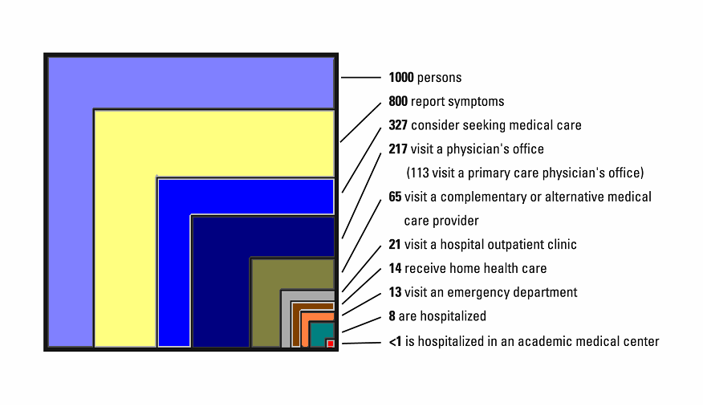
A typical month of health care in the United States
Source: New England Journal of Medicine 2001; 344:2021-25
Notes:
More women, men and children receive medical care each month in the office of primary care
physicians than any other professional setting.
In 2002, only 27 percent of American adults and 13 percent of American children saw a
subspecialist. More than 12 times as many people are seen in primary care physicians’ offices
as in hospitals.

Slide 22
Hospital practices of family physicians
66% have hospital admission privileges; additional 11% have consulting, courtesy, or visiting privileges
45% provide care in the ICU
40% provide care in the emergency department
59% provide newborn care; 30% attend newborn at C-section
37% provide care in the CCU
36% perform minor surgery; 21% assist in surgery
19.2% do routine OB
Source: American Academy of Family Physicians, Practice Profile I Survey, April 2011
Notes:
Hospital-based care is an important part of family physicians’ training and practice. A very
small percentage elect not to provide hospital-based care and do so to accommodate lifestyle
choices, mix of patients that they serve, or specific clinical interests.

Slide 23
Family physician’s lifestyle
Income for a family physician in 2012
  Median: $170,000 | Average: $190,907
Practice an average of 48.3 hours a week
Spend an average of 34 hours a week, or 70%, working directly with patients
Spend an average of 2.6 hours per week on non-patient-care duties
Source: American Academy of Family Physicians, 2013 Practice Profile Survey
Notes:
Like most physicians, family physicians work hard to balance their calling to help patients with a
desire to be available for their own families and other interests.
Family physician work hours depend a great deal on the choices the physician makes about
his/her practice. For family physicians, the practice setting, size and mix of patients are key
variables. Family physicians have the flexibility to tailor their clinical services to the unique
needs of their patients and situation. For example, nearly one-fourth of family physicians have
reported practicing part-time at some point in their careers to accommodate personal and
professional needs.
Family physician income is highly dependent on region, practice setting, and the number and
mix of patients. A family physician's flexibility to tailor clinical services can shape income. For
example, family physicians who see more patients and see patients in the hospital will have a
higher income. In the future, incomes for family physicians are projected to increase as much
as 25% in practices that use new technologies and new care models such as chronic disease
management.
Insert examples of shared call schedules and other ways family physicians balance personal
and professional responsibilities

Slide 24
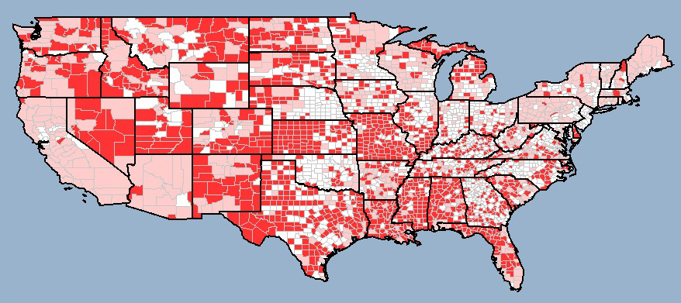
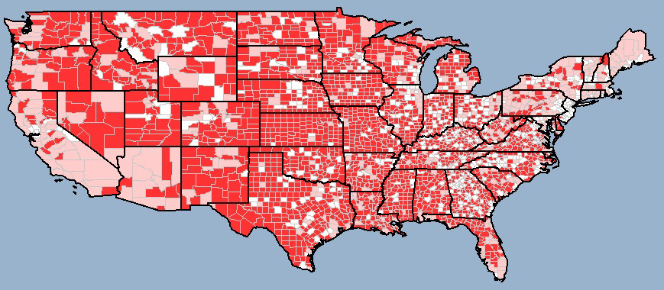
Primary Care Health Professional Shortage Areas
Primary Care Health Professional Shortage Areas (2006)
Primary Care Health Professional Shortage Areas, Family Physicians Removed (2006)
Source: Health Landscape Primary Care Atlas (healthlandscape.org)
Notes:
Family medicine training gives family physicians the flexibility to go where people need health
care and to adapt to different practice environments.
This whole-person training makes family physicians the ideal specialty to care for America's
most vulnerable and underserved communities.
This slide documents the impact family medicine has on America’s access to quality health
care. The red areas noted on the map on the left show the location of designated Primary Care
Health Personnel Shortage Areas at this time. Primary Care Health Personnel Shortage Areas
are designated by the federal government based on low physician to population ratios and/or
unique ethnic and socioeconomic status. The map on the right depicts the location and number
of shortage areas that would be designated if family physicians were removed.

Slide 25
Family physicians in demand
The most recruited specialty in 2013-14; at the top of the list for 8 straight years
“…demand for family physicians continues strong, exerting upward pressure on salary offers…”
Source: Merritt Hawkins 2014 Review of Physician and Advanced Practitioner Recruiting Incentives
Notes:
As you progress through your medical education, you’ll likely hear references to physician
workforce projections. To put this information into context of specialty choice, review the data
with a critical eye. Past physician workforce projections have proven to be flawed, mostly
because they depended on complex models that are not easy to predict. For example, at one time workforce experts predicted that by the year 2000 certain subspecialists
would not be able to find work.
Once again, organized medicine is studying the physician workforce needs of the nation and the
debate about the mix of subspecialists to primary care physicians is heating up. While there are
documented shortages in some medical specialties, it is clear that family physicians are and will
be in demand for the foreseeable future.
Current recruitment data show that family physicians are in demand in nearly every region of the
United States, particularly in underserved communities. Fifty-nine thousand more primary care physicians are needed by 2025 to meet the shortage and ensure health care access for all Americans.

Slide 26
Loan repayment options for family physicians
AAMC Database of Loan Repayment/Forgiveness and Scholarship Programs
AAFP Funding Resources for Practicing in Underserved Areas
National Health Service Corps
National Area Health Education Consortium (AHEC) Organization
Debt management resources
Notes:
Family physicians make enough money to pay off student loans and have the lifestyle they
want. More importantly, the demand for family physicians provides unique borrowing and loan
repayment options that other specialists may not be eligible to receive.
Loan repayment programs for family physicians are sponsored by national, state, and local
governments and some private organizations. Most contracts require a 2-4 year commitment.
Benefits may include tax relief, scholarship opportunities and service commitments.
There are several sources for this information but no one resource lists them all. The
Association of American Medical Colleges and your medical school’s financial aid office are the
best places to start.
The best thing you can do to manage your educational debt is to get organized, be informed
and get counsel at the beginning of each year of medical school to plan your budget and
consider all of the options available to you. Don’t let complexity of the loan process, personal
budget mismanagement and procrastination limit what you want to do with your career.

Slide 27
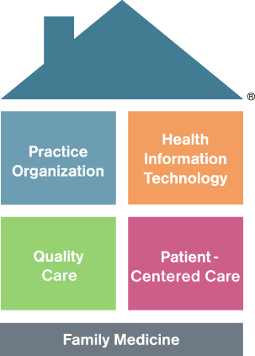
What is the future of family medicine?
Patient-centered medical home (PCMH)
  Population health
  E-visits and online appointments
  Web-based patient education
  Group visits
  Team approach to care; systematic approach to care
  Chronic disease management
  Joy in practice through innovation
Notes:
Family medicine has been successful at helping meet the health care needs of people --
particularly the needs of the underserved -- for more than 35 years. Yet, the specialty is not
resting on its past success and is actively engaged in innovations to better care for people while
making a career in family medicine even more rewarding.
Many of the new innovations include technology to better accommodate patients and support
the clinical and practice needs of family physicians. These innovations are based around a patient-centered medical home model.
Family practices and family medicine training programs are implementing electronic health
records with increasing frequency. EHRs will permit family physicians and other clinicians to
have -- in hand, at the time of the visit -- all the information known about a patient: lab results,
imaging reports, correspondence from consultants, medications lists, refill histories and all the
chart notes. The focus of the visit can then be on caring for the patient rather than collecting
missing patient information.
EHRs also can be used to support clinical decision tools and to collect information that can help
measure clinical outcomes. Clinical decision support tools include drug interaction warnings
and clinical guidelines. Family medicine is one of the leading advocates for this technology and
is helping family physicians and other primary care practices to test, finance and implement this
technology.
Also, family physicians are increasingly integrating email and Web-based technologies to
improve physicians-patients’ communication. Analysts project that using these technologies will
help patients avert unneeded visits and allow the physician to spend more time with patients
when they do need an office appointment. They also project that these technologies will help
patient’s get access to reliable information about their health conditions and the latest
developments in treatments.

Slide 28

Remember why you chose medicine

Slide 29
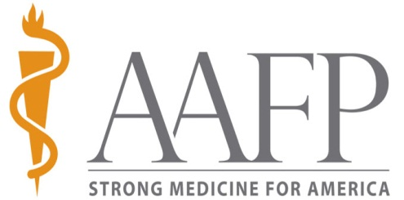
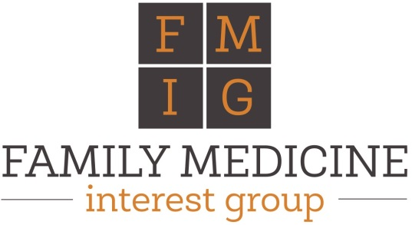
Family medicine and student interest on the Web
AAFP website: aafp.org
FMIG Network website: aafp.org/fmig
FMIG Network
  Facebook.com/fmignetwork
  Twitter.com/aafp_fmig
  Twitter.com/fammedstudents
  Youtube: search “FMIG Network”
AAFP
  Facebook.com/familymed
  Twitter.com/aafp
  Youtube.com/aafpmedia
  Leader voices blog: aafp.org/leadervoices

Slide 30
Want to learn more about family medicine?
Contact your:
  Family medicine department
  Family medicine clerkship director
  Your school’s FMIG
  National FMIG Network website at aafp.org/fmig
  AAFP state or constituent chapter

