Slide 1

Career advising and Planning
Introduction – session #1
Suzy reuter md

Slide 2
AN important (and fun, satisfying) decision that often occurs in Pillar 2?

Slide 3

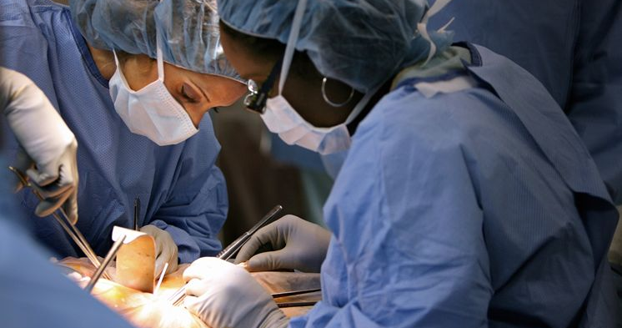

Slide 4


Slide 5
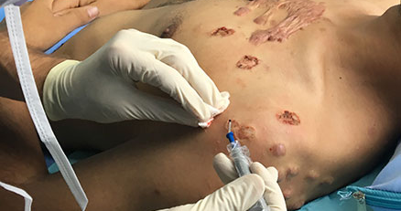

Slide 6
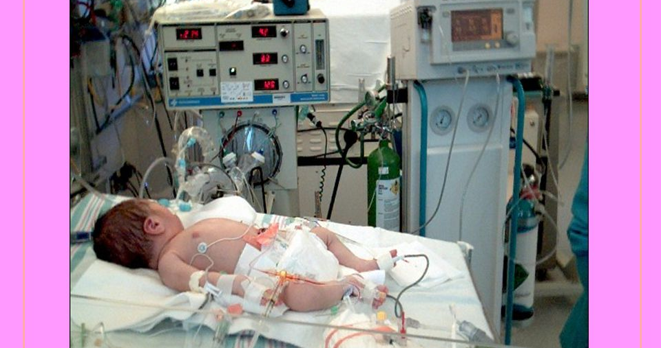

Slide 7
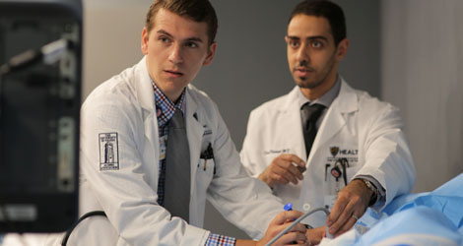

Slide 8
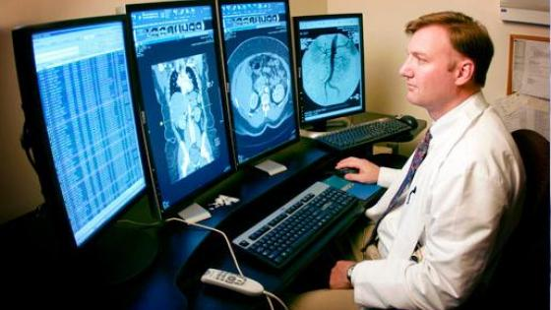

Slide 9
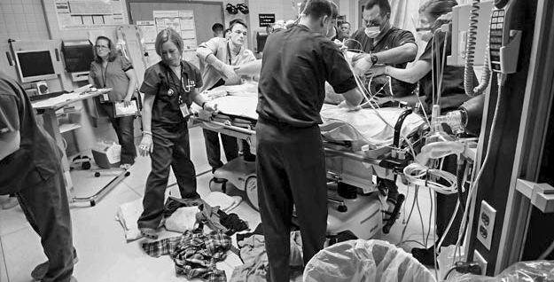

Slide 10
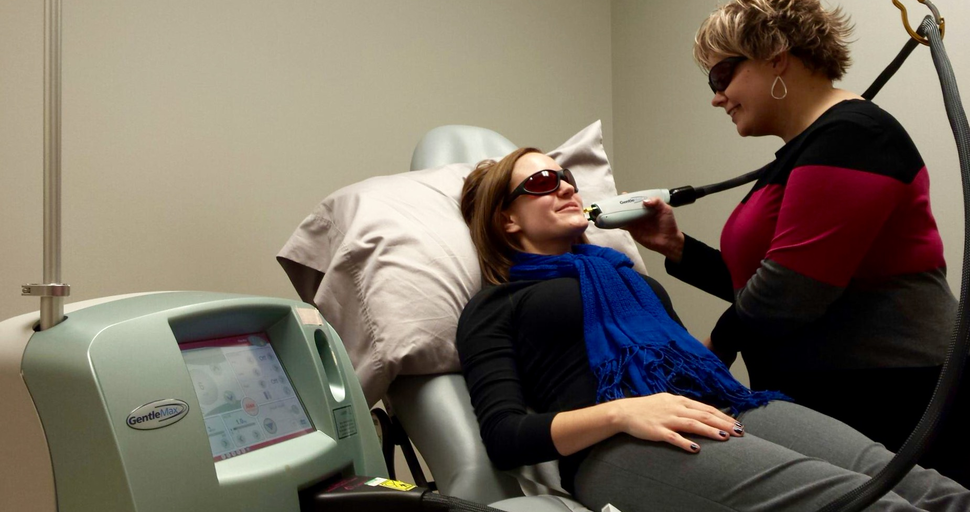

Slide 11
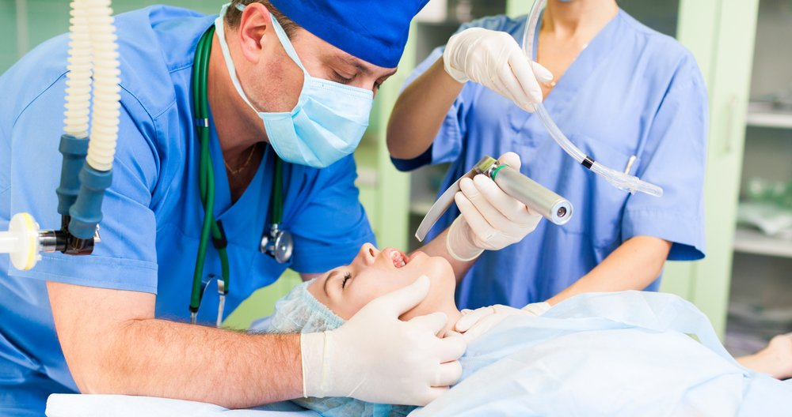

Slide 12
Ssom career advising microsite link on D2L
https://rise.articulate.com/share/CB6iHRHQnIHR5PRUQva1ZKoFcCJVUyId

Slide 13
Objectives:
Expand on career counseling that started in Pillar 1 (noon presentations)
Guide students how to choose a specialty in medical school
Provide ways for you to learn more about yourself and best fits for you in a career
Present statistics as they relate to the most recent match and specific specialties
  This information may change from year to year

Slide 14
Trends in healthcare
GME not keeping pace with the retirement of physicians
  Due to aging physician population
  Due to dissatisfaction with changes in medicine (EMR, etc)
Increase in use of mid-levels
  Nurse practitioners
  Physician Assistants
  In part due to Duty-hour restrictions

Slide 15
Trends in healthcare – what does this mean to you?
Few specialties that don’t have mid-levels as part of their care team
  Pediatric ICU
  Radiology
  Radiation oncology

Slide 16


Slide 17
Trends in healthcare
Inpatient versus outpatient
  Most providers that work in a city (>50,000) do one or the other
  Hospitalists
  Clinic physicians
  Exception: rural areas

Slide 18

Trends in healthcare – alternative medicine
Herbs
Over-the-counter medications
Medications from other countries
Massage therapists
Chiropractors
Google.com
What is your role as a physician??

Slide 19
Key distinctions in medical practice
Sick patients vs healthy patients
Procedures vs diagnostics
Scheduled hours vs more flexible hours
Patient-centered vs colleague-centered
Academic-based vs community-based
All ages/both genders vs specific ages/one gender
Primary care vs specialty care
Continuity of care vs brief encounter
Hospital-based vs clinic-based
Rural – city – urban
Variety vs uniformity
In-house call vs out-of-house call

Slide 20
Approach to the clinical years
Try to develop an interest in all areas (try, I say…)
Categorize what ‘draws you towards’ a specialty vs what ‘drives you away’
Be aggressive in seeking clinical experience opportunities, when possible ☺

Slide 21
Pillar 3 registration in October
May start to ‘specialize’ in the area that most interests you
In preparation for residency application and the match

Slide 22

Food for thought…
What am I excited about?
Do I like staying up all night/part of a night, if it means I am on a certain service (ob, surgery)?
When I am called emergently to a particular service, am I thrilled or do I curse?
Do I like the lifestyle this specialty provides?

Slide 23
No specialty chosen at end of pillar 2?
Do not fret!
More time for personal insight in pillar 3 (no hqip, no ethics, etc.)
Take 2-4 week rotations where you can experience the specialty as a Pillar 3 student
  Do you miss other areas of medicine?
  Can you envision spending your life in this one specialty?
  You have time to decide!
  This is the beauty of a 16-month long pillar 3!

Slide 24
Helpful websites in career planning
Careers in Medicine: www.aamc.org/cim/profile
  Self-assessments
  Specialty-specific information
  Information on interviewing, CVs, personal statements
www.ama-assn.org/life-career/search-ama-residency-fellowship-database
  contact information and general program information
  number and timing of interviews
  length of programs, work schedules, program policies
  can be sorted by specialty, region, or state

Slide 25

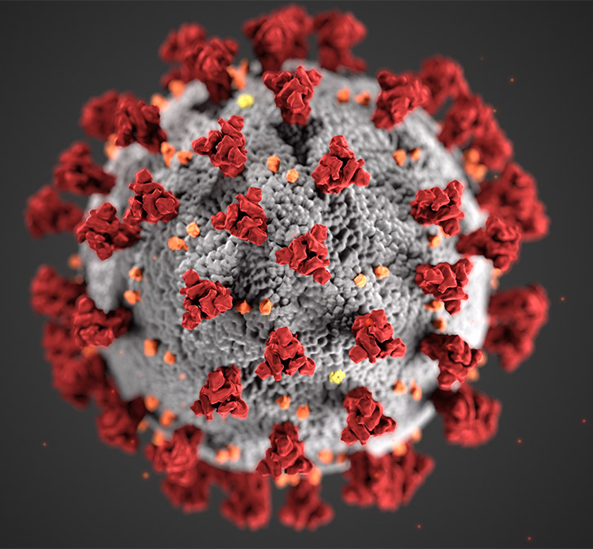
2021 Residency Match

Slide 26
2021 match data – nrmp.org
19, 866 US MD Seniors (+ 540)
5, 165 US-Internationals (- 2)
6, 940 Osteopathic (+939 in 2 years)
7, 943 Non-US Internationals (+1036)
42,508 (48, 700) total applicants for 38,106 slots
  (applicants up 2,424 from 2020)
  (residency positions up 928 from 2020)
Notes:
48,700 – 2300 students who withdrew from the match and 3889 with no rank list

Slide 27
2021 match data: overall match rates
US MD Seniors = 93.7% to 92.8 in 2021 (Couples Match 95.6% to 93.4%)
Osteopathic = 90.7% to 89.1 in 2021
US International = 61% to 54.8% in 2021
Non-US International = 61.1% to 54.8 in 2021
Previous Grads – US Seniors = 45.6% to 48.2 in 2021

Slide 28
Match 2021
Dermatology – Highly competitive (as in years past)
Anesthesiology, EM – highly competitive this year
ob/gyn, neurosurgery, vascular surgery, ophthalmology, urology, ortho, ent, general surgery – Highly competitive
Radiation oncology – Not competitive this year
Radiology, psychiatry – Fairly competitive
Primary care – fm, peds, im, transitional year, neurology, pathology – less competitive but more so in 2021 than years past

Slide 29

Recommendations for YOUR match
Publications
  Case reports
  Original research
  Hqip submitted for publication?
Service Experience
Leadership
Activities that make you stand out on the application (in a positive light)

Slide 30

Overview of pillar 2 – career planning viewpoint
Career planning and advising #1 – spring 2021
Career fair – Monday of cultural colloquium week
Career planning and advising #2 – fall 2021
Career planning and advising #3 – OSCE Week in February
Career planning and advising #4 – after 2022 Match Week

Slide 31
Overview of pillar 2 – career planning viewpoint
Individual self-assessments on careers in medicine (may take more than one time)
Use white space wisely to learn more about various specialties
  Use student affairs and/or campus dean to make contact with certain specialties
Talk to the class of 2022
  Feedback on why they chose the specialty they did
  What turned them off about a particular area of medicine
  Who mentored them in their particular specialty?
    This is huge!!!

Slide 32

Overview of pillar 2 – career planning viewpoint
Participate in interest groups
Query your attendings (if time allows) during call or clinic
Query your residents as to the perks of the specialty
Seek insight to those who know you well
Individual career advising/planning session Oct-January 2022

Slide 33


Slide 34
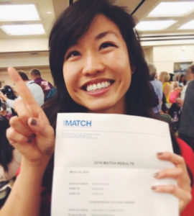
Overview of pillar 3 career planning viewpoint
May–July
“Dean’s Letter” Interview (MSPE)
June–September
Register/Complete Applications
September
Submit Applications
September
MSPE Release date (Nationwide)
October - February
Interviews
February
Rank Order Listing due
March
Match Week

Slide 35
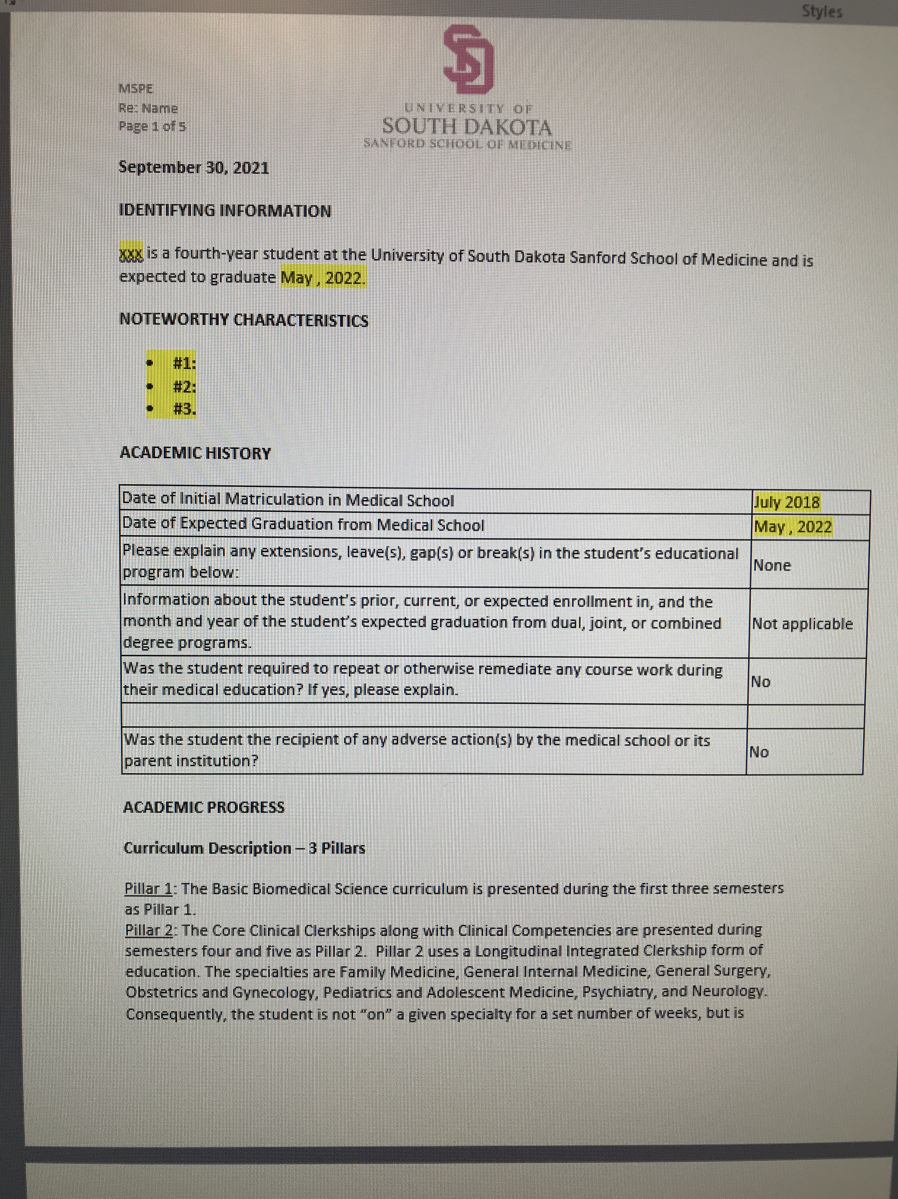
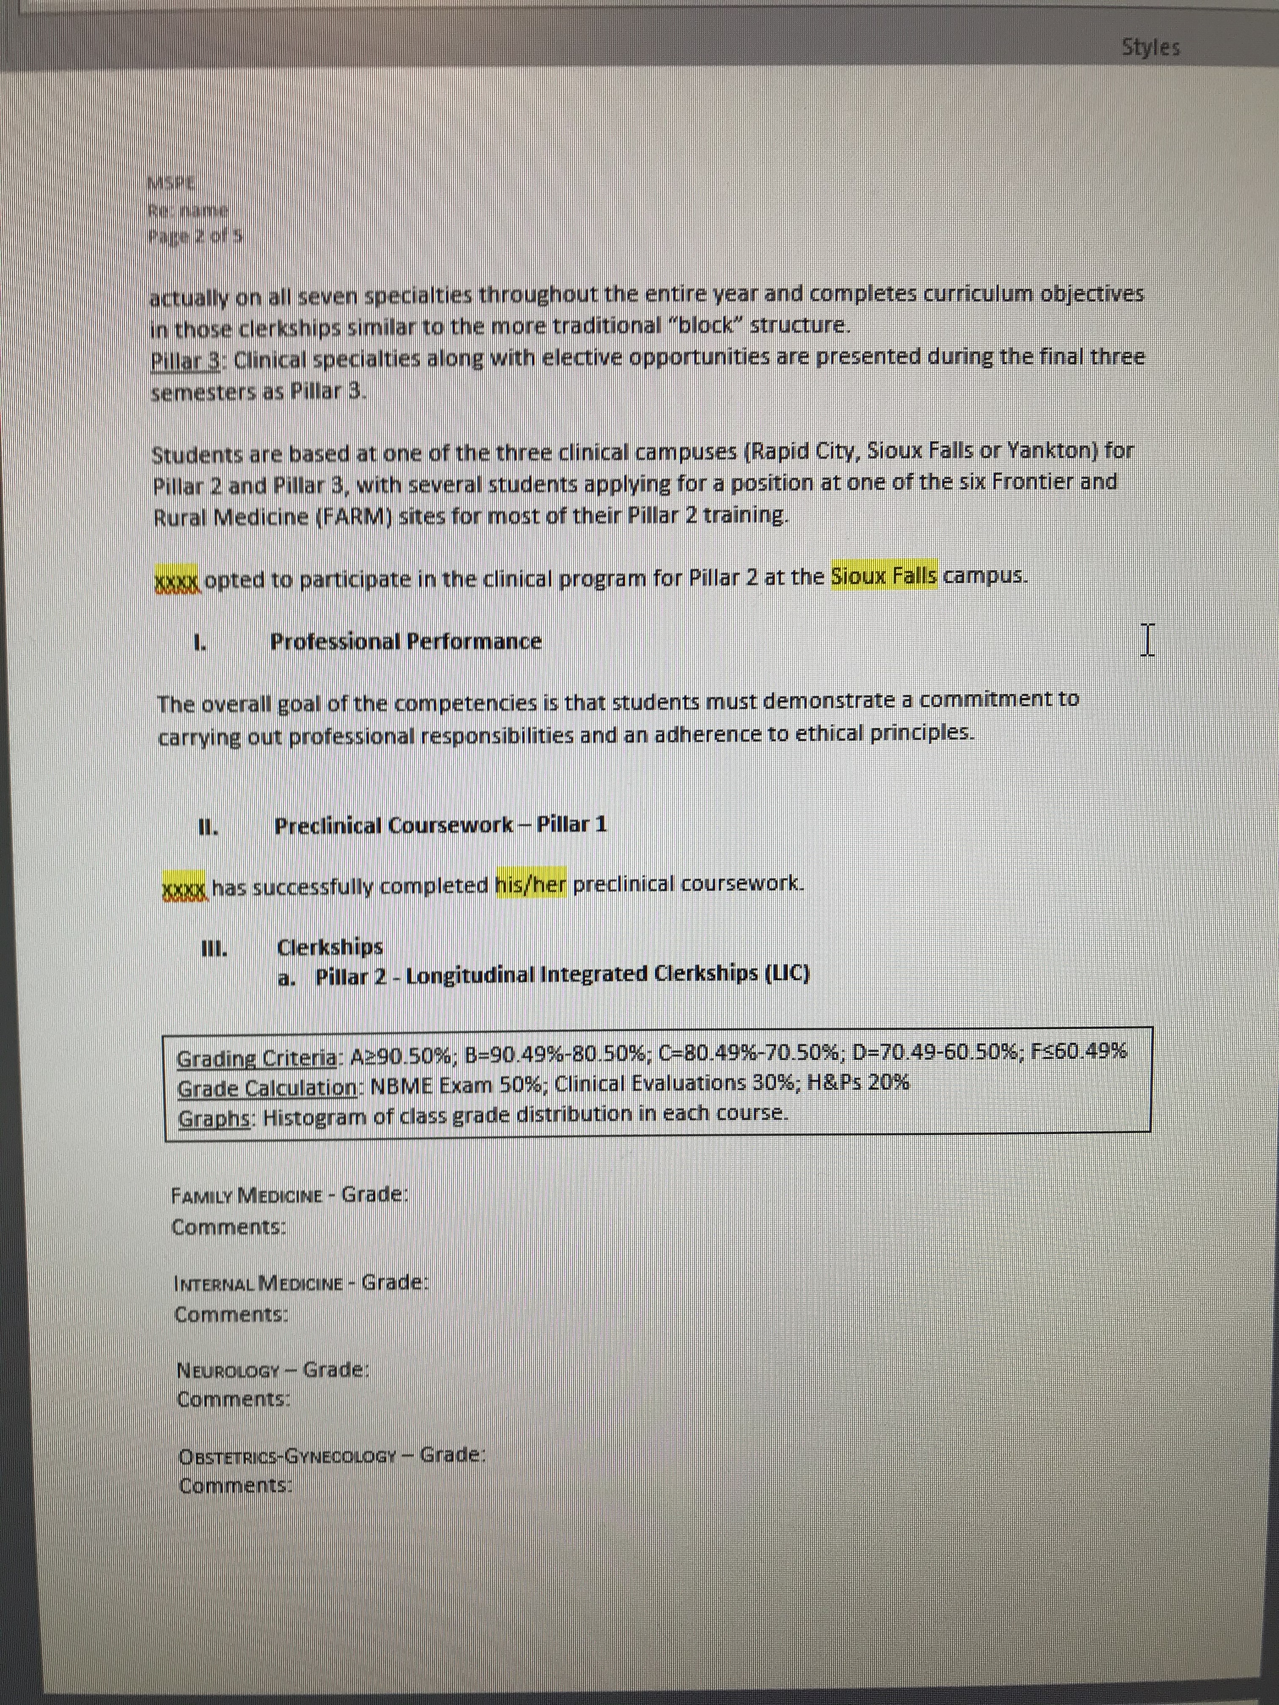
Notes:
3 noteworthy characteristics
Comments from attendings on your P2 eval

Slide 36
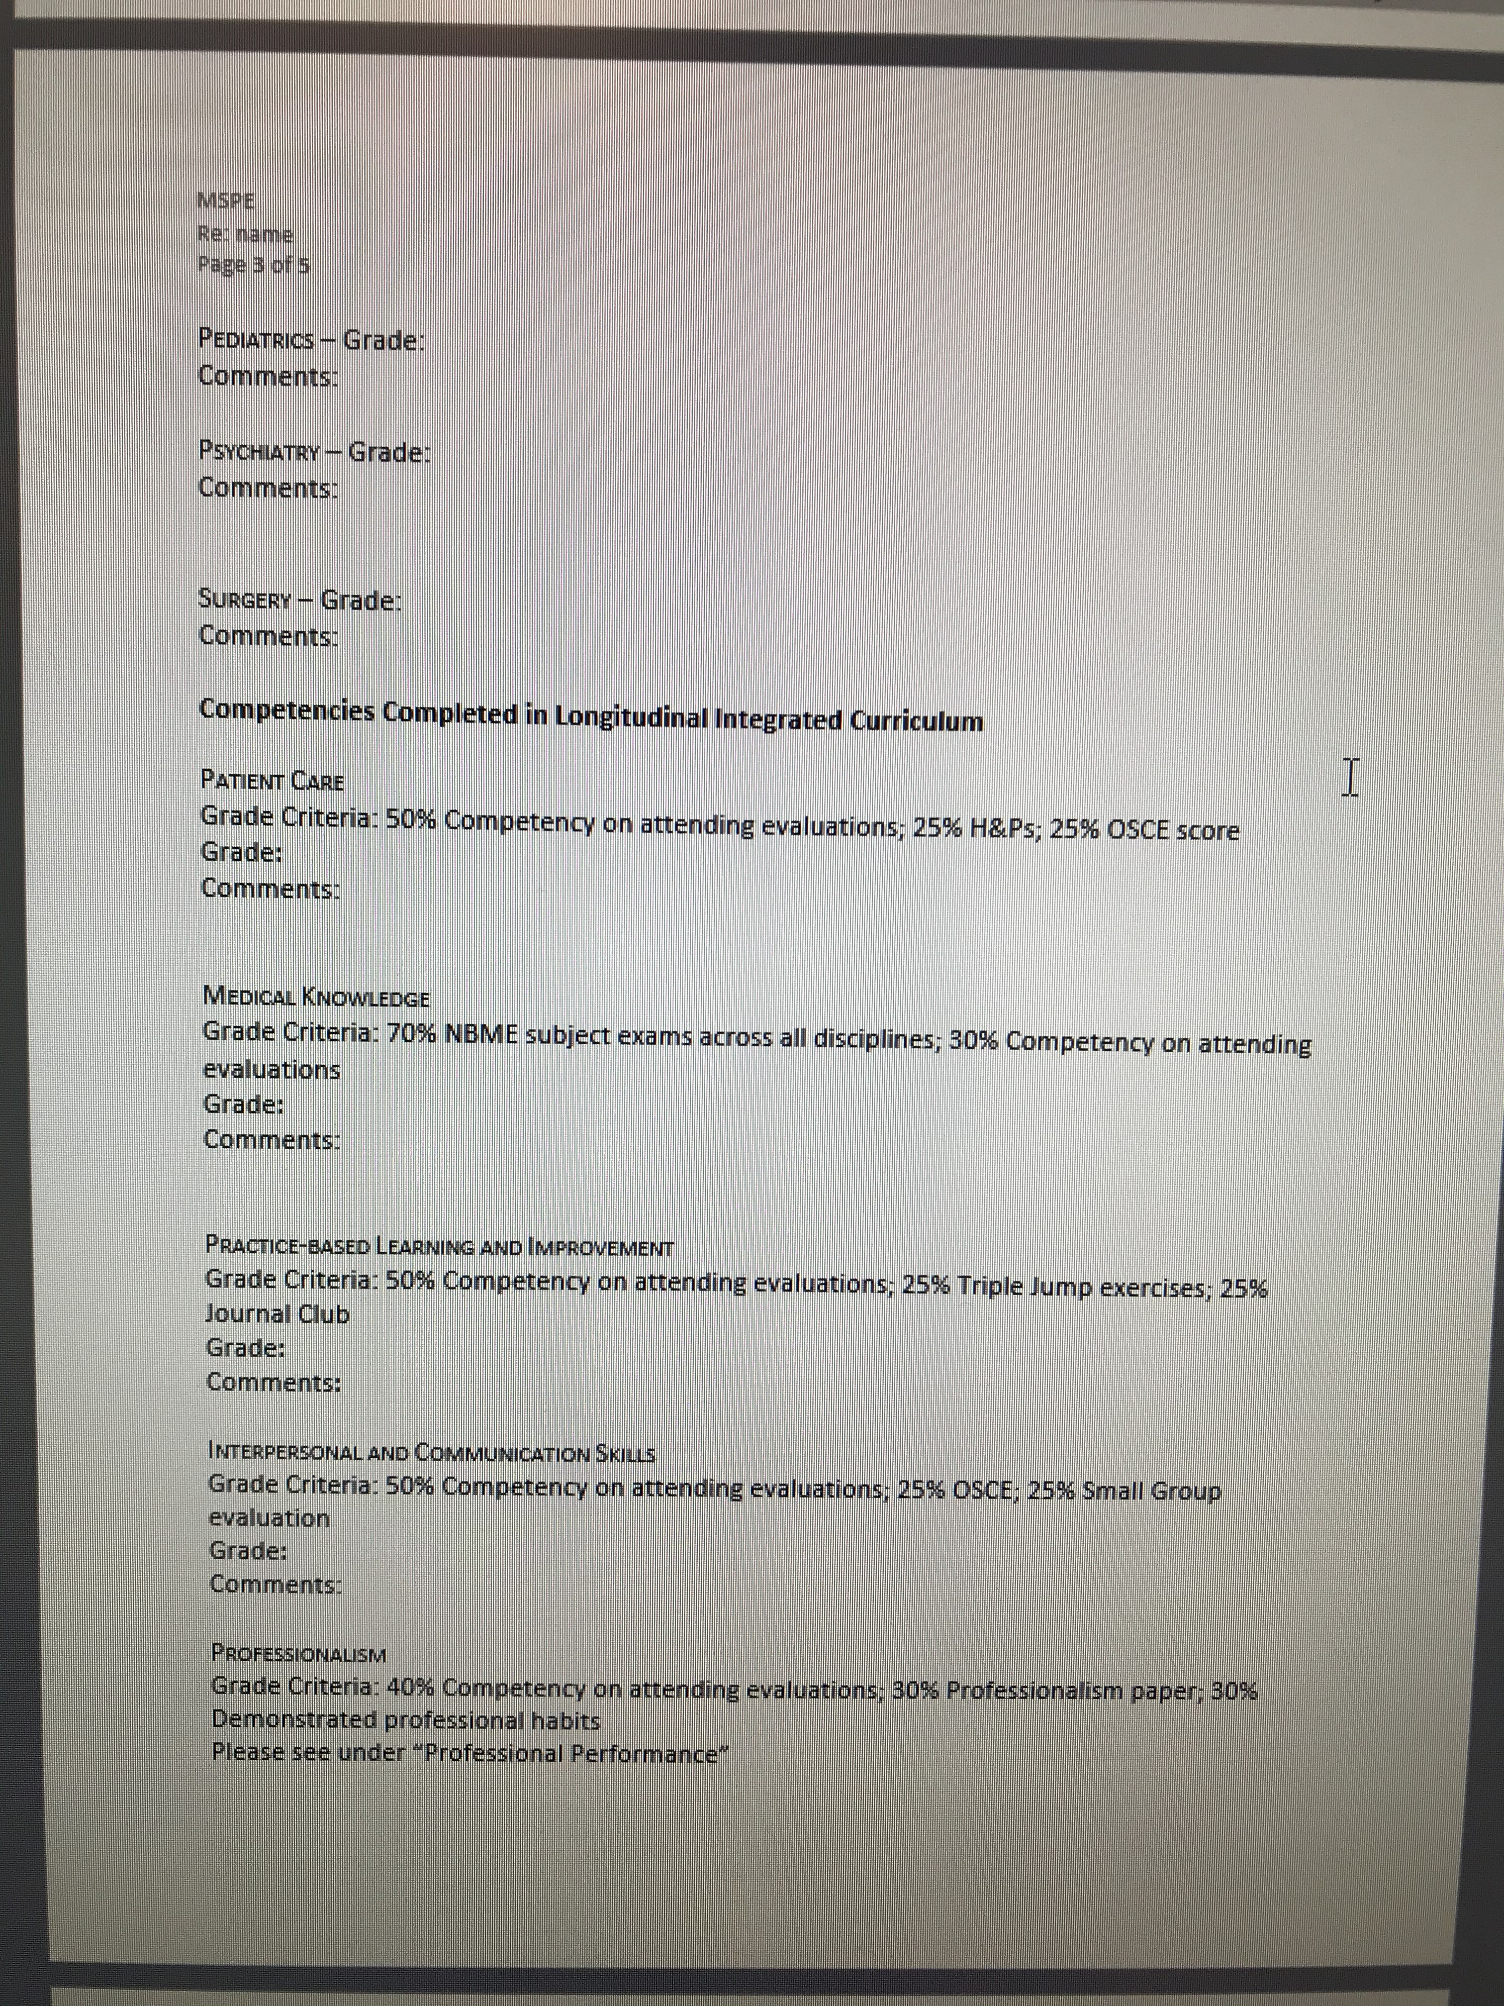
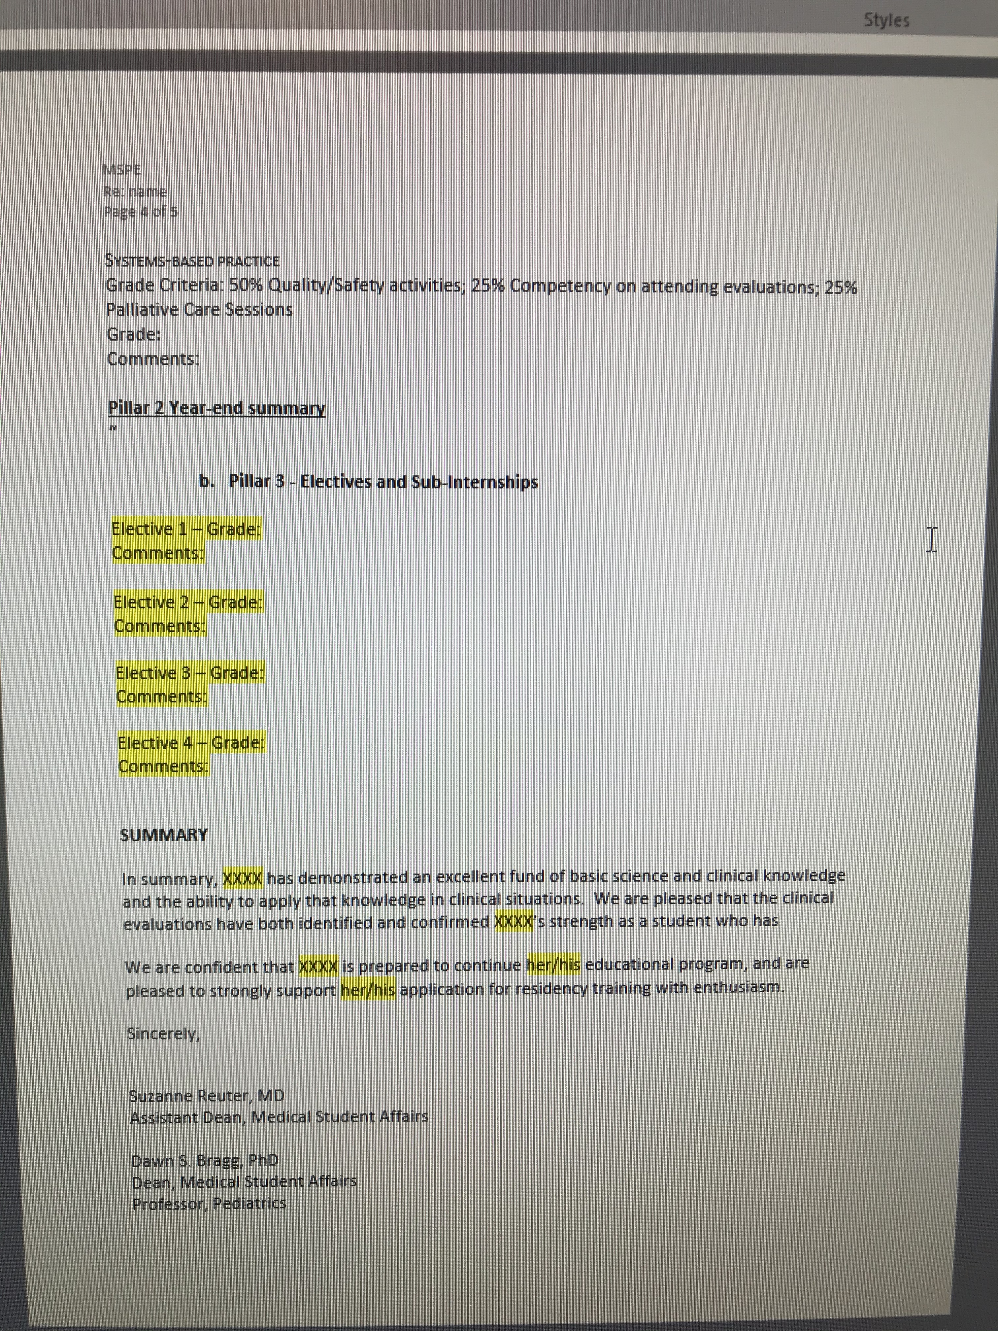

Slide 37

CURRICULUM VITAES and personal statements
Most create or update at the beginning of pillar 3
  Needed to apply for away rotations
Will discuss in-depth in career planning session #3
  Samples
  Career advising microsite
  Careers in Medicine samples

Slide 38
Faculty Mentors (advisors)
Some students are requesting a faculty mentor earlier in Pillar 2
Each of you will have the opportunity to choose an advisor/mentor
  2nd half of Pillar 2
  Varies by campus
  Usually done in coordination with the education coordinators by campus
Typically in the specialty you are interested in – but don’t have to be!

Slide 39

QUESTIONS

Slide 40

Usmle Step 2 CK
May register for CK up to 6-months prior to taking exam
  exam can be taken at Prometric Center

