Slide 1
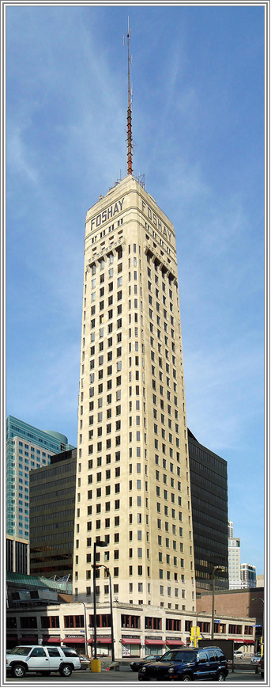
Pinnacle Neurology
Dr. Jerome Freeman

Slide 2
Neurology
Why is neurology so much fun?
If one has an interest in neurology, what should be done in Pillar 1?
Residency options
Fellowship options
Lifestyle (how much on-call time)
Small town options…can a small community support a neurologist?

Slide 3
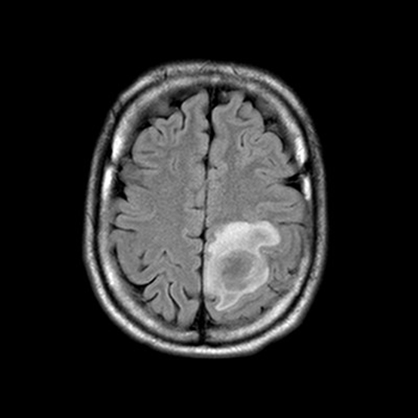
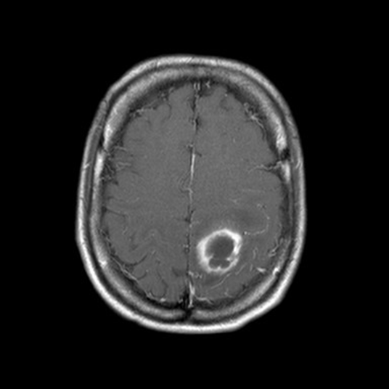
Infectious
Case #1 - - This 25 year old male developed right foot weakness and then focal right body seizure activity. Neurosurgery drained this abscess which proved to be Strep anginosus. Post operatively he continued to have right body focal seizures for a time.

Slide 4
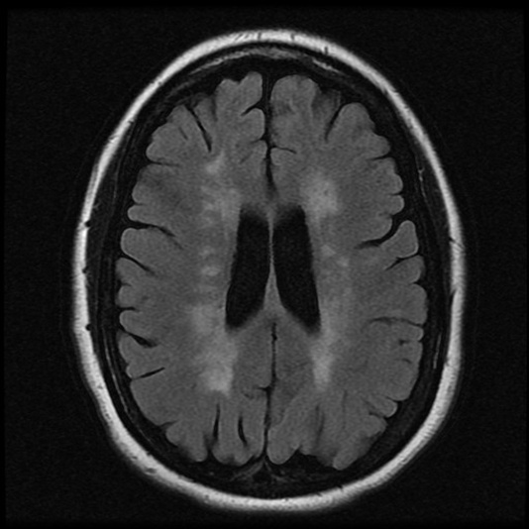
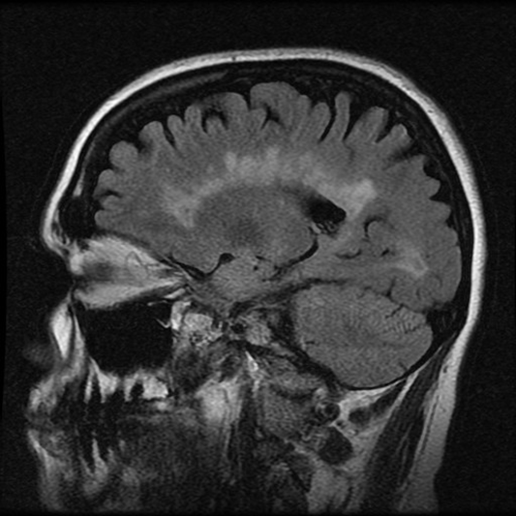
MS
Case #2 - - A 49 year old woman was diagnosed to have MS at age 32 after falling down some stairs and developing numbness in her feet and weakness in her legs. Her initial MRI of the brain and cervical showed a significant burden of demyelinating change. At the time of this current MRI she had leg spasticity and weakness. She walked slowly and cautiously. She had bilateral Babinski. She reported some decrease in memory.

Slide 5
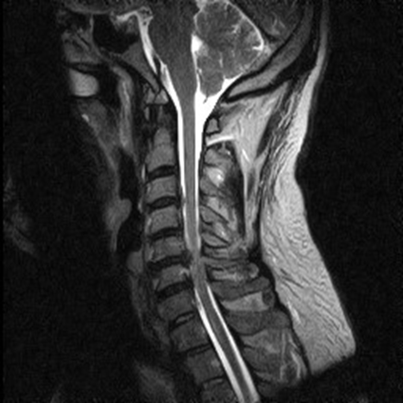
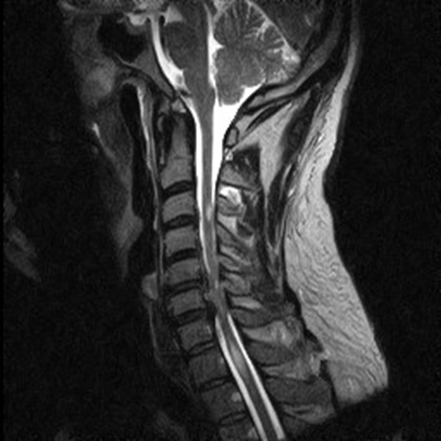
SPINE
Case #1- - A 41 year old male has a two month history of right leg weakness as well as numbness in the left leg and urinary urgency. He has decreased dexterity in the right hand and some mild, increased tone and weakness in the right leg. A right Babinski is present. There is a decrease in pin sensation in the left leg versus the right. His MRI was felt to show demyelinating change both above and below his area of canal stenosis. After a C5-6 and a C6-7 anterior cervical diskectomy infusion, his right leg weakness improved. An MRI of the brain was normal. Five months after surgery he developed new left leg weakness and a new lesion in the upper thoracic spine. His symptoms improved with high-dose steroids. He declined a spinal fluid evaluation, but a presumptive diagnosis of multiple sclerosis was made. Glatiramer was initiated.

Slide 6
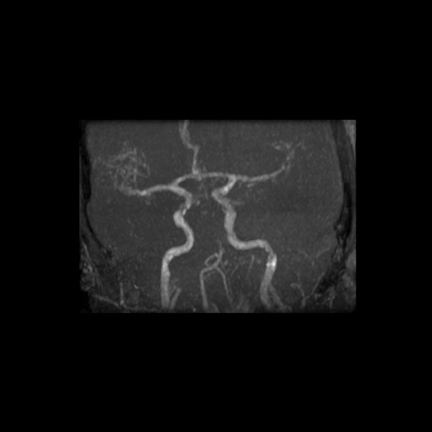
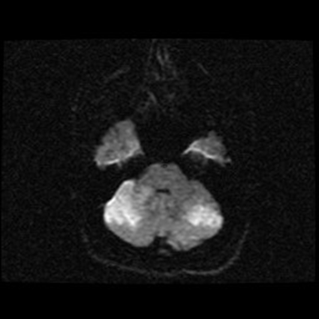
STROKE
Case #6 - - A 40 year old male suddenly collapsed with severe headache and left body weakness. On arrival in the ED he had developed severe dysarthria, trouble handling his secretions and opthalmoplegia. His MRI confirmed cerebellar ischemia (Flair image on the left) and a MRA demonstrated basilar artery occlusion. He was taken emergently to the angiography suite and was treated with intra-arterial TPA. The basilar artery recanalized and his symptoms significantly improved.

Slide 7
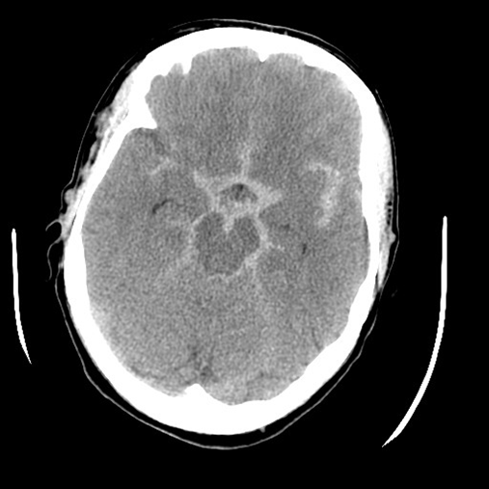
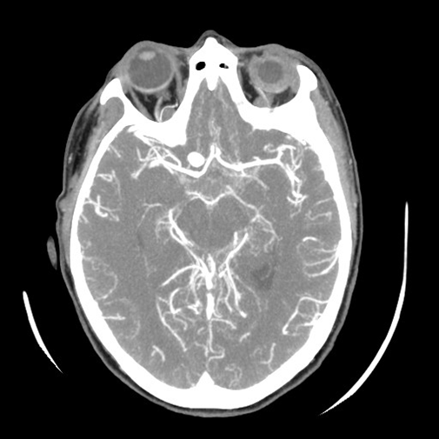
VASULAR
Case #3 - - This 49 year old woman developed a severe headache followed by collapse and obtundation. Eventually she had clipping of her aneurysm and recovered.

Slide 8
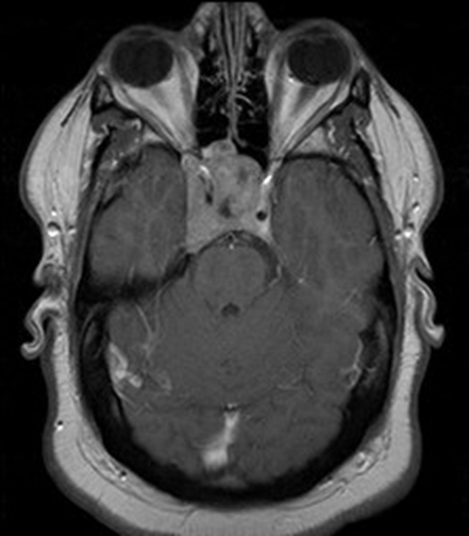
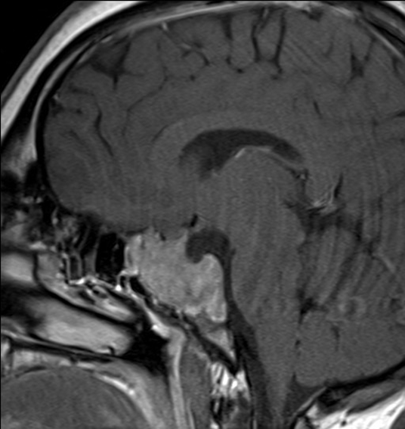
TUMORS
Case #1- - A 23 year old male complained of blurred vision for a year. His optometrist found a bitemporal visual field loss that was also confirmed on his subsquent neurologic exam.

Slide 9
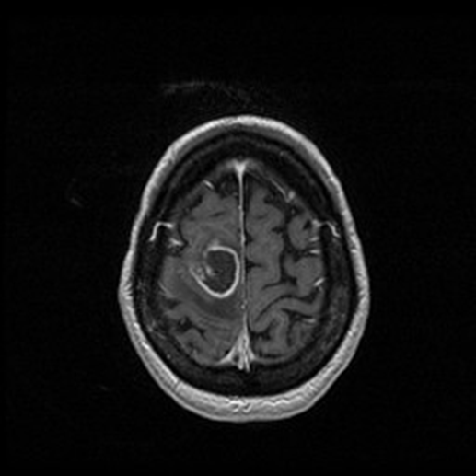
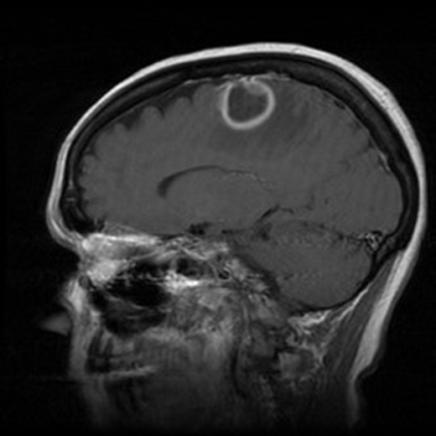
TUMORS
Case #4 - - A 66 year old woman experienced the gradual onset of left leg weakness over four weeks. While sitting in the waiting room for her first neurologic visit she developed focal left body seizures. A biopsy at craniotomy confirmed a glioblastoma.

Slide 10
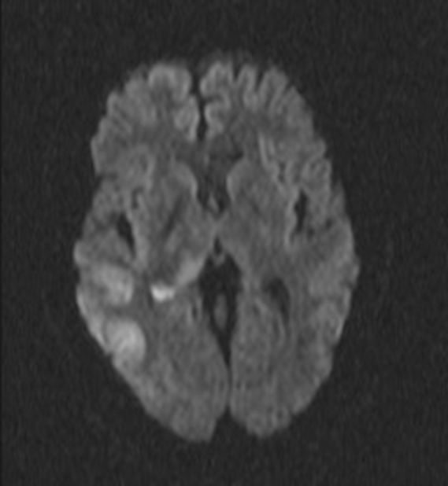
MISC
Case #5 - - A 38 year old man had experienced West Nile Encephalitis six year earlier. He had refractory seizures. Some of them were partial complex and he did have some rhythmic jerking of the left body. After a bout of seizures abnormalities were seen in the right temporal and parietal lobes on DWI.

